Slide 1
David K. Johnson, PhD. Alzheimer’s Disease Research Center a NIH center of excellence at the University of California - Davis
Who Takes Care of
the Caregivers?
Caregiver Bootcamp – Nov 9th 2022

Slide 2
Notes:
Individuals who care for people with Alzheimer’s disease are often told to ‘take care of yourself’ yet receive little direction regarding how to do this.
Spouses of people with Alzheimer’s disease are especially at risk because chronic health conditions like heart disease, depression, smoking, and physical disabilities are made worse by the caregiving burden.
How do we gives caregiver tools to take care of themselves?
1) We know that understanding dementia behavior ➔ Un-Complicates grief process that goes along with caregiver burden
2) BUT What are other self-care tools needed for the AD caregiver?

Slide 4
Caregiving as a Risk Factor for Mortality The Caregiver Health Effects Study
Mortality risk = 63% higher than non-caregiving controls
BUT…
NO risk increase for those caregivers who were:
providing care but not report emotional strain
disabled spouse who were not providing care
Schulz and Beach. JAMA, December 15, 1999—Vol 282, No. 23
Notes:
Context There is strong consensus that caring for an elderly individual with disability is burdensome and stressful to many family members and contributes to psychiatric morbidity. Researchers have also suggested that the combination of loss, prolonged distress, the physical demands of caregiving, and biological vulnerabilities of older caregivers may compromise their physiological functioning and increase their risk for physical health problems, leading to increased mortality.
Objective To examine the relationship between caregiving demands among older spousal caregivers and 4-year all-cause mortality, controlling for sociodemographic factors, prevalent clinical disease, and subclinical disease at baseline.
Design Prospective population-based cohort study, from 1993 through 1998 with an average of 4.5 years of follow-up.
Setting Four US communities. Participants A total of 392 caregivers and 427 noncaregivers aged 66 to 96 years who were living with their spouses.
MainOutcomeMeasure Four-year mortality, based on level of caregiving: (1) spouse not disabled; (2) spouse disabled and not helping; (3) spouse disabled and helping with no strainreported; or(4)spouse disabled and helping with mental or emotional strain reported.
Results After 4 years of follow-up, 103 participants (12.6%) died. After adjusting for sociodemographic factors, prevalent disease, and subclinical cardiovascular disease, participants who were providing care and experiencing caregiver strain had mortality risks that were 63% higher than noncaregiving controls (relative risk [RR], 1.63; 95% confidence interval [CI], 1.00-2.65). Participants who were providing care but not experiencing strain (RR, 1.08; 95% CI, 0.61-1.90) and those with a disabled spouse who were not providing care (RR, 1.37; 95% CI, 0.73-2.58) did not have elevated adjusted mortality rates relative to the noncaregiving controls.
Conclusions Our study suggests that being a caregiver who is experiencing mental or emotional strain is an independent risk factor for mortality among elderly spousal caregivers. Caregivers who report strain associated with caregiving are more likely to die than noncaregiving controls.

Slide 5
International Journal of Epidemiology, 2015, 1959–1969 doi: 10.1093/ije/dyv172
Notes:
Background: Countries with advanced welfare systems are increasingly relying on the input of informal caregivers, and there are growing concerns for their mental and physical wellbeing. However, the evidence about the relationship between caregiving and mortality risk is less clear.
Methods: A census-based record linkage study with mortality follow-up of 33 months: participants totalled 1 122 779 individuals including 183 842 caregivers, of whom 28.2% (51 927) were providing 50 or more hours caregiving per week.
Results: Over 33 months of follow-up a total of 29 335 deaths occurred, 2443 of these among caregivers. Mortality risk for caregivers was lower than for non-caregivers [hazard ratio (HR) ¼ 0.72: 95% confidence interval (CI) ¼ 0.69, 0.75 in the fully adjusted model], and the lower risk was evident even for those providing 50 or more h of caregiving per week (adjusted HR ¼ 0.77: 95% CI ¼ 0.71, 0.83 and 0.76: 95% CI ¼ 0.69, 0.83 for men and women, respectively). There was no evidence that this relationship varied by either age or marital status. Even among people with chronic health problems such as poor mental health, caregivers had lower mortality risk than non-caregivers. Caregiving is associated with reduced mortality risk for most causes—for example, the risk of death from ischaemic heart disease for caregivers providing 50 or more h was 27% and 31% lower for men and for women, respectively, compared with non-caregivers (HR ¼ 0.73: 95% CI ¼ 0.60, 0.88 and HR ¼ 0.69: 95% CI ¼ 0.51, 0.92).
Conclusions: This large population-based study confirms that for the majority of caregivers the beneficial effects of caregiving in terms of short-term mortality risk appear to outweigh any negative effects, even among people with significant health problems. These results underscore the need for a reappraisal of how caregiving is perceived.

Slide 6
RESOURCES MAKE THE DIFFERENCE
International Journal of Epidemiology, 2015, 1959–1969 doi: 10.1093/ije/dyv172
Notes:
Background: Countries with advanced welfare systems are increasingly relying on the input of informal caregivers, and there are growing concerns for their mental and physical wellbeing. However, the evidence about the relationship between caregiving and mortality risk is less clear.
Methods: A census-based record linkage study with mortality follow-up of 33 months: participants totalled 1 122 779 individuals including 183 842 caregivers, of whom 28.2% (51 927) were providing 50 or more hours caregiving per week.
Results: Over 33 months of follow-up a total of 29 335 deaths occurred, 2443 of these among caregivers. Mortality risk for caregivers was lower than for non-caregivers [hazard ratio (HR) ¼ 0.72: 95% confidence interval (CI) ¼ 0.69, 0.75 in the fully adjusted model], and the lower risk was evident even for those providing 50 or more h of caregiving per week (adjusted HR ¼ 0.77: 95% CI ¼ 0.71, 0.83 and 0.76: 95% CI ¼ 0.69, 0.83 for men and women, respectively). There was no evidence that this relationship varied by either age or marital status. Even among people with chronic health problems such as poor mental health, caregivers had lower mortality risk than non-caregivers. Caregiving is associated with reduced mortality risk for most causes—for example, the risk of death from ischaemic heart disease for caregivers providing 50 or more h was 27% and 31% lower for men and for women, respectively, compared with non-caregivers (HR ¼ 0.73: 95% CI ¼ 0.60, 0.88 and HR ¼ 0.69: 95% CI ¼ 0.51, 0.92).
Conclusions: This large population-based study confirms that for the majority of caregivers the beneficial effects of caregiving in terms of short-term mortality risk appear to outweigh any negative effects, even among people with significant health problems. These results underscore the need for a reappraisal of how caregiving is perceived.

Slide 9
Stay Connected
We are social animals!
Helps with Emotional Distress
Social activity has the indirect benefit of lowering stress, which may help with feelings of isolation, anxiety and depression.
Notes:
Anneliese

Slide 10
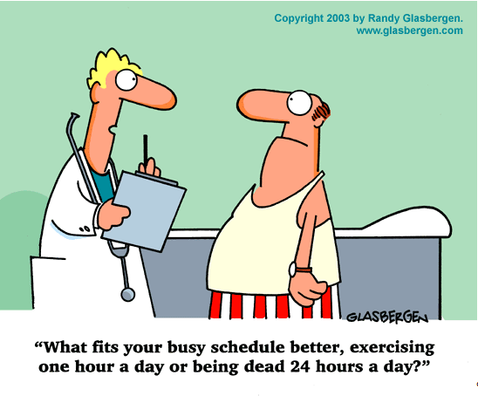
Hard to Do

Slide 11
THANK YOU!

