Slide 1
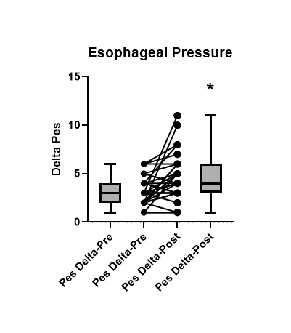
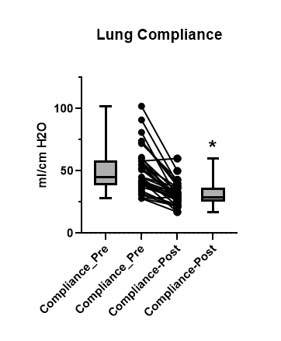
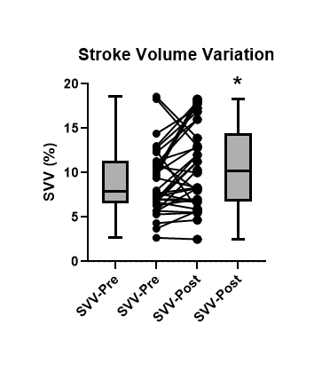
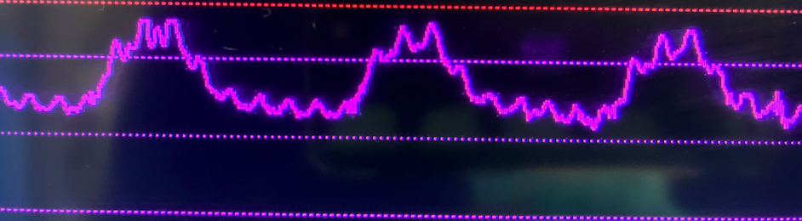


An Observational Study Comparing Intrathoracic Pressure Changes and Stroke Volume Variation with Abdominal Insufflation: SVV vs Pes
Sadaf Sadjadi, BA, Omar Alzayat, BA, Chaitra Subramanyam, MS, Neal Fleming, MD, PhD
BACKGROUND
Stroke volume variation (SVV) is a proxy for fluid responsiveness in mechanically ventilated patients ¹
Esophageal pressure (Pes) is an accepted method of determining transpulmonary pressure and estimation of intrathoracic pressure²
Current literature is sparse and conflicting regarding SVV or PPV changes with pneumoperitoneum
RESULTS
27 female and 7 male subjects undergoing general abdominal surgery
Average Age: 56 ± 18 yr, Height: 167 ± 9 cm, Weight: 83 ± 17 kg, Ideal Weight: 60 ± 10 kg
STUDY OBJECTIVE
Compare and correlate predictive agreement between Pes and Edwards ClearSite hemodynamic measurement changes following abdominal insufflation
METHODS
Approved by Human Subjects Research Committee . Written, informed consent
ASA I-III adult patients undergoing elective laparoscopic surgery with general anesthesia and abdominal insufflation
Standardized tidal volume (8ml/kg) and PEEP (5 cm H₂O)
Esophageal balloon catheter inserted after induction to measure Pes with optimized waveform
Measured pre- and post- insufflation min/max Pes, lung compliance and SVV
ClearSite cuff connected to Edwards HemoSphere advanced monitoring platform to measure SVV
Paired t-test to analyze Pes, lung compliance and SVV changes.
CONCLUSION
Abdominal insufflation to 15mmg Hg increases the esophageal pressure swing (Δ Pes) from 3 ± 1.4 cm H₂O to 4.4 ± 2.4 cm H₂O
Abdominal insufflation decreases lung compliance from 51 ± 18 L/cm H₂O to 31 ± 9.0 L/cm H₂O
There is a corresponding significant increase in SVV with abdominal insufflation from 9.0 ± 3.7 to 11 ± 4.6
Pneumoperitoneum increases Pes & decreases lung compliance.
There is a corresponding increase in SVV.
NEXT STEPS
• Extend study to confidently establish the relationship between abdominal insufflation, Pes, lung compliance and SVV
• Characterize the potential correlation between SVV and Pes
Download poster & Abstract:
Omar Alzayat BA, UC Davis School of Medicine, Sadaf Sadjadi, UC Davis School of Medicine, Chaitra Subramanyam MS, Western University of Health Sciences
Neal Fleming M.D., Ph.D., Department of Anesthesiology and Pain Medicine,
UC Davis School of Medicine
REFERENCES
Reuter, et al, Intensive Care Med; 2002; 28(4):392-8.
Grieco, et al., Annals of Translational Medicine; 2017; 5(14)a:285

