Slide 1

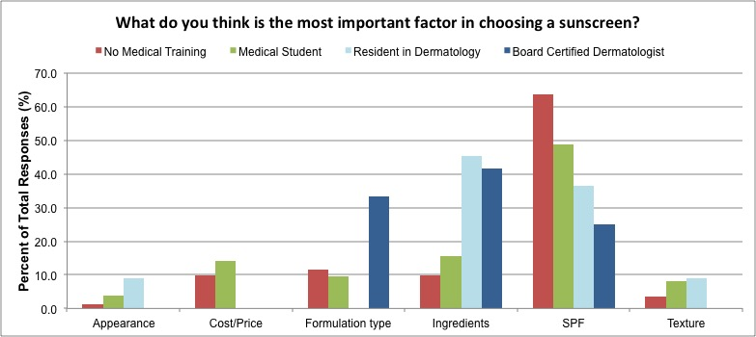
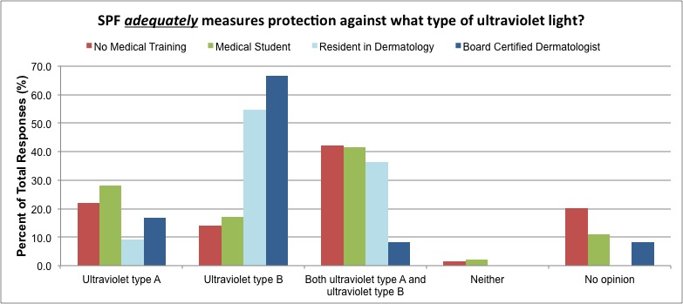
Assessment of how individuals choose their sunscreen based on medical education level
Gabriela Monico¹ MS2, Andrea Caldas Costa De Sa, Negar Foolad MAS², Ramses Delgadillo, Raja K. Sivamani² MD MS CAT
University of California Davis School of Medicine¹, Department of Dermatology², University of California, Davis, USA
BACKGROUND
RESULTS
CONCLUSION
In 2012, the U.S. Food and Drug Administration (FDA) introduced new regulations on sunscreen product labeling and testing to help consumers make educated purchases when choosing among multiple photoprotective factors. Through the revision of these guidelines, the FDA anticipated minimizing some of the claims that were potentially confusing for purchasers of sunscreen.
Individuals with higher levels of health care training, such as residents in dermatology and board-certified dermatologists, are more likely to correctly identify UVB radiation as the type of radiation most adequately protected against by SPF compared to non-medically trained individuals or medical students.
The majority of medical students and individuals with no medical training incorrectly identified SPF as measuring protection against both ultraviolet type A and ultraviolet type B radiation.
This finding demonstrates the confusion surrounding the term “Sun Protection Factor” (SPF) and its relationship to type of ultraviolet radiation it protects against. In practice, SPF is defined as a measure of “the level of protection against UVB and UVA2 (320-340nm), and is based on the ratio of MED (minimal erythema dose) on sunscreen-protected skin compared to unprotected skin” [1].
Despite the mandated FDA regulations requiring sunscreens to be labeled as both "Broad Spectrum" and “SPF 15” (or higher) on the front [2], the misconception that SPF measures protection against both UVA and UVB is pervasive among our sample population. Moreover, it is evident that individuals without medical training as well as medical students would benefit from training on how to effectively choose a sunscreen with broad-spectrum protection. Medical students and residents would benefit from enhanced education on interpreting sunscreen labels.
INTRODUCTION
As sunscreens continue to evolve with the addition of organic ingredients and broad spectrum protection, it is becoming increasingly difficult for individuals to determine the components of an effective sunscreen. The goal of this cross-sectional study is to assess the approach that subjects take in choosing their sunscreen. In addition, we are evaluating whether levels of health care training affects understanding of sunscreen labeling.
METHODS
Between July 2014 and August 2015, participants were randomly recruited from the University of California Davis main campus (Davis, CA) and the UC Davis Dermatology Clinic in Sacramento, California (n=539). All participants were over the age of 18 years and were asked to complete a nine-question survey assessing their knowledge about sunscreen. Following completion of the survey they were asked to self-identify as belonging to one of the following four categories: no medical training (n=381), medical student (n=135), dermatology resident (n=11), or board certified dermatologist (n=12). The study was approved by the UC Davis Institutional Review Board. Participation was voluntary and results were recorded anonymously.
Among the respondents, 63.8% with no medical training and 48.9% of medical students chose SPF as the single most important factor in choosing sunscreen whereas only 36.4% of residents in dermatology and 25% of board-certified dermatologists chose SPF as the most important factor. Additionally, residents in dermatology and board-certified dermatologists chose UVB as the type of radiation that is most adequately protected against by SPF (54.5% and 66.7%, respectively) compared to medical students and “no medical training” individuals who chose both UVA and UVB (41.5% and 42.3%) as the most adequately protected types of radiation. Among the residents in dermatology, 36.4% also identified UVA and UVB as the most adequately protected types of radiation protected by SPF.
REFERENCES
1. Jansen, R., U. Osterwalder, S.Q. Wang, M. Burnett, and H.W. Lim, Photoprotection: part II. Sunscreen: development, efficacy, and controversies. J Am Acad Dermatol, 2013. 69(6): p. 867 e1-14; quiz 881-2. PMID: 24238180
2. Administration, U.S.F.a.D. FDA Sheds Light on Sunscreens. 2012 [cited 2015 September 17]; Available from: http://www.fda.gov/ForConsumers/ConsumerUpdates/ucm258416.htm.
3. Schalka, S. and V.M. Reis, Sun protection factor: meaning and controversies. An Bras Dermatol, 2011. 86(3): p. 507-15. PMID: 21738968
ACKNOWLEDGMENTS
Thank you Dr. Raja Sivamani for your mentorship and support of my endeavors.

