Slide 1


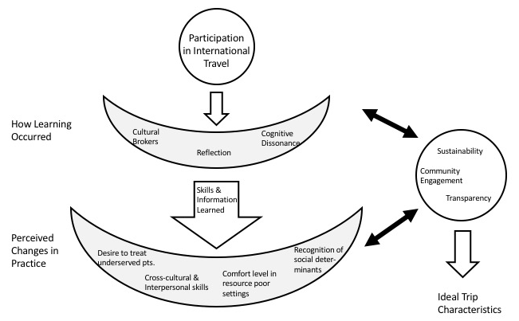
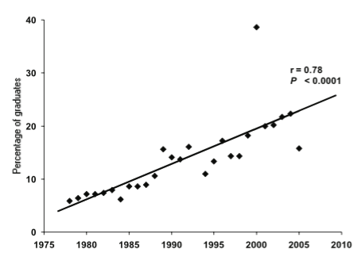
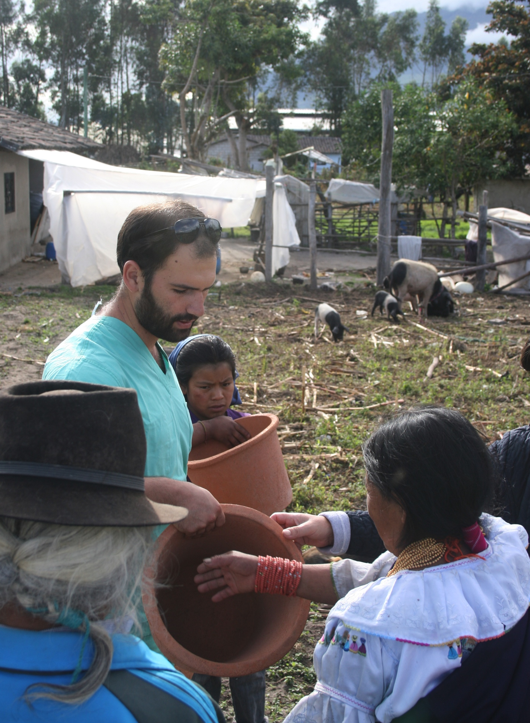
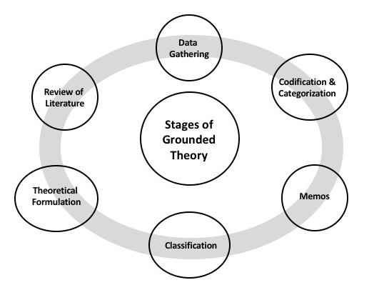

Medical Students’ Insights on International Experiences and their Role in Medical Education
Charlotte Pickett, Hayley Rousek, W. Suzanne Eidson-Ton, MD
UC Davis School of Medicine and the Rural Program in Medical Education
INTRODUCTION
RESULTS
DISCUSSION
LIMITATIONS/FURTHER STUDY
International health experiences are growing in popularity among US medical students [1], with an average of 23.1% of graduating seniors having participated in international electives [2]. These experiences have been associated with many positive effects. In their literature review of nine articles that evaluated international medical educational opportunities during medical school, Jeffrey et al. [3] found that these opportunities were positively associated with skills acquisition and attitudinal changes. Several studies included in the review showed that participants of international health experiences were more likely than non-participants to choose primary care specialties (e.g., family medicine, internal medicine, pediatrics), seek employment in low-income clinics, and pursue graduate education in public health. The association with choosing a primary care specialty is of particular interest at a time of physician shortage in these areas [4]. Further, increased confidence practicing in low-resource settings could foster student interest in working in rural and remote areas within the US.
However, existing studies are mostly observational, based on self-administered questionnaires and encompassing diverse international health experiences differing in preparation, layout, and duration [3][5].
Three key models emerged from the data. The first relates to how medical students learned through international travel. Various factors contributed to their learning, from cultural brokers to the types of activities they engaged in, the emotions those experiences elicited, and their reflections on how the experience compared to their expectations. Much of the learning came from informal situations outside the clinical setting. It’s plausible the clinical setting, with a white coat, changes the power dynamic. Despite still being cultural experts, locals in this situation are less likely to directly teach or correct the student. Importantly, misguided cultural brokers run the risk of reinforcing or teaching generalizations and stereotypes. Stark contrasts to the home environment and group discussions fostered student reflection and facilitated learning. Often, reflection and learning arose out of difficult or uncomfortable situations, that forced students to grapple with their previously held attitudes and beliefs.
The second model explains how international travel changed the way medical students see themselves practicing in the future. Supporting findings of Godkin et al. [9], participants expressed a strengthened desire to work with the underserved and in primary care, as well as greater comfort level working in resource poor settings. They also reported improved cross-cultural and interpersonal skills, and a greater recognition and appreciation for social determinants of health. Findings are consistent with research by Ramsey et al. who found that 74% of students who participated in an international health elective entered primary care versus 43% of their comparison group [10]. The third model addresses the very nature of medical student international travel, using student experience to formulate a theory of what ideal medical student global engagement would entail. Participants expressed a resounding need for international medical student trips to involve local community partnership. This was felt to promote sustainability, another key aspect to trip success. Students envisioned various methods of achieving sustainability, from teaching and empowering community members, to providing continuity, to a more interdisciplinary approach to health care. Consistent with opinions expressed by global health experts [11], the majority of students felt the need for greater transparency, stressing the importance of openly discussing the extractive nature of medical student travel in order to move closer to mitigating the unequal exchange.
One limitation of the study was that the data collection and analysis process occurred only semi-iteratively rather than entirely iteratively, as grounded theory dictates. In addition, saturation of ideas may not have been reached in all themes, in particular the “How Learning Occurred” theme which arose later in the data collection and analysis process.
Additionally, this study was limited by selection bias; students self-select to go on international trips and may already be more interested in working with the underserved for example. Thus, while the study suggests international travel is associated with positive outcomes, a causal relationship cannot be identified.
Data collection from participants who are further along in their careers would be helpful in clarifying long-term outcomes.
Finally, research assessing short and long-term impacts of medical student travel on the international communities visited would greatly aid in guiding sustainable and ethical travel.
REFERENCES
Given one of the biggest obstacles to international health electives is funding [6], and institutions seek justification to continually invest in and sustain an international health program, the present study seeks to further understand the type of experience best suited to medical student education by exploring how learning occurs during international experiences and corresponding effects on career interests.
Figure 3. A conceptual diagram representing three models that emerged from medical students’ insights from international travel and how those three models relate and inform each other.
1. Margolis CZ, Deckelbaum RJ, Henkin Y, Alkan M. Bringing global issues to medical teaching. Lancet. 2002;359(9313),1253–1254.
2. Association of American Medical Colleges. Medical School Graduation Questionnaire All Schools Reports. Washington, DC: Association of American Medical Colleges; 1979–2005.
3. Jeffrey J, Dumont RA, Kim GY, Kuo T. Effects of international health electives on medical student learning and career choice: results of a systemic literature review. Family Medicine. 2011;43(1):21-8.
4. Song Zd, Chopra V, McMahon LF. Addressing the primary care workforce crisis. American Journal of Managed Care. 2015;21(8):e452-4.
5. Thompson MJ, Huntington MK, Hunt DD, Pinsky LE, Brodie JJ. Educational effects of international health electives on U.S. and Canadian medical students and residents: a literature review. Academic Medicine. 2003;78:342–347
6. McKinley DW, Williams SR, Norcini JJ, Anderson MB. International exchange programs and U.S. Medical Schools. Academic Medicine. 2008;83:53-57.
7. Houpt ER, Pearson RD, Hall TL. Three domains of competency in global health education: recommendations for all medical students. Academic Medicine. 2007;82(3):222.
8. Watling CJ, Lingard L. Grounded theory in medical education research: AMEE Guide No. 70. Medical Teacher. 2012; 34:10, 850-861.
9. Godkin M, Savageau J. The effect of medical students’ international experience on attitudes toward serving underserved multicultural populations. Family Medicine. 2003;35:273–278.
10. Ramsey AH, Haq C, Gjerde CL, Rothenberg D. Career influence of an international health experience during medical school. Family Medicine. 2004;36(6), 412–416.
11. Gupta R, Farmer PE. International electives: maximizing the opportunity to learn and contribute. Medscape General Medicine. 2005;7(2):78.
“A lot [of the learning] is how much reflection the program instills in the participants.”[P3]
Fig 1. Percentages of US medical graduates having participated in international rotations as reported to the Association of American Medical Colleges in their Annual Medical Student Questionnaire [7].
METHODS
In order to create an explanatory theory of how international experiences contribute to medical students learning and influence career interests, a constructivist grounded theory approach was used.
A purposive sample of medical students were recruited from a single US medical school. All medical students from years one through four were sent a recruitment email. Interested medical students were interviewed. The study was approved by the University's Institutional Review Board.
Nineteen (8 male, 11 female) medical students, representing all four years and a range of medical and surgical specialty interests, participated in individual, semi-structured interviews lasting up to one hour. Interviews were recorded and transcribed verbatim without personal identification. Interview data were analyzed using the comparative method standard to grounded theory [8]. Analysis began after one half of interviews had been transcribed and thus informed further data collection; initial transcripts were read and emerging themes identified, with some themes intentionally explored in greater detail in subsequent interviews.
CONCLUSIONS
Students make complex judgments regarding the adequacy of healthcare provided in international settings and the factors influencing health outcomes. Their experiences reinforce their humanistic values and change the way they see themselves practicing in the future. Community engagement, sustainability, and transparency are key aspects of international trips considered essential by most participants.
Further characterization of the specific aspects of international medical trips that foster student growth and contribute positively to international communities is still needed.
“It taught me a lot about how much you can do with very little.”[P2]
ACKNOWLEDGMENTS
I would like to thank my advisor, Dr. Eidson-Ton, for her ongoing support and guidance. I would also like to acknowledge the generosity of my fellow classmates who took time out of their busy schedules to participate in this study. Finally, thank you to the UC Davis School of Medicine’s Scholarly Project Option, which provided the structure and motivation for this research.
Once coding was complete, re-analysis occurred in order to elicit the relationships between concepts and move from the categorical to the conceptual, thus identifying an interpretive model that would not only account for these data but render them meaningful [8]. The theory was then re-examined in the context of relevant published literature, with an emphasis on how it furthered or challenged existing theoretical constructs.
“Just recognizing we’re going there to learn, rather than fix the world.”[P5]
Fig 2. A conceptual diagram of grounded theory.
Fig 4. UC Davis medical student, David Roldan, teaches the use of clay water filters, Azama, Eduador.

