Slide 1
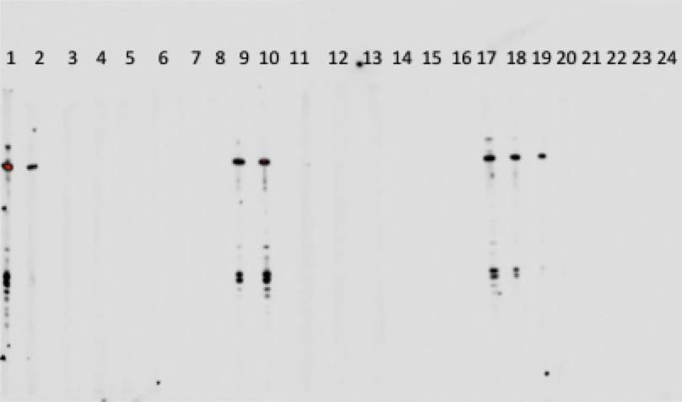
Preliminary investigation of high molecular weight allergens in shrimp
Jacqueline Hsieh, Benjamin Lam, Iris Nkamba, Shang An Shu, David Yang and Patrick S.C. Leung
School of Medicine, University of California, Davis, CA 95616
ABSTRACT
RESULTS
CONCLUSIONS AND FUTURE RESEARCH
Shellfish allergies are among the most prevalent types of food allergies, in both adults and children. The most commonly studied and understood shellfish allergen is tropmoyosin, of around 34-40 kDa. However, recent reports have suggested that shellfish allergy patients may also be allergic to other larger shellfish allergens. In this preliminary study, we investigated the possibility of high molecular weight allergens in shrimp. Using sera of patients with known shellfish allergies and healthy volunteers without seafood allergies, Western blots were used to analyze for IgE antibodies against shrimp extracts. Our data clearly demonstrated that IgE from shellfish allergic subjects recognize a number of high molecular weight shrimp proteins. Future work is directed to identify these high molecular weight IgE reactive shellfish proteins at the molecular level and lay the groundwork for a more comprehensive panel of shellfish allergens for immunodiagnosis of shellfish allergy.
A: Western blot showing the presence of high molecular weight IgE reactive shrimp proteins recognized by sera of patients with known shellfish allergies. Lanes 1-12: IgE reactivity in sera from patients with known shrimp allergies. Lane 13: Positive control. Lane 14: Negative control. Lane 15: Blank. Green arrow: Approximately 38 kDa. Yellow arrow: Approximately 98 kDa.
B: Western blot showing the presence of high molecular weight IgE reactive shrimp protein recognized by sera of patients with known shellfish allergies. Lanes 1-21: IgE reactivity in sera from patients with known shrimp allergies. Lanes 22-24: Blanks. Blue arrow: Approxi-
As evidenced by the Western blots, there are multiple high molecular weight proteins that react with IgE antibodies in the sera of patients with shellfish allergies. This further validates the findings of previous studies that there are high molecular weight allergens capable of potentially inducing a Type I hypersensitivity reaction other than tropomyosin. Of particular interest, this study identified previously unreported high molecular weight IgE reactive proteins at approximately 98 KDa.
Future work will be focused on confirming these observations with a larger cohort of subjects and identifying these high molecular weight allergens at the molecular level by a combination of 2D gel electrophoresis, MALDI-TOF mass spectrometry and protein databases mining. Identification of novel allergens can lead to improvement in the clinical diagnosis with component resolved diagnosis and individualized immunotherapy for shrimp allergies.
1 2 3 4 5 6 7 8 9 10 11 12 13 14 15
BACKGROUND AND OBJECTIVE
The National Institute of Allergy and Infectious Diseases (NIAID) defines food allergies as “abnormal response[s] to food, triggered by the body’s immune system” [1]. In allergic individuals, the immune system perceives certain foods as allergens, stimulating the production and release of IgE [2].The circulating IgE binds to and activates mast cells in the tissues and basophils in the blood [2]. Subsequent exposure and binding of the food allergen to these sensitized basophils and mast cells triggers the release of compounds such as histamine, leukotrienes, and cytokines [2]. Clinically, this immune response can manifest as anything from mild pruritus to a severe, life-threatening event such as anaphylaxis [1, 2].
Rather than being an isolated condition, food allergies are quite common. They are estimated to affect 6-10% of children and 1-2% of adults worldwide [3]. Around 90% of food allergies are attributed to only eight types of food: eggs, milk, peanuts, tree nuts, fish, shellfish, wheat, and soy [4]. Of these, the foods that most commonly induce an allergic response are peanuts and tree nuts in children – and shellfish in adults [5]. In fact, shellfish allergies represent one of the most common food allergies in the world. They affect up to 1.4% of the world’s population, and up to 2% of the US population [6, 7].
Advances in molecular biology, biochemistry, and bioinformatics have greatly facilitated identification of shellfish allergens at the molecular level. The most well known and characterized of these is tropomyosin. Tropomyosin is a low molecular weight, heat stable protein of 34-40 kDa found in the muscle of several varieties of shellfish, including crab, lobster, and shrimp [8-10]. It is composed of two α-helices in a coil-coil formation, with five major IgE binding regions [10].
Recent research has suggested that tropomyosin may not be the only allergenic protein in shellfish. There may be high molecular weight shellfish allergens. In a study performed by Sahabudin et. al, a novel 75 kDa protein was identified as a major allergen in black tiger prawns [11]. Another study by Lee et. al. has revealed possible allergens of 71 and 82 kDa in common whelk [12].
The objective of this study was to investigate the possibility of high molecular weight allergens in shrimp.
A
REFERENCES
1. National Institute of Allergy and Infectious Diseases. What Is Food Allergy? [Website] 2010 [cited 2016 2 Feb]; Available from: http://www.niaid.nih.gov/topics/foodAllergy/understanding/Pages/whatIsIt.aspx.
2. National Institute of Allergy and Infectious Diseases. Report of the NIH Expert Panel on Food Allergy Research. [Website] 2006 [cited 2016 2 Feb]; Available from: http://www.niaid.nih.gov/topics/foodallergy/research/pages/reportfoodallergy.aspx.
3. Sicherer, S.H., Epidemiology of food allergy. J Allergy Clin Immunol, 2011. 127(3): p. 594-602.
4. American College of Allergy, A.I. Food Allergies | Causes, Symptoms, & Treatment | ACAAI. 2014 [cited 2016 2 Feb]; Available from: http://acaai.org/allergies/types/food-allergies.
5. Sicherer, S.H. and H.A. Sampson, 9. Food allergy. J Allergy Clin Immunol, 2006. 117(2 Suppl Mini-Primer): p. S470-5.
6. Sicherer, S.H., A. Munoz-Furlong, and H.A. Sampson, Prevalence of seafood allergy in the United States determined by a random telephone survey. J Allergy Clin Immunol, 2004. 114(1): p. 159-65.
7. Rona, R.J., et al., The prevalence of food allergy: a meta-analysis. J Allergy Clin Immunol, 2007. 120(3): p. 638-46.
8. Leung, N.Y., et al., Current immunological and molecular biological perspectives on seafood allergy: a comprehensive review. Clin Rev Allergy Immunol, 2014. 46(3): p. 180-97.
9. Shanti, K.N., et al., Identification of tropomyosin as the major shrimp allergen and characterization of its IgE-binding epitopes. J Immunol, 1993. 151(10): p. 5354-63.
10.Lehrer, S.B., R. Ayuso, and G. Reese, Seafood allergy and allergens: a review. Mar Biotechnol (NY), 2003. 5(4): p. 339-48.
11.Sahabudin, S., et al., Identification of Major and Minor Allergens of Black Tiger Prawn (Penaeus monodon) and King Prawn (Penaeus latisulcatus). Malays J Med Sci, 2011. 18(3): p. 27-32.
12.Lee, B.J. and H.S. Park, Common whelk (Buccinum undatum) allergy: identification of IgE-binding components and effects of heating and digestive enzymes. J Korean Med Sci, 2004. 19(6): p. 793-9.
mately 39 kDa. Pink arrow: Approximately 97 kDa.
B
MATERIALS AND METHODS (CONTINUED)
WESTERN BLOT
200 micrograms of shrimp extract were resolved by gel electrophoresis using NuPage 4-12% Bis-Tris gel. The gel was then transferred onto a nitrocellulose membrane overnight. Multiple 3-4mm strips were cut from the membrane. The strips were then blocked with 3% BSA for 1 hour.
The sera of patients with shellfish allergies served as the primary antibody. The sera was diluted to 1:10 with 3% BSA in PBS. The diluted sera were incubated at 4ºC overnight with the BSA-blocked strips.
Following overnight incubation, the strips were washed three times with 0.1% PBS-Tween. Antihuman IgE diluted to 1:10000 with 3% BSA served as the secondary antibody. The strips and the secondary antibody were incubated for 1 hour at room temperature, before being washed three times with 0.1% PBS-Tween.
The strips were then treated with SuperSignal West Pico Substrate according to manufacturer directions and visualized with FujiFilm LAS-4000 Imager under the chemiluminescence setting.
A total of 88 unique sera samples were examined and imaged.
ACKNOWLEDGEMENTS
This project was generously funded by the Medical Student Research Fellowship at the University of California, Davis School of Medicine and the Division of Rheumatology, Allergy, and Clinical Immunology at the University of California, Davis.
MATERIALS AND METHODS
PREPARATION OF SHRIMP EXTRACT
Fresh shrimp was purchased from local supermarkets. 20 gram of peeled raw shrimp were diced into small pieces, homogenized in phosphate buffered saline (PBS), rocked overnight at 4ºC and thereafter centrifuged at 6000xg for 20 minutes at 4ºC. The protein concentration of the supernatant was determined by BCA assay and stored afterwards at -20ºC.

