Slide 1

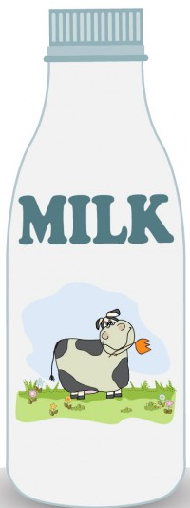
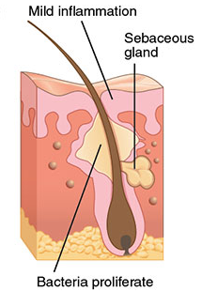
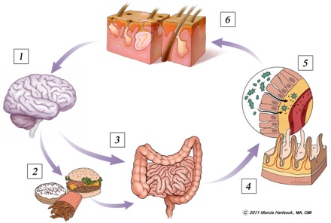
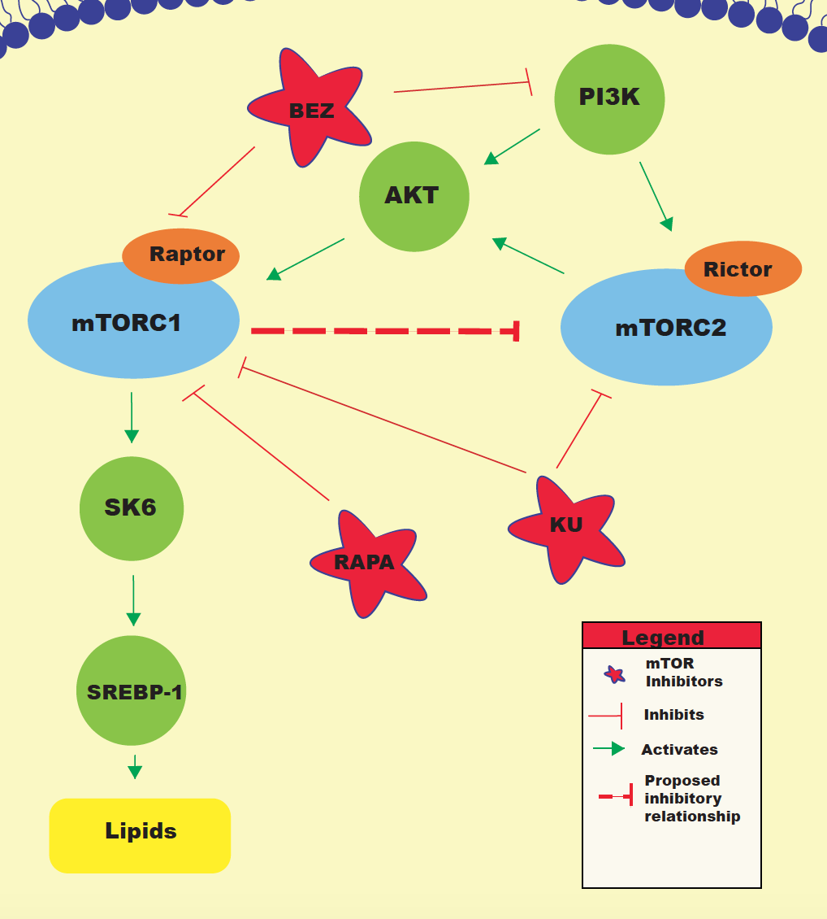
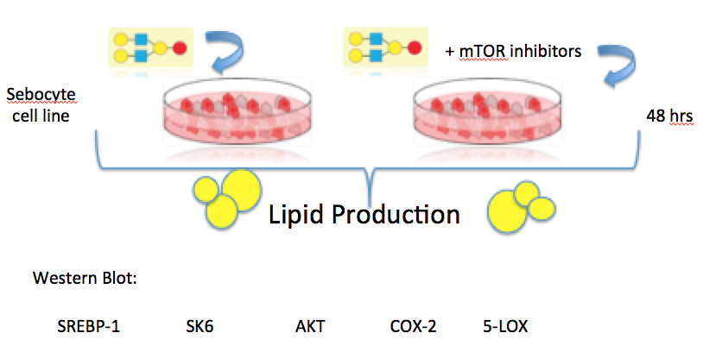
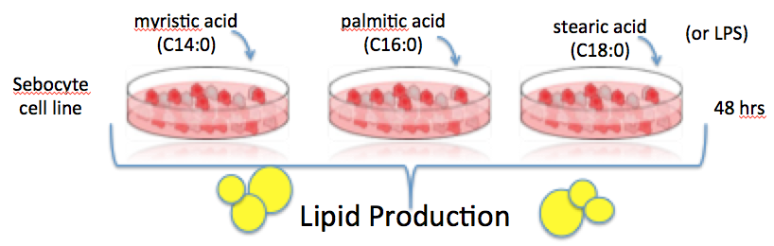
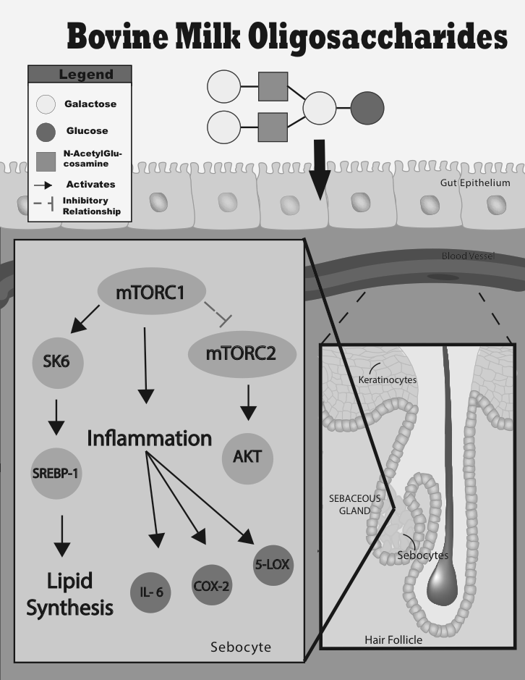
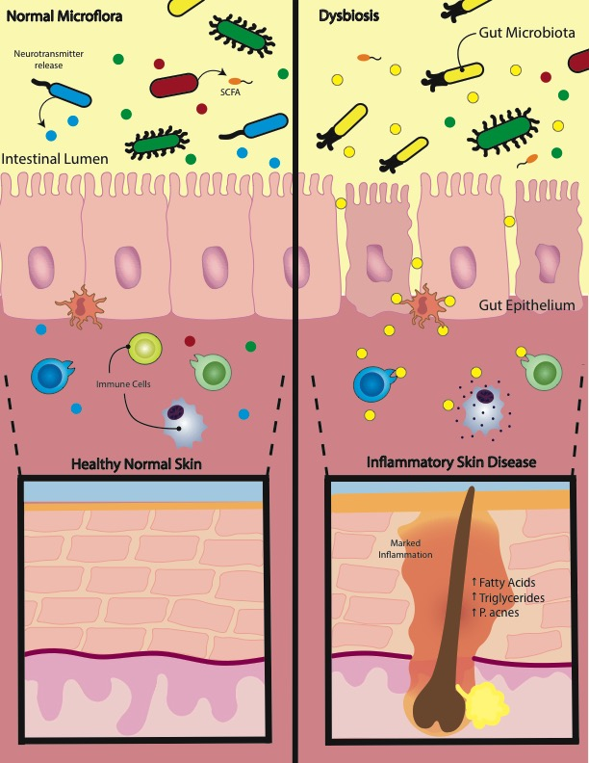
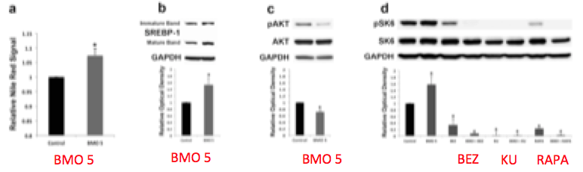
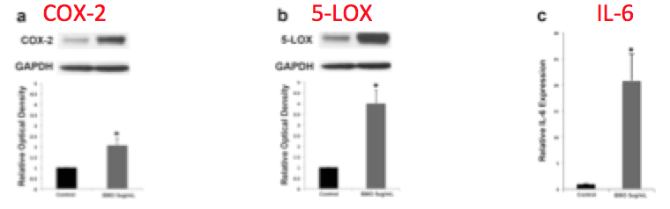
Acne, Is It Something In your Gut?
Ashley K. Clark¹, Waqas Burney² MBBS, Raja K. Sivamani² MD
University of California- Davis School of Medicine¹, Department of Dermatology, University of California-Davis²
Diet
Microbiome
Background:
One of the most common questions concerning acne is, “Is it something I ate?”
In a study among high school students, 62.3% implicated diet as a cause of their acne.
In order to properly advise patients on the relationship of acne and nutrition, we have sought to better understand the role of bovine milk oligosaccharides and its effect on inflammation and lipid production.
An early study dating back to 1949 reported on 1,925 patients who reported that milk was the most common food attributing to their acne flares.
More recently, a second study revealed that milk intake during adolescence was associated with a history of teenage acne.
Oligosaccharides are listed as most abundant after lactose and lipids in milk, and stimulate lipogenesis through IL-2 receptors.
A study in 2014 found milk oligosacccharides in the plasma of infants.
Background:
1916: Intestinal permeability might be augmented in acne vulgaris. One study of 57 acne patients used a blood serum complement fixation test to demonstrate enhanced reactivity to stool-isolated coliforms in 66% of the acne patients compared to none of the control patients.
1930’s: As many as 40% of those with acne had hypochlorhydria. In recent years, hypochlorhydria has been confirmed to be a significant risk factor for small intestinal bacterial overgrowth (SIBO), which can cause increased intestinal permeability (or ‘leaky gut’) leading to systemic inflammation. The excess bacteria can produce toxic metabolites, and cause direct injury to enterocytes.
1950’s: Bacteroides more commonly isolated
1960’s: Probiotic tablets given to 300 patients reported 80% of patients with acne had clinical improvement.
1980’s: A study involving 80 acne patients showed both the presence of and high reactivity to blood LPS endotoxins from Escherichia coli
2006: Gut microflora produce fatty acids derived from food we eat
Hypothesis:
Sebocyte cell lines treated with Bovine milk oligosaccharides will lead to an increased production of lipids and inflammatory enzymes.
Hypothesis:
The gut microbiome will be altered toward a dominance of Bacteroidetes in those with acne with an associated increase in circulating long chain saturated fatty acids (LCFAs) and lipopolysaccharide (LPS) which will stimulate sebocytes to produce lipids and inflammatory mediators.
Methods:
Clinic: Human Data
Methods:
Laboratory: Cell Study
Study patients: Age: 13-25 Mod-Severe acne
Exclusion: Systemic antibiotics, Probiotics
Seborrheic dermatitis, rosacea, or PCOS
Proton pump inhibitors
BMI greater than >30 kg/m2,
Results:
Results:
ACKNOWLEDGEMENTS:
Thank you to Dr. Waqas Burney and Dr. Raja Sivamani

