Slide 1

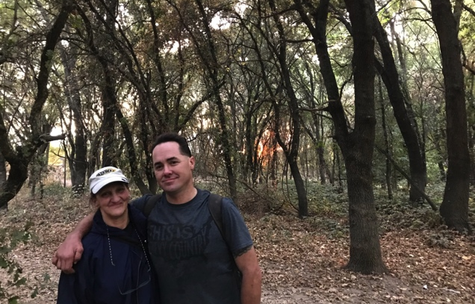
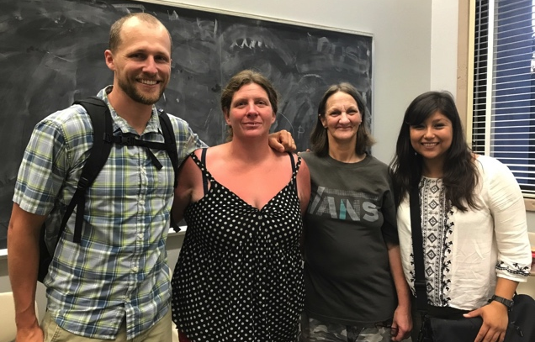
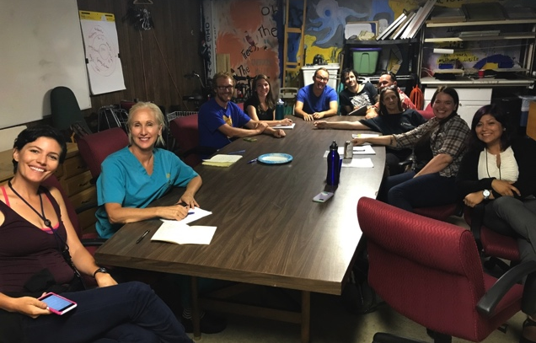
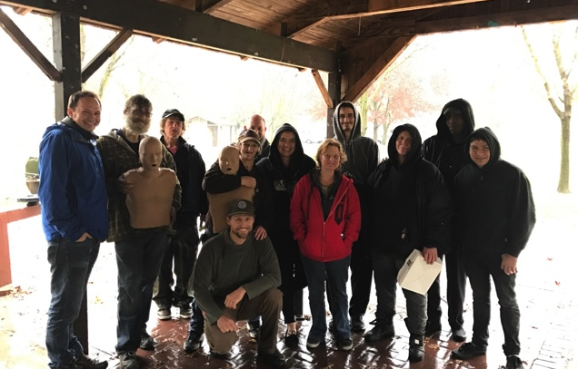
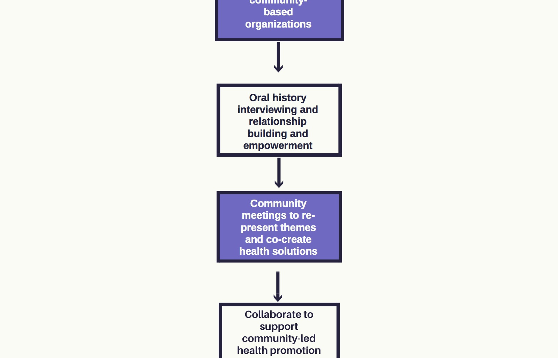
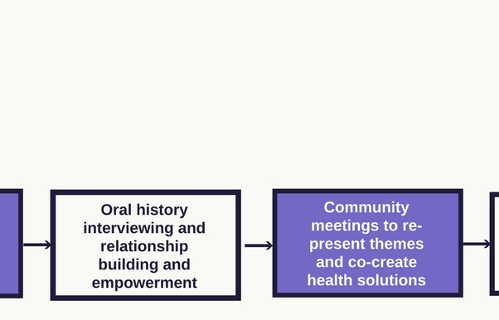
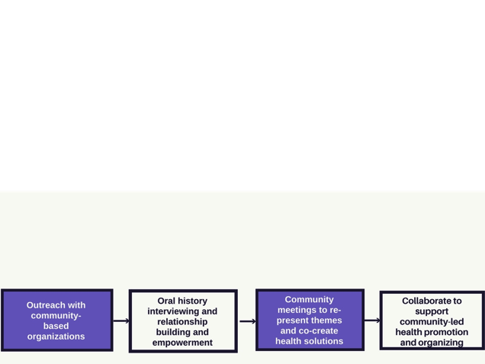
Lessons From the Island:
Shared Leadership for Health with Communities Experiencing Homelessness
Crister Brady, MPH, Dee Marie Chavez, and W. Suzanne Eidson-Ton, MD, MS
University of California Davis School of Medicine
Introduction
Methodology
Results
Conclusions
In 2017, nearly 600,000 people across the United States were experiencing homelessness¹. In Sacramento County, California, over 5,000 people were estimated to experience homelessness that year, with 78 people having died, a mortality rate 2-3 times that of the general population². These alarming statistics add to a narrative of victimization and powerlessness that homogenizes large, diverse groups of people and can discount both personal experiences and the larger structural forces contributing to homelessness.
For the past 20 years, a group of people experiencing homelessness have created a unique community on an area of the Sacramento River known as the “Island”. Informal relationships formed with community members built from interactions with outreach organizations demonstrated evidence of community-led health promotion activities and illuminated a pervasive lack of trust in formal healthcare settings. Stories of unique and unexpected community health promotion and leadership in this community were shared. Given that oral history interviewing in the context of health promotion in communities experiencing homelessness is a largely unexplored area of research, this project was co-created with community leaders in order to learn more about their lives and networks of care.
Study Question: How can an understanding of the lived experiences of a community experiencing homelessness be harnessed to create collaborative health interventions that are empowering and build upon existing solutions?
Build meaningful and long-lasting partnerships with project participants and the communities to which they belong.
Learn from community stories and collective wisdom in order to develop specific health interventions building on strengths and challenges unique to people who have experienced homelessness.
Cultural Humility: Defined by Tervalon and Murray-Garcia as a “lifelong commitment to self-evaluation and self-critique…to developing mutually beneficial and non-paternalistic clinical and advocacy partnerships with communities on behalf of individuals and defined populations³.” Cultural humility demands not only engagement at the beginning or end of a project, but the creation of consistent forums for honest critique, as well as a reliance on community guidance and an responsibility to change based on such guidance. Beyond the oral history interviews, regular community visits to sit in camp sites, hear stories, and offer connections to health resources were an essential component of the project.
"When people are listened to, they develop new confidence that their experiences are worthwhile...the process of teaching can...reinforce rather than undermine self- esteem." (Hugo and Slim, Listening for a Change)
Oral History Interviewing: “Applied” oral testimony demands a response from the listener and serves as a guide for action⁴. Moreover, oral history in the context of health care can serve as counterpoint to the official history taking in clinics and hospitals. It demonstrates that health knowledge can be found outside of traditional settings and belongs to community members themselves⁵.
Community Partnership: Outreach with Harm Reduction Services helped to create relationships with people experiencing homelessness in Sacramento through their consistent community presence.
Selection Process: Project participants were selected after an introductory connection made via a trusted community member. Verbal and written consent to participate in the project was given by each participant.
Interviews: Interviews were held on park benches, along riverbanks, and in campsites. The format was open-ended by design without an interview guide. Many conversations began with the initial question, “Tell me about where you live.”
Interview Analysis and Community Guidance: The transcriptions of each interview and project field notes were analyzed for themes and conclusions. Additionally, project participants were invited to discuss the identified themes and strategize on specific steps forward to further community-driven health interventions. The meetings affirmed the value of the community’s knowledge, experiences, and identities. Reflecting an iterative process, the meetings changed the direction of the project to an investigation into ongoing community health promotion efforts and the development of collaborative trainings.
Place:
“Homeless people in general do not like to be seen in public due to the scrutiny of the public. When people look at us sideways…It affirms what we believe about ourselves…There will be weeks that I will not leave this island…this is where I can hide and be safe.“ -Dawn
The Island as a place of sanctuary and empowerment was cited by all participants. Many described adverse childhood experiences and traumas in institutions such as prison, healthcare settings, and the foster care system. The relative safety and shared experience with the community on the Island provided many people with a sense of family and mutual support.
“...my street family, which is more family than I’ve ever had in my life, is probably why I’m still out here. I’ve never felt so wanted, so loved.” -Dustin
Care:
“...I roll into main camp and say, “Food! Come and get it!” You know? That’s how we do it out here. When we have fat findings, we share them. We take care of each other cause no one else will.” -Carl
Community-driven care through health promotion activities was shown to be central to the fabric of the Island. This network of care includes actions as well as shared knowledge of health access points. This non-traditional network of care has grown out of need for self-sufficiency and to preserve dignity.
“I don’t care if I don’t like you, if you need something, I’ll help you.” -Dee
Leadership:
“…the thing to come out into the community is a cool thing, but I think you should always make sure that you have one of your--what I’m getting--one of the people that are in the community, and make them a part of your team. I think that’s the only way…” -Wanda
Shared leadership with community members allowed for more focused interaction and collaboration with health care providers. This facilitated a co-learning process in which Island community members were empowered to define their own needs and strengths and develop solutions from their lived experiences.
This project affirms that opportunities for meaningful health interventions and community empowerment are possible through shared leadership. In the context of the Island, shared leadership grew to encompass community-led and directed health promotion efforts. The trusting partnerships that formed through the oral history interviewing and active engagement allowed for more meaningful and relevant health interventions to be enacted. Further, the lasting effects of the training collaboration and momentum for further health activities have shown that this form of leadership can build capacity through empowerment.
The shared leadership of this project and contextualization within a vibrant community showed that the needs and strengths of each community are unique and best defined by the experts—community members themselves. Efforts to solve homelessness or increase access to medical care for communities experiencing homelessness must incorporate community-identified solutions and create space for leadership and active participation.
National Alliance to End Homelessness. 2016 State of Homelessness in America. . 2016:7.
Sacramento Steps Forward. 2015 point-in-time homeless count report. . 2015.
Tervalon M, Murray-García J. Cultural humility versus cultural competence: A critical distinction in defining physician training outcomes in multicultural education. J Health Care Poor Underserved. 1998(2):117.
Slim H, Thomson PR, Bennett O, Cross N. Listening for a change : Oral testimony and community development. Philadelphia, PA : New Society Publishers, c1995; 1995.
Minkler M. Community organizing and community building for health and welfare. New Brunswick, N.J. : Rutgers University Press, c2012; 3rd ed; 2012.
Objectives
References

