Slide 1
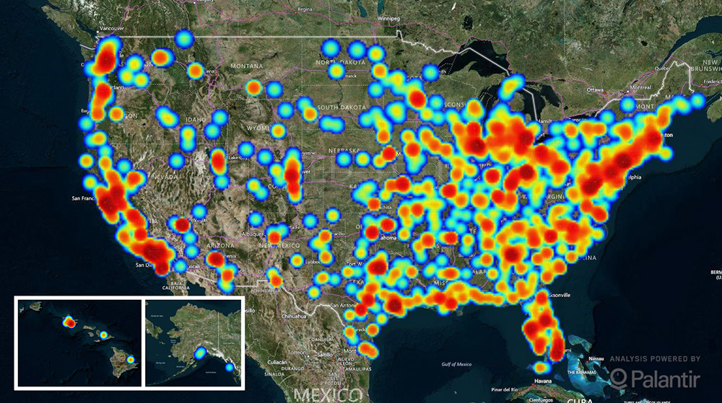
Screening for Victims of Trafficking in the Pediatric ED
Bjork Olafsdottir-Gardali MD, Madeline Venturino, Leah Timbang, Bryn Mumma MD, MAS
UC Davis Department of Emergency Medicine, UC Davis School of Medicine
METHODS
RESULTS
BACKGROUND
In a convenience sample, patients in the pediatric ED at UC Davis from 12-20 years were screened by trained medical students. After obtaining permission from the patient and family, a previously validated six-question screening tool for Commercial Sexual Exploitation of Children (CSEC) was administered to the patients without family or visitors present. We added a seventh question from our discussion with local experts: “Have you ever used sex as a means to survive?” A positive screen was defined as 1) answering “yes” to two or more questions or 2) answering “yes” to “using sex as a means to survive”. The treatment team was notified of all positive screens and a full social work interview was conducted if deemed necessary. We also worked with agencies/resources to develop an algorithm outlining the next steps after screening positive. True positives were defined as a confirmation during the social worker interview that the patient was a victim of sex trafficking.
Table 1. Patient demographic information
Age – median (range) | 17 (12-20)
Gender (%)
Female | 75
Male | 25
Race (%)
Caucasian | 34
Hispanic | 30
African American | 25
Other | 11
Chief Complaint (%)
Abdominal Pain/GI/GU | 36
Trauma/MSK | 22
Neurologic | 16
Respiratory/Cardiac | 13
Other* | 8
Mental Health/Drug | 5
Positive Screen (%) | 34
True Positives (%) | 4
*hyperkalemia, sickle cell crisis, diabetes evaluation, rabies vaccine, breast pain
The US Department of State defines human trafficking as:
Sex trafficking in which a commercial sex act is induced by force, fraud or coercion, or in which the person induced to perform such an act has not attained 18 years of age; or
The recruitment, harboring, transportation, provision, or obtaining of a person for labor or services, through the use of force, fraud or coercion for the purpose of subjection to involuntary servitude, peonage, debt bondage or slavery.
Furthermore, a victim need not be physically transported from one location to another in order for the crime to fall within these definitions¹.
DISCUSSION
Of the true positive screens, we found two patients presenting with abdominal pain and one with syncope. Our results are consistent with previous work that found abdominal pain to be a common symptom among trafficked victims². Complaints other than sexual health problems should not be dismissed when deciding to evaluate a patient for trafficking.
Some limitations to this quality improvement project include the method of sampling. Our convenience sample makes it difficult to generalize to pediatric EDs outside of UC Davis Health, or even to the UC Davis adult ED. We were also limited in screening patients with unstable mental health conditions, non-English speakers and those with breathing difficulties. Patients could also elect to refuse the entire survey or specific questions, which may cause selection bias. Additionally, of the 26 positive screens, only 3 were true positives. The survey was validated but the questions were nonspecific. Clinical judgment was required to decide whether or not to initiate social work evaluation.
Surveyor screens patients age 12-20
Screen negative
Screen positive
Usual care continues
Surveyor notifies treatment team and social work
CONCLUSION
Screening Questions:
Have you used drugs or alcohol in the past?
Have you ever run away from home?
Have your ever been involved with law enforcement?
Have you ever had a sexually transmitted infection?
Have you had sexual activity with more than 5 partners?
Have you ever used sex as a means to survive?*
Have you ever broken a bone, had traumatic loss of consciousness or sustained a significant wound?
Social worker performs full interview of patient to determine risk of CSEC
It is feasible to screen for victims of sex trafficking in our pediatric ED. Over 18 months, our screening tool identified three victims, with one being newly identified as a sex trafficking victim. We developed an algorithm for assisting a patient who screens positive that involves ED physicians, ED social workers, child protective services and law enforcement that can be used effectively in the ED setting. Abdominal pain was identified as a common chief complaint among true positive screens.
Continued research is needed to assess the utility of the algorithm in the adult ED, as well as to modify the algorithm to maximize efficacy and efficiency in a busy ED setting.
Overall, 34% (26/77) of patients screened positive. Of these, three females (2 African-American, 1 Caucasian) were true positive screens including one who was newly identified as a sex trafficking victim. These patients underwent full interviews with a social worker and were provided appropriate resources.
Abdominal pain was most common chief complaint (36%) among positive screens, followed by trauma/MSK (28%). For the three true positive screens, two patients presented with abdominal pain, and the third with syncope.
If CSEC suspected, Social Worker notifies Child Protective Services Abuse Hotline (916-875-5437)
If sexual assault/contact in last 7 days, contact law enforcement for possible evidentiary exam at BEAR
Hotspots for trafficking based on survivor data (Polaris Project, 2016)
Sacramento is a hub for sex trafficking. Sex trafficking victims tend to seek medical care in emergency departments (EDs), making this an ideal venue to identify vulnerable patients. As the median age of entry into sex trafficking is 14, the pediatric ED may provide an opportunity to identify these victims.
Over the phone CPS determines if patient safe to go home with close follow-up
CPS responds to hospital to help with disposition while patient is kept in care area to monitor for safety
REFERENCES
Provide resource card: WIND, CARES, Weave, Planned Parenthood, etc.
Home with non-offending adult vs. CPS intake facility vs. youth detention
1 Trafficking in Persons Report. United States Department of State. July 2015.
2 Oram, S, Stockl H, Busza J, Howard LM, Zimmerman C (2012) Prevalence and Risk of Violence and the Physical, Mental, and Sexual Health Problems Associated with Human Trafficking: Systematic Review. PLoS Med 9(5): e1001224. https://doi.org/10.1371/journal.pmed.1001224
OBJECTIVES
The objective of this project was to test the feasibility of screening for trafficking victims in the pediatric ED. Additionally, we sought to develop an algorithm for assisting patients who screen positive, train social workers in its use and implement it in the pediatric ED. Finally, we hoped to identify high-risk chief complaints among patients that screen positive to inform future care and increase provider suspicion.
If CSEC is suspected, treatment team can consider ordering:
Pregnancy test
Urine gonorrhea/chlamydia PCR
Other diagnostic testing as indicated (e.g., for suspected trauma or other infection)
Offer STI and pregnancy prophylaxis
Upon discharge, can provide contact info for Planned Parenthood: 916-452-7305, 5385 Franklin Blvd.
ACKNOWLEDGEMENTS
UC Davis Department of Emergency Medicine
UC Davis School of Medicine

