Slide 1

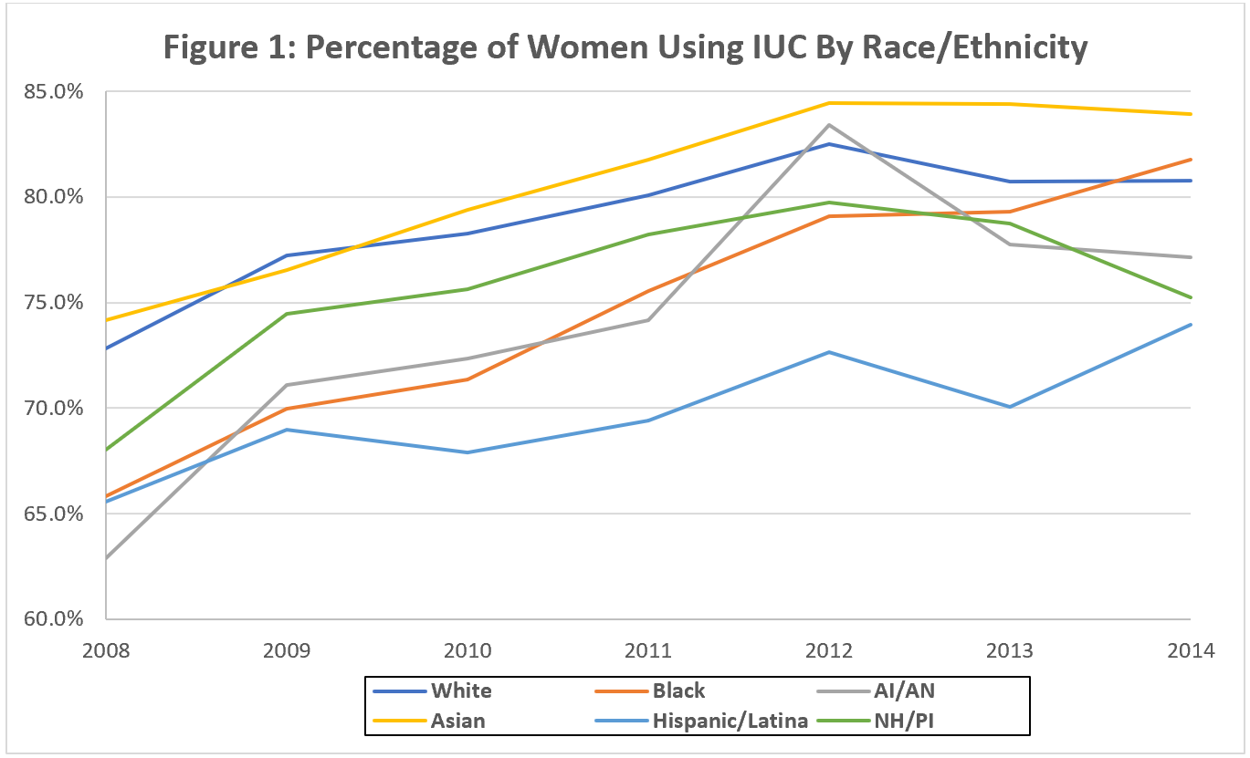
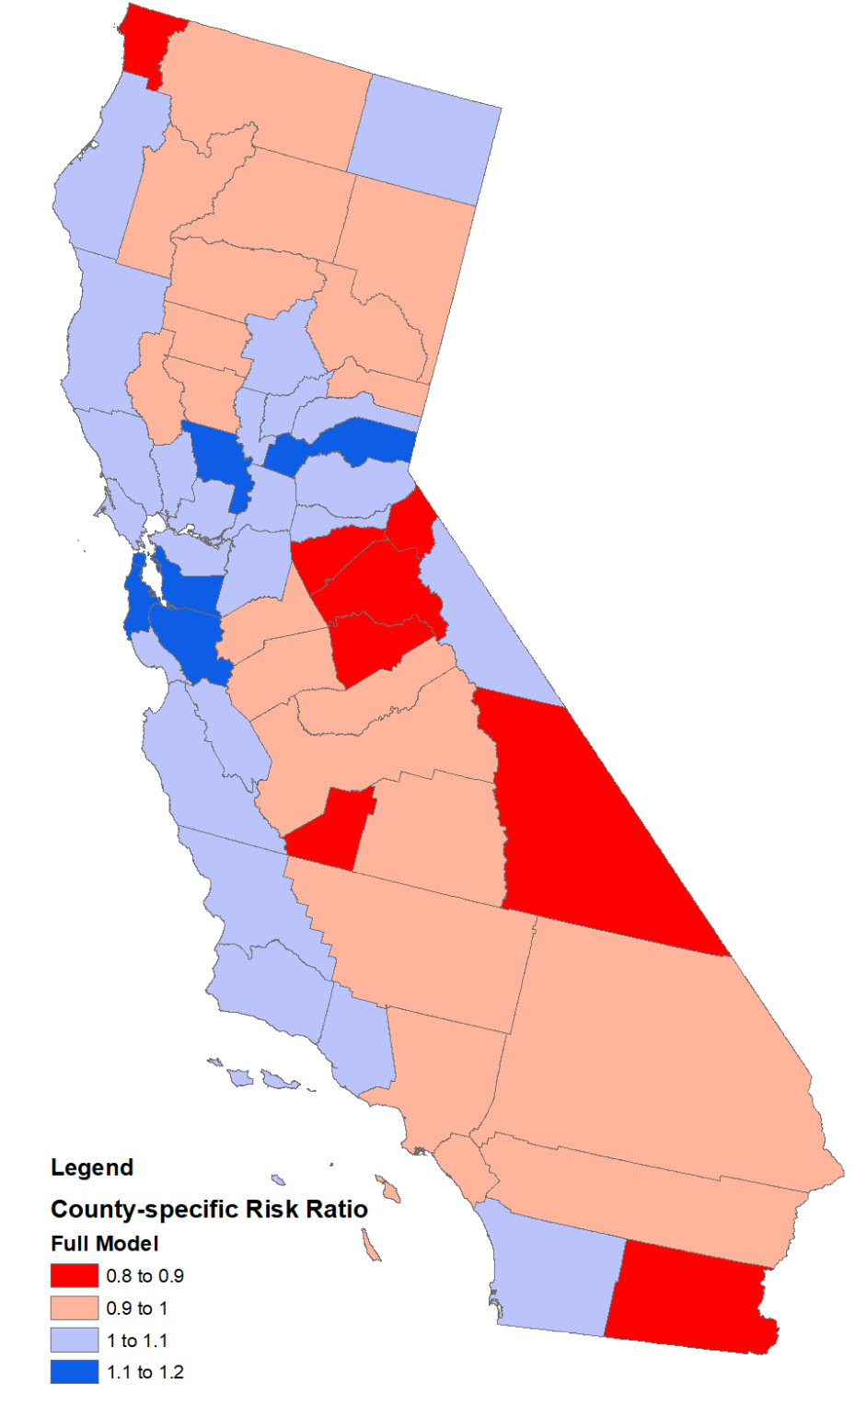
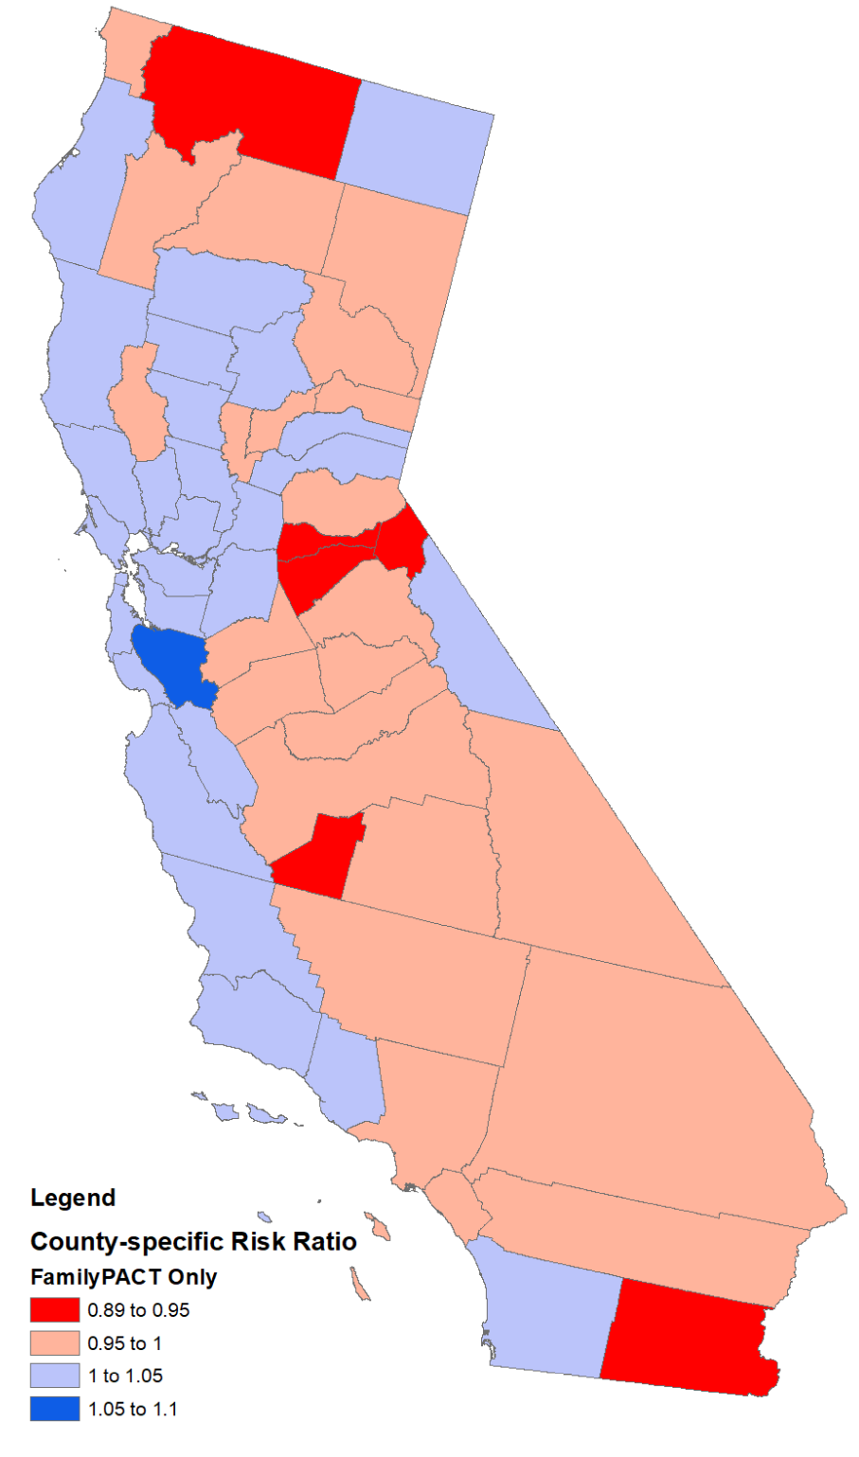
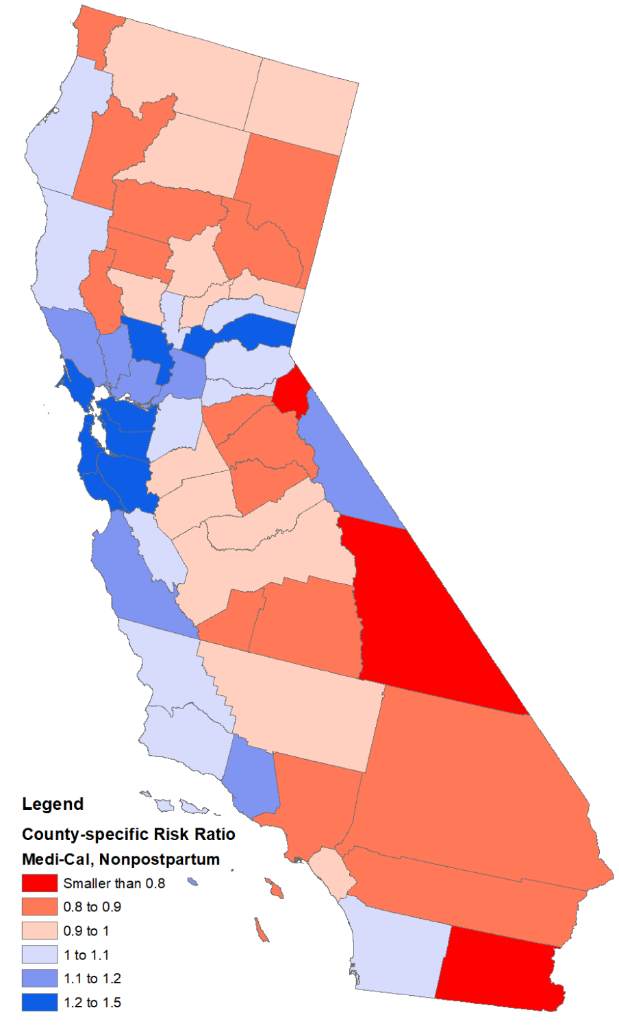
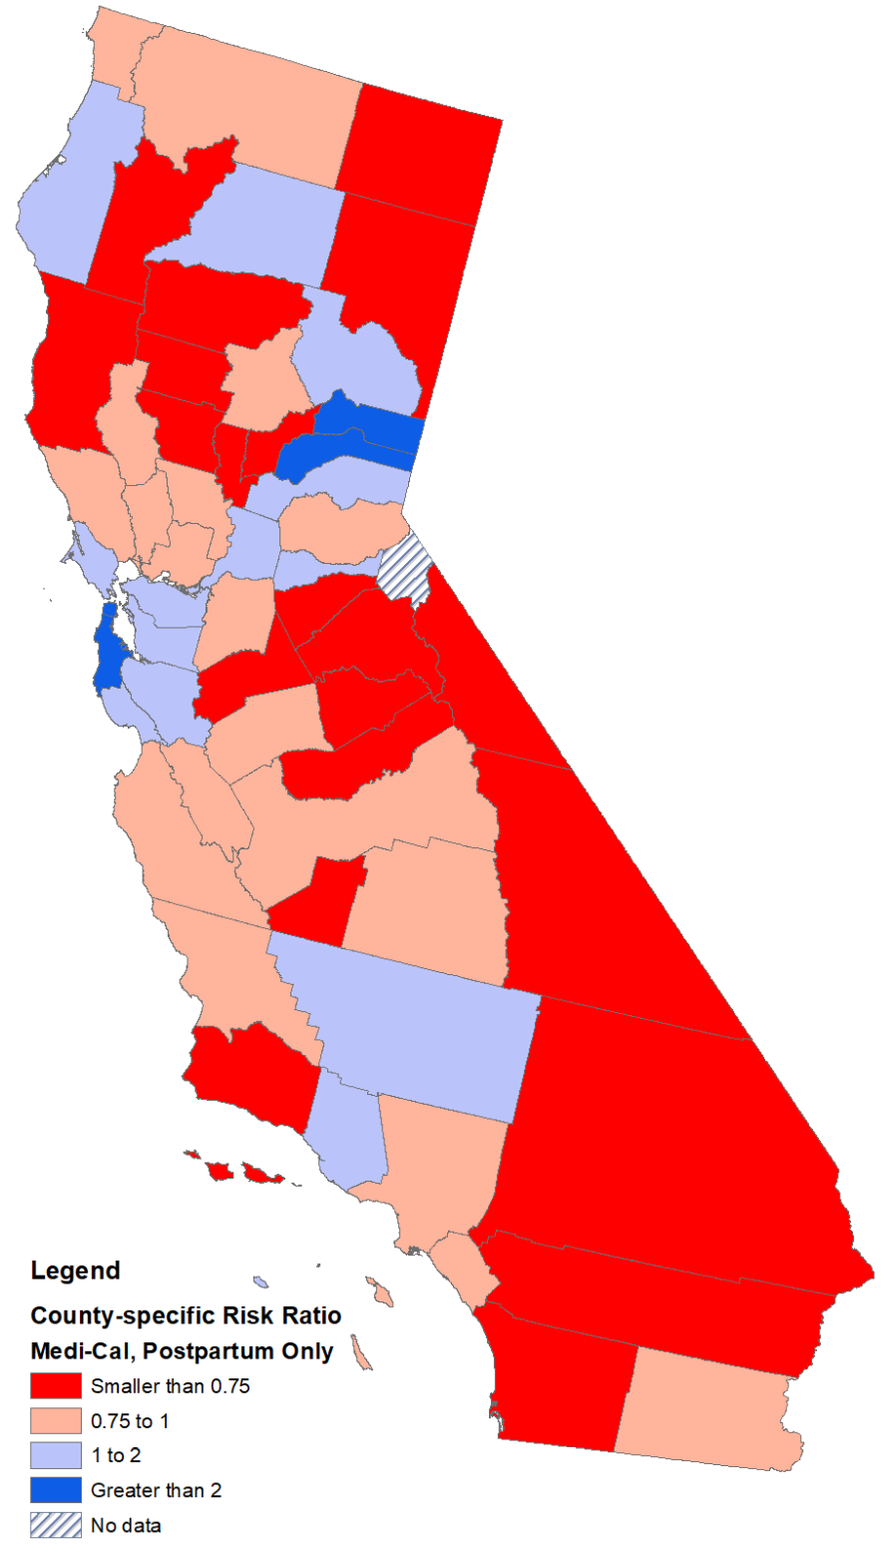
Racial/Ethnic Differences in the Use of Long-Acting Contraception Among Low-Income Californian Women
Alexandra Calderon, BA; Andrew Padovani, PhD; Rebecca Canfield; Olivia Campa, MD; Eleanor Bimla Schwarz, MD, MS
University of California, Davis School of Medicine, Sacramento, CA 95817, Center for Healthcare Policy and Research, University of California, Davis, Sacramento, CA 95817
INTRODUCTION
FIGURE 1 –PROPORTION OF STATE-FUNDED LONG-ACTING CONTRACEPTION THAT IS REVERSIBLE,
IUC, BY RACE/ETHNICITY, 2008-2014
RESULTS
Up to 25% of US women regret having undergone surgical sterilization
Intrauterine contraception (IUC) can be safely used for up to 20 years offering rapidly-reversible contraception that is as effective as surgical sterilization
FamilyPACT covers service for Californians living at or below 200% of the Federal Poverty Level, who do not meet criteria for Medi-Cal eligibility
Discriminatory medical practices have long-term effects on minority communities’ trust in the healthcare system. California has a problematic history of eugenics practices that spanned over 70 years, until 2010.
Objective: To assess racial/ethnic differences in use of permanent vs reversible contraception among low-income Californian women seeking long-acting contraception and receiving state-funded family planning services.
In the Family PACT program, there were no significant differences between Black, White, and Asian women;
However, Latina women were less likely to receive IUC and more likely to receive permanent contraception than White women (adj RR 0.96, 95% CI 0.94-0.98).
In Medi-Cal, among women seeking interval contraception, there were no significant differences between Black and White women;
However, Latina women were less likely to receive IUC and more likely to receive permanent contraception than White women (adj RR 0.92, 95% CI 0.88-0.97), while Asian women were more likely to receive IUC (adj RR 1.16, 95% CI 1.11-1.22).
In postpartum Medi-Cal, there were no significant differences between Black, White, Asian, and Latina women; compared to White women, Pacific Islanders were more likely to receive IUC than permanent contraception.
Women in San Francisco were most likely to receive IUC while women in San Bernardino, Calaveras, Del Norte, Inyo, Kings, Mariposa, Tuolumne, Alpine, and Imperial County were all more likely to receive permanent contraception than an IUC.
METHODS
FIGURE 2 – REGIONAL VARIATION IN USE OF IUC vs PERMANENT CONTRACEPTION, BY PAYER, 2008-2014
Claims data from the CMS Research Data Assistance Center related to all surgical sterilization and intrauterine contraception (IUC) placements funded by California’s Family PACT and Medicaid (Medi-Cal) programs between 01/01/2008 to 12/31/2014.
Examined racial/ethnic variation in the proportion of women seeking long-acting contraception who received a permanent method.
Stratified analysis by state funding program and postpartum status (contraception provided within 30 days of delivery).
Estimated robust multivariate Poisson regressions to estimate the effect of race/ethnicity on the probability of receiving reversible intrauterine contraception vs permanent surgical sterilization, adjusted for year of service provision, age, and region of residence.
DISCUSSION
Whether these differences are due to differences in access to desired services, bias in counseling, or cultural preferences, deserves further study.
Conclusion: Geographic and racial/ethnic difference in use of IUC and permanent contraception persist among low-income Californian women seeking long-acting contraception.
ACKNOWLEDGEMENTS
UC Davis Medical Student Research Fellowship
Society of Family Planning Research Fund Emerging Scholars award
Red = Permanent more likely; Blue = IUC more likely

