Slide 1
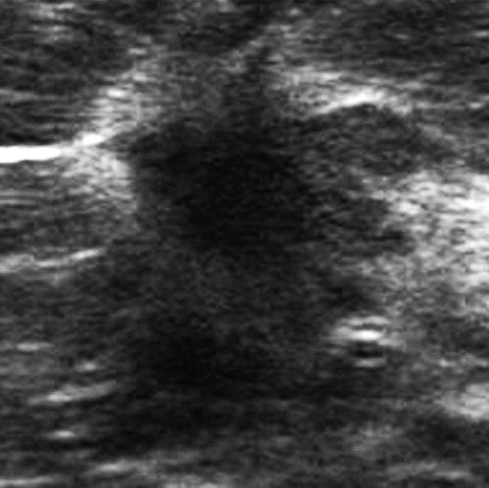
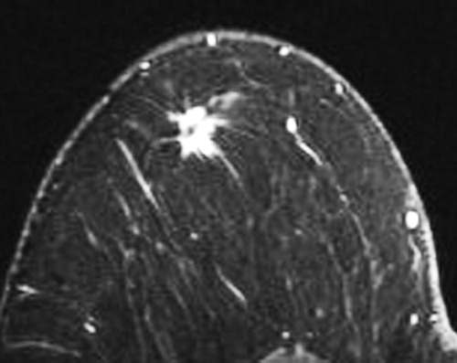
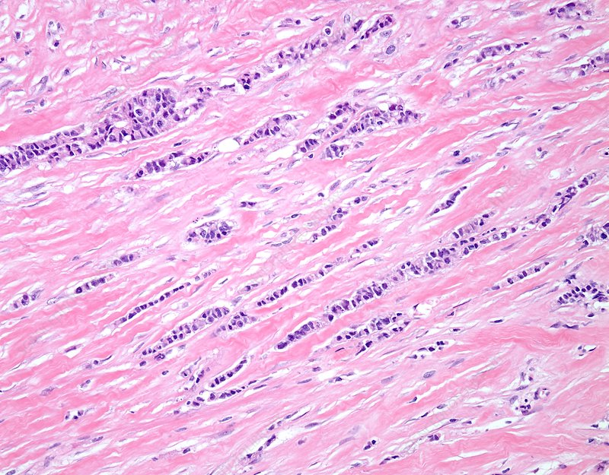
Pre-operative detection rate of invasive lobular carcinoma with ultrasound guidance versus magnetic resonance imaging
Alisha A. Othieno¹, Candice A. M. Sauder MD², Shadi Aminololama-Shakeri MD³
¹UC Davis School of Medicine, ²Department of Surgical Oncology, University of California, Davis; ³Department of Radiology, University of California, Davis
INTRODUCTION
BACKGROUND
STUDY METHODS & MATERIALS
PROGRESS TO DATE & TIMELINE
Invasive lobular carcinoma (ILC) is a breast cancer that affects the milk-producing glands of the breast, also known as lobules
It is characterized by the loss of E-cadherin, increase in intracellular mucin, and cells that grow in a single-file pattern (Figure 1)
About 5-15% of all invasive breast cancers are invasive lobular carcinoma, but many may be difficult to detect via common imaging modalities based on the unique morphology of ILC
In the literature, there are varying results regarding the utility of ultrasound imaging for detection of ILC in lymph nodes
However, studies have yet to compare the data to the utility of MRI detection of ILC in the lymph nodes, which is the standard of care for imaging primary breast cancer
Historically, breast MRI has a sensitivity of 93% for ILC detection, which is slightly higher than the sensitivity of MRI detection of all types of breast cancer (90%) ²
  Imaging indicates a mass with irregular margins or a non-mass lesion
Breast ultrasound has not traditionally been used to screen for ILC, but reported appearance of ILC include a hypoechoic mass with posterior acoustic shadowing²
  As a diagnostic tool, sonography has an overall sensitivity of 68-98%, but there is limited data on screening sensitivity
A recent study conducted in 2016 evaluated 142 patients diagnosed with ILC and evaluated with ultrasound imaging³
  ILC clinicopathology and ultrasound features reported that the sensitivity of ultrasound imaging in detecting ILC nodal metastasis was 52.3%, which was lower than the sensitivity of detecting all types of breast cancer (61.4%)
  Ultrasound was found to exclude 96% of advanced axillary node metastasis
Another study evaluated 102 patients with ILC who did not have clinically-detectable axillary node metastasis⁴
  Pre-operative axillary ultrasounds were performed in all patients and follow-up ultrasound-guided fine-needle aspiration biopsy was performed for suspicious lymph nodes (29 cases)
  28% of patients had suspicious lesions via axillary ultrasound and 20% of the total cohort had confirmed nodal ILC via fine-needle aspiration biopsy
  Overall sensitivity and specificity of axillary ultrasound imaging for ILC was 49% and 87%, respectively
  Ultimately, pre-operative ultrasound imaging reduced the need for a two-stage surgery
We will review biopsy-specific imaging and electronic health records of women evaluated at UC Davis Medical Center between 2015-2020 for invasive lobular carcinoma by ultrasound and MRI
Inclusion criteria:
  Female gender
  Age 18-65
  Reported history of ILC or invasive mammary carcinoma with lobular features that received preoperative imaging via ultrasound and MRI
Exclusion criteria:
  Male gender
  Previous history of breast surgery
  History of neoadjuvant therapy
  History of other breast cancers
Primary outcome measures
  Ultrasound predictive results
  MRI predictive results
Secondary outcome measures
  Positive preoperative biopsy results for ILC via biopsy-specific imaging
Discussions with PI regarding study methods and the research timeline
Preparation and submission of IRB application, now pending IRB approval
Timeline for the future:
  Feb-Mar 2020: Consulting with the UC Davis Medical Center radiologist to review cases of specific patients and EMR review
  Mar-Apr 2020: Data analysis
  Apr-May 2020: Abstract preparation
KEY CHALLENGES & LIMITATIONS
Figure 2: Ultrasound image of mass identified as ILC. Ultrasound imaging significant for irregular hypoechoic mass⁵
Figure 3: MR imaging of mass identified as ILC. MRI significant for spiculated mass that is bright and irregular⁵
Challenges
  IRB approval (pending)
  Inconsistent labeling of the pathology reports that correspond to the biopsy-related images
  Reported data in the EMR regarding imaging modality and mass features
Limitations
  Small sample size based on timing and labeling of biopsy-specific images
  Limited access to radiology imaging via Radiology Department
Figure 1: Tissue sample micrograph of ILC¹
OBJECTIVES
REFERENCES
"Invasive lobular breast cancer, light micrograph." Science Photo Library. 2020. Feb. 2020. <https://www.sciencephoto.com/media/925564/view/invasive-lobular-breast-cancer-light-micrograph>.
Johnson K, Sarma D, Hwang ES. Lobular breast cancer series: imaging. Breast Cancer Res. 2015;17(1):94. Published 2015 Jul 11. doi:10.1186/s13058-015-0605-0.
Kim SY, Kim EK, Moon HJ, Yoon JH, Kim MJ. Is pre-operative axillary staging with ultrasound and ultrasound-guided fine-needle aspiration reliable in invasive lobular carcinoma of the breast. Ultrasound Med Biol. 2016;42:1263–1272. doi: 10.1016/j.ultrasmedbio.2016.01.008.
Novak, J., Besic, N., Dzodic, R. et al. Pre-operative and intra-operative detection of axillary lymph node metastases in 108 patients with invasive lobular breast cancer undergoing mastectomy. BMC Cancer 18, 137 (2018). https://doi.org/10.1186/s12885-018-4062-x.
Lopez JK, Bassett LW. Invasive lobular carcinoma of the breast: spectrum of mammographic, US and MR imaging findings. Radiographics. 2009;29(1):165–76.
To determine the prediction rate for each imaging modality (ultrasound and MRI) for invasive lobular carcinoma
To compare the prediction rate of ultrasound and MRI for invasive lobular carcinoma

