Slide 1


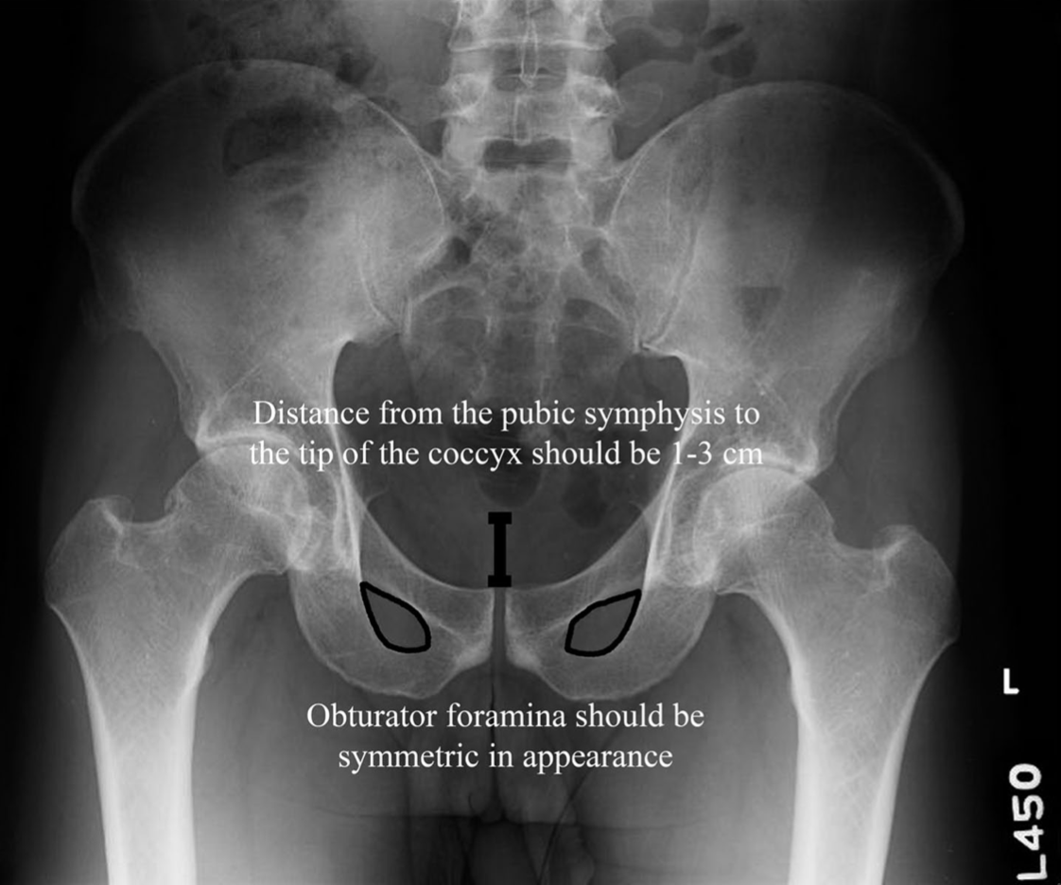
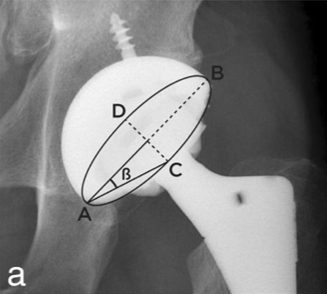
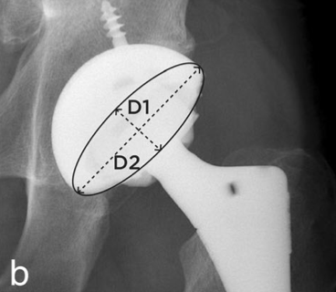
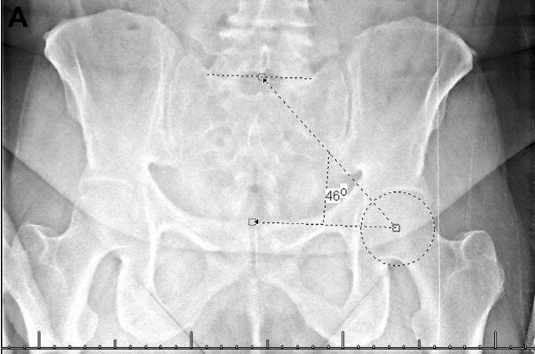
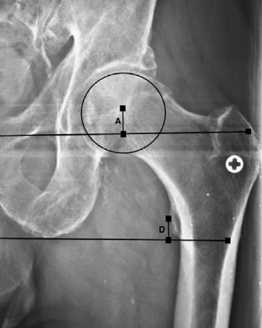
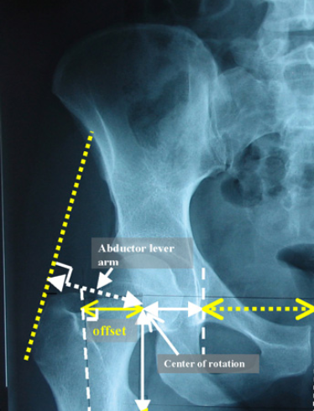
Are There Any Complication to Increased Anteversion of the Cup?
Brian J. Vasquez, BV, Keegan Bowers, BS, Satninderdeep Bhatti, BS, Robert Boutin, MD, John Meehan, MD, Zachary Lum, DO
Department of Orthopedic Surgery, UC Davis Medical Center, Sacramento, CA 95817
Purpose
Methods
Results
Conclusions
To determine the incidence of hip dislocation and other complications following THA for patients in whom acetabular anteversion exceeds 25 degrees.
IRB approved surgical databased of THA patients identified by CPT 27130 between January 2011 and December 2017
Retrospective Case Series – Level IV evidence
Inclusion Criteria
Primary THA between 2011 – 2017
Acceptable AP Radiograph as described in Clohisy et. al (see Figure 1)
Symmetrical obturator foramina, 1-3cm from pubic symphysis to tip of coccyx
Patient Demographics and Complications
Demographics, complications, and risk factors for dislocation reviewed by chart review (sex, prior surgery, surgical approach, neuromuscular disease, etc.)
Patients followed for 1-year minimum
Calculation of Anteversion
Acetabular anteversion calculated from AP radiograph using two distinct methods
Method 1: Liaw – Version = sin⁻¹(tanβ)
β is the angle between the long axis of the component (AB in Fig 2a) and the line connecting the end of AB with the end point of the ellipse
Method 2: Lewinnek – Version = arcsin (D1/D2)
D1 is the distance of the short axis of the ellipse and D2 is the long axis of the acetabular component, reflecting the maximum diameter of the implant
Other Collected Parameters
Pelvic Tilt – Ragsdale Method (Figure 3)
Pelvic Tilt = 75 degrees – sacro-femoral-pubic angle
Limb Length Discrepancy (Figure 4, measurement 4)
Distance from interteardrop line to center of femoral head
Femoral Offset (Figure 5)
Distance from center of femoral head to center of rotation of intramedullary canal
395 consecutive patients underwent primary THA with average follow up 19 months
Approach of the surgeries was 90.1% posterior, 6.8% anterior, 3.1% other
Comparing posterior and anterior approaches, anterior had 3.9 degrees more anteversion (p=0.017) and 2.3mm longer leg length than posterior (p=0.04)
5 dislocations in the posterior group, none in the anterior group (0.74)
3 revisions in the posterior group, 1 in the anterior group (p=0.15)
60 (15%) of cups with > 25 degrees anteversion were identified. No difference in dislocation nor revision rates were seen (p=0.6, p=0,6 respectively)
1.3% of patients sustained a dislocation with average anteversion 16 degrees Liaw, 16.6 Lewinneck
Low dislocation rate may have been a product of the strict selection criteria of AP radiographs set forth in Clohisy et al.
Anteversion with an anterior approach was not less than the posterior approach
Even with increased anteversion outside of the Lewinneck safe zone, few dislocations and revisions occurred. For reasons such as spinopelvic disease, increased anteversion in total hip arthroplasty may be safe.
Background
Hip dislocation is an early and serious complication following total hip arthroplasty. Occurring most commonly within the first month following surgery, posterior dislocations occur through a flexion, internal rotation, and adduction mechanism, and represent 75-90% of dislocation after THA.
The orientation of the acetabular component comprises inclination and anteversion. Inclination refers to the lateral tilt of the acetabular component where as anteversion the anterior tilt. Historically, anteversion has been targeted to 15 degrees +/- 10 degrees. Too little anteversion can lead to posterior hip dislocations vs. to much anteversion leading to anterior dislocations. Recent evidence suggests that increasing anteversion beyond 25 degrees may provide for fewer posterior dislocations, but is is unknown if this leads to other complications.
Variable | Posterior | Anterior | P-Value
N | 356 | 27
Age | 61.4 | 64.8 | 0.14
BMI | 28.6 | 27.7 | 0.45
ASA | 2.3 | 2.3 | 0.62
Total Offset | -1.30mm | 0.503mm | 0.52
Total LLD | -1.00mm | 1.34mm | 0.05
Anteversion (Lewinneck) | 16.4 | 20.4 | 0.017
Anteversion (Liaw) | 15.7 deg | 20.0 deg | 0.012
Pelvic Tilt | 12.7 deg | 13.1 deg | 0.67
Dislocations | 5 (1.4%) | 0 | 0.74
Revisions | 3 (0.8%) | 1 (3.7%) | 0.25
References
1. Clohisy JC, Carlisle JC, Beaulé PE, et al. A systematic approach to the plain radiographic evaluation of the young adult hip. J Bone Joint Surg Am. 2008;90 Suppl 4(Suppl 4):47–66.
2. Park YS, Shin WC, Lee SM, Kwak SH, Bae JY, Suh KT. The best method for evaluating anteversion of the acetabular component after total hip arthroplasty on plain radiographs. J Orthop Surg Res. 2018;13(1):66.
3. Lecerf G, Fessy MH, Philippot R, Massin P, Giraud F, Flecher X, Girard J, Mertl P, Marchetti E, Stindel E. Femoral offset: anatomical concept, definition, assessment, implications for preoperative templating and hip arthroplasty. Orthop Traumatol Surg Res. 2009 May;95(3):210-9.
4. Meermans G, Malik A, Witt J, Haddad F. Preoperative radiographic assessment of limb-length discrepancy in total hip arthroplasty. Clin Orthop Relat Res. 2011;469(6):1677–1682.
5. Ragsdale MI, Wong FS, Boutin RD, Meehan JP. Pelvic Tilt Evaluation From Frontal Radiographs: The Validity, Interobserver Reliability and Intraobserver Reproducibility of the Sacro-Femoral-Pubic Parameter. J Arthroplasty. 2017 May;32(5):1665-1669.
6. Lewinnek GE, Lewis JL, Tarr R, Compere CL, Zimmerman JR. Dislocations after total hip-replacement arthroplasties. J Bone Joint Surg Am. 1978 Mar;60(2):217-20.
Variable | In Liaw Safe Zone | Out of Liaw Safe Zone | P-Value
N | 310 | 85
Total Offset | -1.81mm | 0.88mm | 0.24
Total LLD | -0.90mm | 0.04mm | 0.72
Pelvic Tilt | 12.8 deg | 12.4 deg | 0.64
Dislocations | 5 (1.6%) | 0 | 0.52
Revisions | 3 (0.9%) | 1 (1.1%) | 0.86
Objectives
Specific Aim 1: To evaluate the incidence of dislocation and other complications where acetabular anteversion exceeds 25 degrees
Primary Hypothesis: There is no significant increase in rate of dislocation, anterior or posterior, when anteversion exceeds 25 degrees
Specific Aim 2: To compare acetabular anteversion between anterior and posterior surgical approaches for THA
Secondary Hypothesis: There is no significant difference in anteversion when comparing anterior vs. posterior approaches.
Awknowledgements
Thank you to Dr. Zachary Lum, Dr. John Meehan, Dr. Robert Boutin for their guidance and mentorship
Thank you to Keegan Bowers and Satninderdeep Bhatti for their assistance with data collection
Thank you to the Department of Orthopedic Surgery at UC Davis
Figure 1 Figure 2a Figure 2b
Variable | Below 25 deg Anteversion | Above 25 degrees Anteversion | P-Value
N | 335 | 60
Dislocations | 5 (1.5%) | 0 | 0.61
Revisions | 3 (0.9%) | 1 (1.6%) | 0.58
Figure 3 Figure 4 Figure 5

