Slide 1
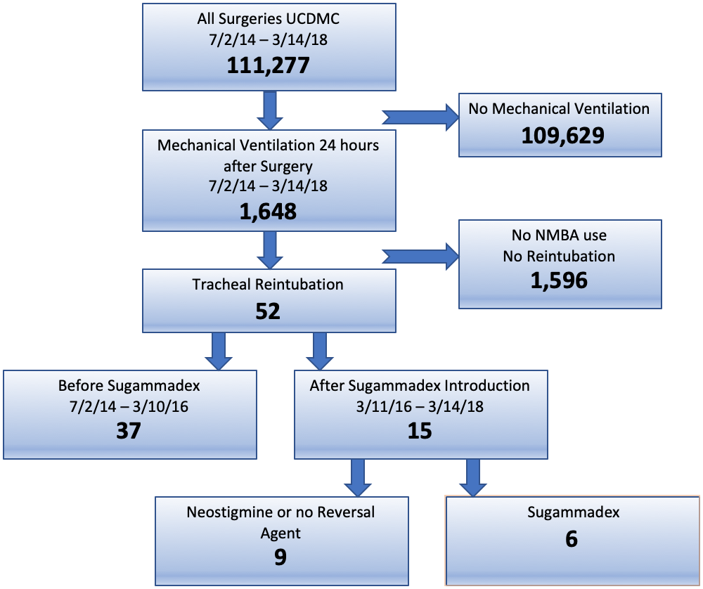
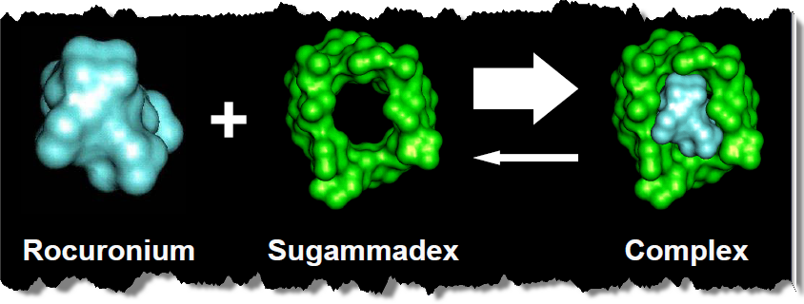
EVALUATION OF REINTUBATION RATES FOLLOWING INTRODUCTION OF NEW REVERSAL AGENT
Presenter: Colton Soudan
Background
Postoperative residual neuromuscular blockade is associated with post-op complications
Current blockade reversal agents are Sugammadex and Neostigmine
Sugammadex may decrease postoperative residual neuromuscular blockade
Sugammadex was introduced to UC Davis Academic Center on 3/11/16
Following the introduction of Sugammadex, tracheal reintubation frequency decreased at UC Davis Medical Center
Discussion
Further research can explore how different patient and surgical characteristics can impact the frequency of tracheal reintubations
Further research can examine patient population not receiving neuromuscular blockade reversal agent
Further research could look at 30 day outcomes following tracheal reintubation
Methods
Used EMR and chart review to find patients requiring post-operative tracheal reintubation
Observed previously associated patient characteristics, as well as new factors, as shown in table 1 and 2
References
Hristovska AM, Duch P, Allingstrup M, Afshari A. Efficacy and safety of sugammadex versus neostigmine in reversing neuromuscular blockade in adults. Cochrane Database Syst Rev. 2017;8
Brueckmann, Britta, et al. “Development and Validation of a Score for Prediction of Postoperative Respiratory Complications.” Anesthesiology, vol. 118, no. 6, 2013, pp. 1276–1285.
Lukannek, C., et al. “The Development and Validation of the Score for the Prediction of Postoperative Respiratory Complications (SPORC‐2) to Predict the Requirement for Early Postoperative Tracheal Re‐Intubation: a Hospital Registry Study.” Anaesthesia, vol. 74, no. 9, 2019, pp. 1165–1174
Results
52 patients required tracheal reintubation; 37 before and 15 after Sugammadex
Significant decrease in the frequency of tracheal reintubations comparing the post-Sugammadex introduction to the pre-Sugammadex introduction group
Significant decrease in frequency of reintubation comparing Sugammadex to Neostigmine in Post-Sugammadex introduction group
QR Code goes here
Take a picture to download the abstract
Colton Soudan, B.S., University of California, Davis
Kevin Nguyen, B.S., University of California, Davis
Neal Fleming, M.D., Ph.D., Department of Anesthesiology and Pain Medicine, University of California, Davis

