Slide 1
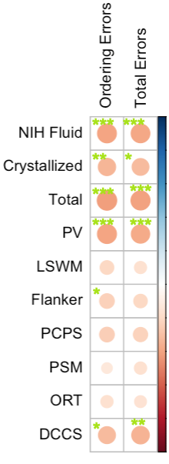

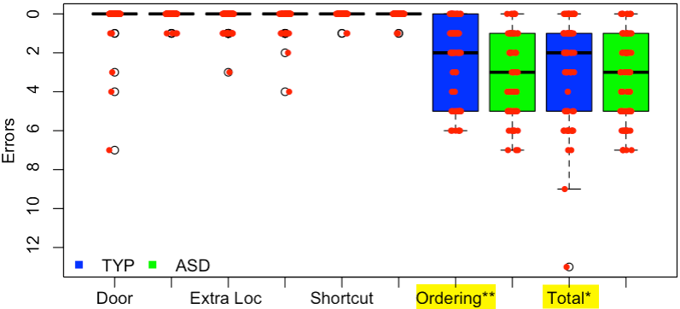
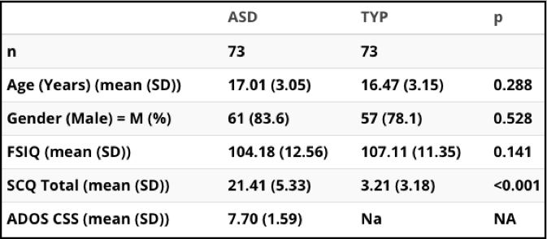
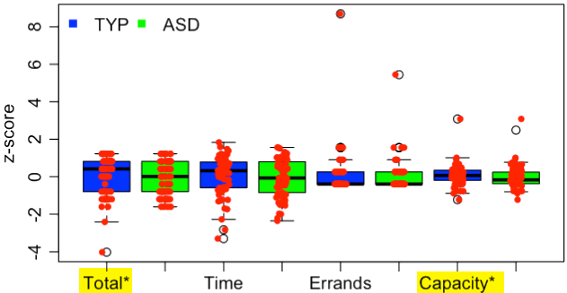

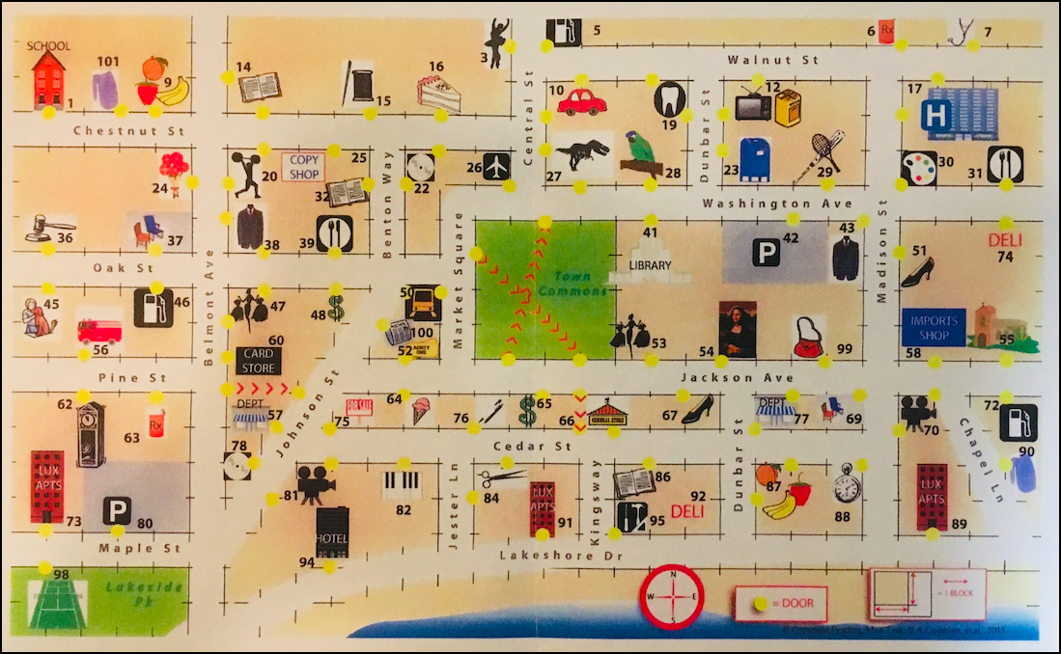
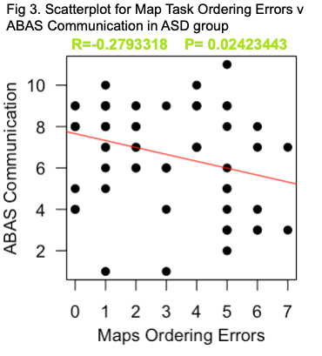
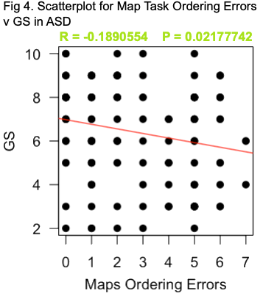

An Ecologically Valid Measure of Executive Control for Adolescents and Young Adults with Autism Spectrum Disorder
Duy Nguyen ^{1,2,3}, Rachel A. Wulff¹ , Marjorie Solomon^{1,3,4}
¹MIND Institute, UC Davis , ²University of California, Davis, School of Medicine, ³Department of Psychiatry & Behavioral Sciences, UC Davis, ⁴Imaging Research Center
Background/Objectives
GS,GR GF: Social scale assesses peer relationships, peer conflict, age-appropriate intimate relationships, and family involvement. GF:Role scale rates performance and amount of support needed in one’s specific role (ie, school, work).
Correlations: Map Task and Cognition
Adolescents with autism spectrum disorder (ASD) frequently exhibit executive control deficits. The field lacks ecologically valid measures of cognitive capacity, which is one aspect of executive control. The Map Task, which was developed to study youth at-risk for psychotic disorders, is one of the first such measures designed to assess capacity to carry out a set of errands on a shopping trip. Here, we report preliminary results of a study of the Map Task implemented in adolescents and young adults with ASD. Specific goals were to: 1) Examine whether individuals with ASD show impairments on the MAP task compared to age, gender, and IQ-matched typically developing Individuals (TYP), 2) Examine associations between Map Task performance and another test of similar construct from the NIH Toolbox, and 3) Investigate associations between Map Task performance and measures of adaptive behavior and social and role functioning.
STATISTCAL ANALYSES Group differences between TYP v ASD across all Map Task variables were assessed using non-parametric Kruskal-Wallis Rank Sum Test. The Spearman’s rho coefficient was used to determine the relationship between the Map task variables and NIH age adjusted scores, covarying for IQ. It was also used to determine the relationship between the Map task variables and ABAS 3 and GS,GR variables, covarying for IQ.
In TYP group, NIH variables were not significantly correlated with any Map Task variables.
In ASD group, there were significant relationships after covarying for IQ.
*P < .05, **P < .01, *** P<.001, Bigger size, deeper color = increasing |R|
RESULTS: Map Task Performance (TYP, ASD)
Fig1. Mean differences in Map Task Performance for TYP, ASD.
*P < .05
**P < .01
METHODS: Participants (N = 146)
Fig2. Mean differences in Map Task Performance for TYP, ASD.
*P < .05
**P < .01
Correlations: Map Task and Measures of Adaptive Behavior and Social and Role functioning
Inclusion/Exclusion: WASI-2-FSIQ>70; No psychotropics, but psychostimulants w/washout. ASD: DSM-V Checklist, ADOS-2, SCQ. TYP: No neurodevelopmental or Axis I disorders. Matched set on gender, age, and IQ. Cohort sequential study = T1
Measures/Analysis
ABAS 3: In the ASD group Map Task Ordering Errors and ABAS Communication significantly correlated after covarying for IQ.
Discussion
MAP TASK Participants were required to efficiently plot a route on a map of a fictional town in order to complete a set of specified errands. Specific rules and sequences, when violated, captured specific deficits.
Door Errors, Extra location errors, Shortcut errors = deficit in sustained attention.
Ordering errors = deficit in logical planning.
GS,GR: In ASD group Map Task Ordering Errors and GS significantly correlated after covarying for IQ.
ASD showed impairments on Map Task Ordering Errors, Total Errors, and Capacity Score, supporting the task’s ability to capture cognitive impairments in this demographic.
Significant correlations with NIH Fluid Cognition in ASD group supports the tasks ability to capture executive control in ASD group.
Significant correlations with NIH Crystallized Cognition in ASD group supports the tasks ability to capture language skills. This is supported by its correlation with ABAS Communication and GS, since language underpins.
Ordering errors seemed to drive Total errors which seems to drive Capacity Score, suggesting it is the most sensitive variable.
Exploratory correlational analysis showed that in the ASD group, Ordering errors could be predictive of ABAS Communication and GS.
Total errors combined all errors and was averaged with Completion Time, Number of Errands Completed to create a Capacity Score. (McLaughlin, 2016)
NIH TOOLBOX Measures cognition. Fluid cognition = working memory(LSWM), sequence memory (PSM), inhibition (Flanker), cognitive flexibility (DCCS), processing speed (PCPS). Crystallized cognition = vocabulary (PV), reading (ORT)
ABAS 3 Measures adaptive functioning. Conceptual = communication, functional academics, self-direction. Practical = social skills, leisure skills. Social = self-care, home living, community use, health and safety, work skills. General Adaptive = All
U.C.Davis SOM Medical School Research
Thank you to Danielle McLaughlin for use of the Map Task

