Slide 1


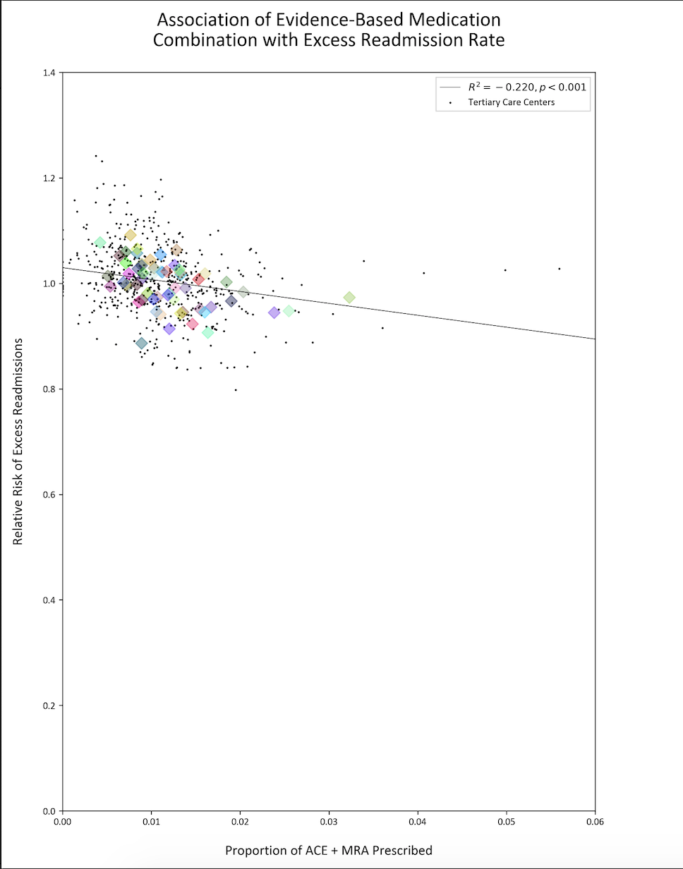
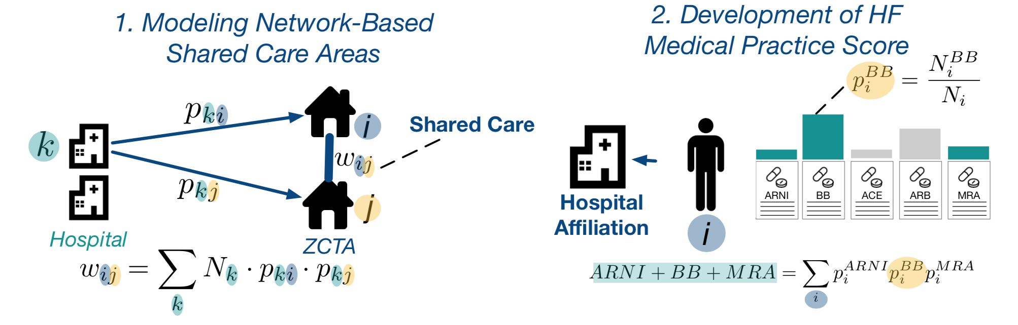
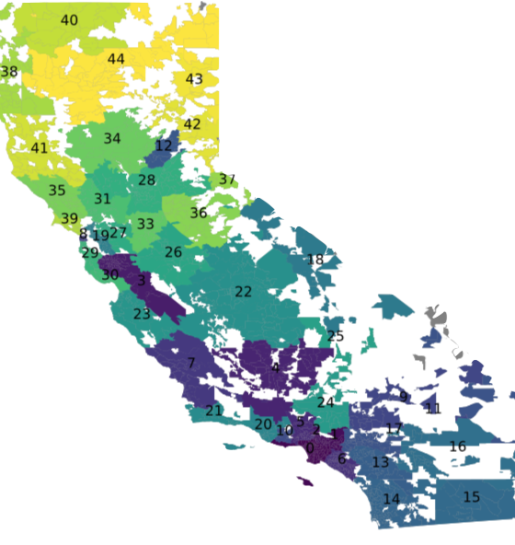
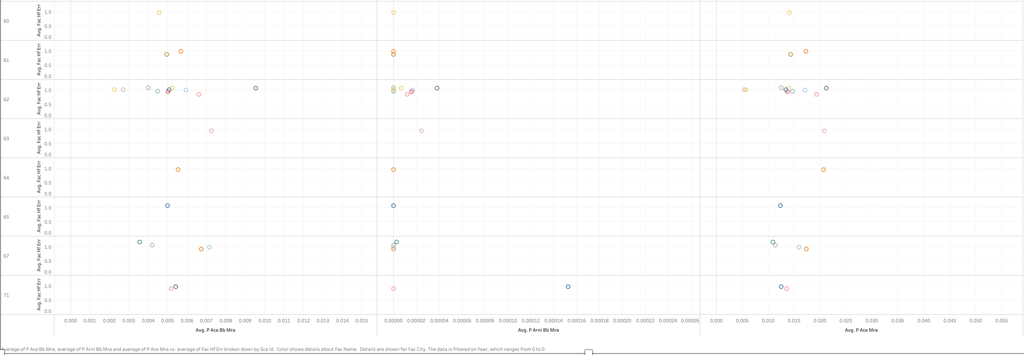
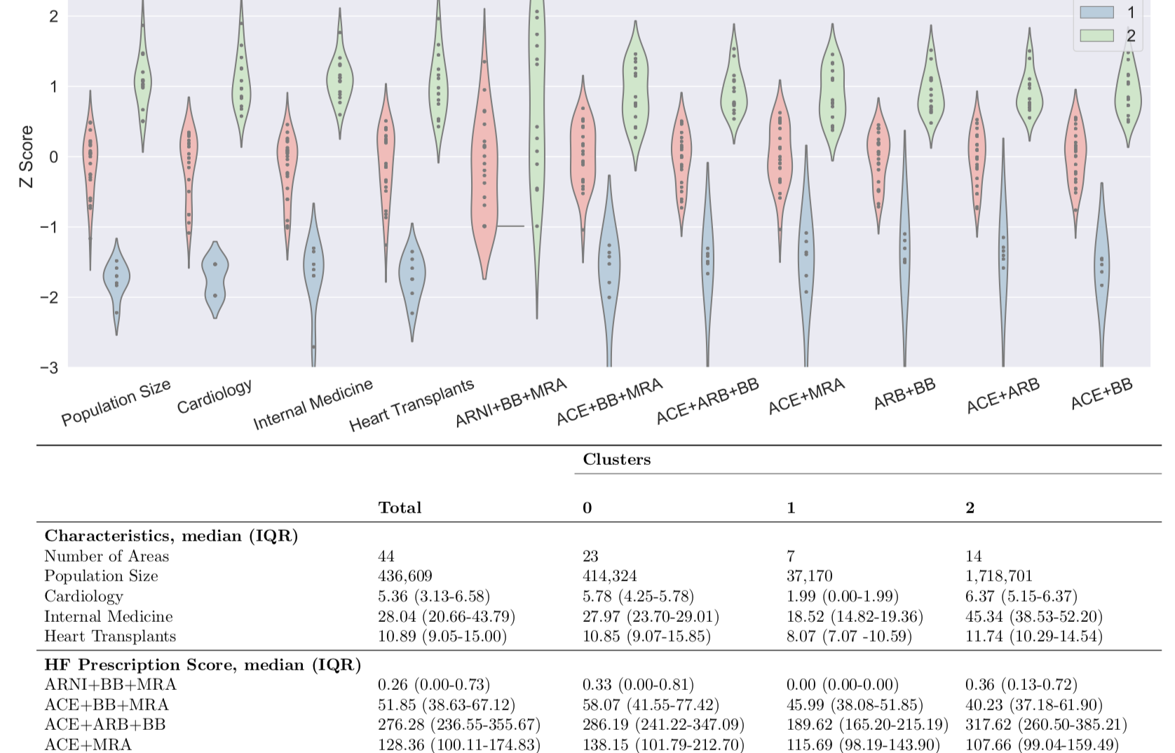
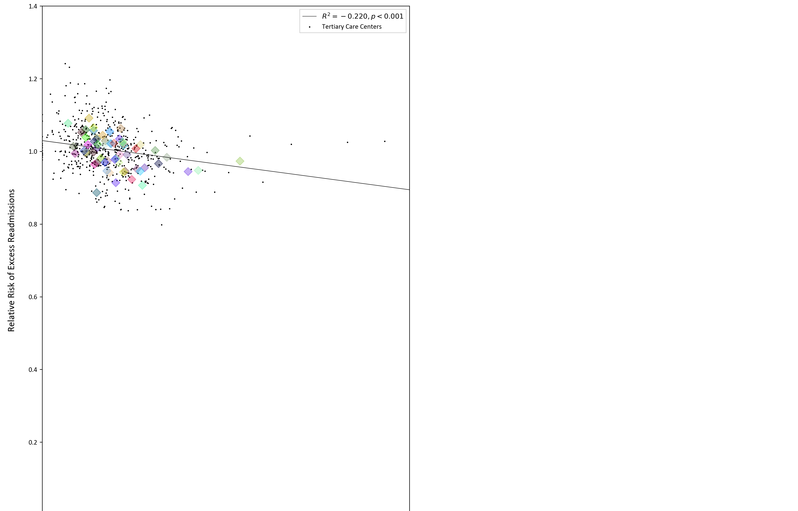
Associations among Shared Care, Adherence to Guideline-Directed Medical Therapy, and Hospital Readmissions
Jing Mai, Diego Pinheiro, and Martin Cadeiras
Department of Cardiology at the University of California, Davis
Introduction
Methodology
Preliminary Results
Conclusions and Significance
Heart failure (HF) is of special interest to healthcare professionals and policymakers alike, due to both cost and efficiency burdens – and there is lack of ownership and accountability with these issues. Projected to cost the US healthcare system $57 billion annually by 2030[1]. 20% of HF patients are also readmitted within 30 days of discharge. These persistent issues demand novel evaluations to improve heart failure management – specifically, evaluation of physician behavior at the population level.
Physician practice variations[2] has impacts on healthcare outcomes, and, moreover, evaluating the influence that physicians exert on one another are of special interest when it comes to evaluating costs of care[3]. Shared care models, and adherence and adoption to medical guideline directed therapies are advocated as effective for improving the management of patients with complex conditions.
Shared Care Areas and their adherence scores to Medical Guideline-Directed Therapy will be evaluated with hospital-specific excess readmissions rates to determine a relationship between the degree of adherence to medical therapy and excess readmissions.
Definition and Development of shared care areas: Shared Care Areas (SCAs) are care centers that discharge to similar zip codes (Zip Code Tabulated Areas). The more in common the hospital discharges, the more "connected" a certain practice is to another. The product between the proportions of the discharges to both ZCTAs weighted by the total number of discharges by the hospital. SCAs are calculated yearly. This clustering method quantifies the likelihood that hospitals are connected to one another within a network, subsequently delineating discrete nodes of care across California.
Estimates of Adv-HF-GDMT will be calculated for (i) a list of specific drugs, (i) drug classes, and (iii (iii) combinations of drug classes.
An estimate of adherence will be developed for the 7 commonly prescribed combination of heart failure drug classes (prescribed 2014-2019), as follows: ARNI+BB+MRA, ACE+BB+MRA, ACE+ARB+BB, ACE+MRA, ARB+BB, ACE+ARB, ACE+BB.
Hospital-specific ERRs from the Medicare Hospital Readmissions Reduction Program and estimates of adherence to GDMT will be aggregated at the SCA level and further integrated with network-based measures of SCA.
Exploratory results reveal a significant trend in the rate of evidence-based medication prescriptions with excess readmissions rates, which establishes a base to continue exploration with the data by using shared care areas and overlaying network data onto these existing trends. We aim to translate these findings into larger Medicare Part D datasets across California.
Network medicine evaluation methods provide a population-level view of natural networks of care. Although this evaluation method requires further validation, it can be a useful tool for informed decision making to evaluate community needs and allow for greater ownership on how physician behavior can be associated with patient outcomes and healthcare expenses. By evaluating the deviations in behavior of provider practices, we can better identify which networks may require interventions for improvement or further inquiry.
Ultimately, the impact of this study will make progress towards the goals of precision medicine, by helping legitimize the use of community detection algorithms to inform both local and policy decisions and to more precisely identify and present interventions to the appropriate parties.
References
[1] Ziaeian et al. Epidemiology and etiology of heart failure. Nat Rev Cardiol. 2016 Jun; 13(6): 368–378
[2] Landon, Bruce E., et al. "Variation in patient-sharing networks of physicians across the United States." Jama 308.3 (2012): 265-273.
[3] Landon, Bruce E., et al. "Patient-sharing networks of physicians and health care utilization and spending among Medicare beneficiaries." JAMA internal medicine 178.1 (2018): 66-73.
Objectives and Hypotheses
To address the historical heterogeneity in HF readmissions in California, this study develops estimates of HF-GDMT (Heart Failure Guideline Directed Medical Therapy) adherence and explores its association with excessive hospital HF readmission among Shared Care Areas using claims-based data. This builds on a previous study that noted significant variations in prescribing practices of heart failure medications between different shared care areas.
1. Claims-based data can be used to estimate adherence to HF-GDMT
2. Changes in claims-based estimates of adherence to HF-GDMT are negatively associated with changes in the excess readmissions rates among shared care areas
3. Changes in estimates of shared care are associated with changes in the excess readmission rates among shared care areas
4. Changes in estimates of shared care are associated with changes in claims-based estimates of adherence to HF-GDMT
Sample data over a single year (2016) noted significant variations of prescribing rates not only across Shared Care Areas, but within Shared Care Areas as well.
Aknowledgements and Contact
Special thanks to Dr. Diego Pinheiro, Dr. Martin Cadeiras, Saad Soroya and Joshua Bloomstein for their contributions and samples.
Contact: Jing Mai (jimai@ucdavis.edu)

