Slide 1



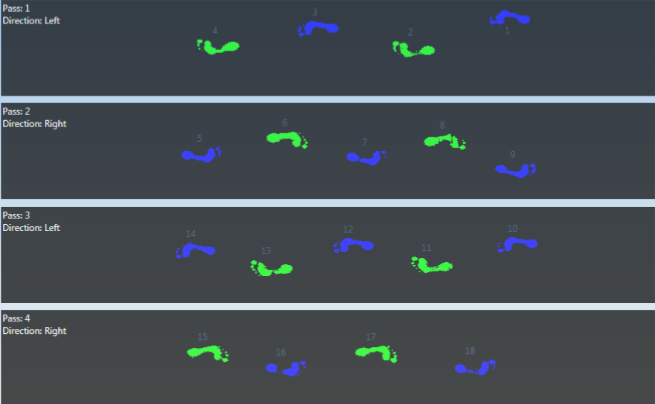
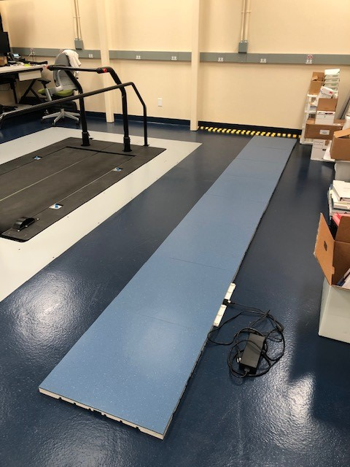
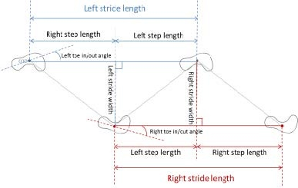
Walking Parameters Affected by Prior Musculoskeletal Injury Using
Community-Accessible Measurement Technique
Lydia Henderson, MD Candidate; Theresa E. McGuirk, MS; Caitlin L Banks, MS; Cherie Kuo PT, PhD; Elliott S. Perry; Carolynn Patten PhD, PT, FAPTA
Department of Physical Medicine and Rehabilitation, University of California, Davis School of Medicine
INTRODUCTION
METHODS
CONCLUSIONS
Walking ability is an important marker of overall health¹.
Speed is the most frequently used metric of walking function²⁻³. However, walking speed is a non-specific metric as it is influenced by multiple factors¹.
Previous work⁴ has identified key components of bipedal locomotion to develop a Comprehensive Locomotor Index⁵ (CLI) for objective assessment of walking function in stroke survivors.
Notably, many presumed healthy controls received sub-maximal scores on the CLI⁴⁻⁵. On further examination, we found these individuals revealed presence of subclinical pathology across multiple systems.
Further investigation is needed to determine which elements of the CLI are most affected by specific pathologies.
Data contributing to development of the CLI were obtained in a dedicated laboratory setting. For a diagnostic tool to become broadly used it needs to become more accessible for patients and providers.
Participants
14 adults (6 male, 8 female) ages 19-61 (median age 24) were recruited from the University of California Davis academic campus public space.
8 healthy
6 with prior history of musculoskeletal (MSK) injury including: (torn achilles tendon, hip fracture, meniscus tear, ACL injury, MCL injury, or ankle sprain)
Data Collection
Health history and demographic information were provided by all participants using RedCap, a mobile-equipped secure database.
All participants walked across a StepScan pressure sensitive walkway at their self-selected walking speed (SSWS) and fastest comfortable walking speed (FCWS).
Four gait parameters were examined:
SSWS
Velocity change between SSWS and FCWS
Change in swing limb step length between SSWS and FCWS
Dynamic force production during late stance phase (i.e., “push off”)
This project represents proof-of-concept for collecting relevant gait parameters outside of the dedicated motion analysis laboratory. Use of a novel pressure sensitive walkway enables acquisition of both spatiotemporal parameters and dynamic force production, a key component of the CLI.
Preliminary results show differences in the targeted gait parameters, indicating the ability to identify individuals with history of prior MSK injury from the pressure profiles.
It appears possible to differentiate individuals with prior MSK injury even without instrumented motion capture data including force plates.
Given ability to identify and differentiate gait characteristics of ostensibly healthy individuals with prior MSK injury supports the potential for detection of sub-clinical pathology through non-invasive measurement of walking over a pressure-sensitive walkway.
Figure 4. Force profiles obtained from the pressure sensitive walkway are similar to data obtained from a force plate. Here we calculated dynamic force production in the late stance phase to explore its use as a substitute for ankle power, used in the CLI.
RESULTS
OBJECTIVES
Deploy novel technology requiring little participant burden (buy-in) and little technical expertise to determine feasibility of testing in clinical type settings.
Develop a scoring rubric with this new technology that allows for objective assessment of the key functions of bilateral locomotion.
REFERENCES
Gage JR. An Overview of Normal Walking. Instructional Course Lectures. 1990(39):291-303.
Fritz S, Lusardi M. White paper: "walking speed: the sixth vital sign". J Geriatr Phys Ther. 2009;32(2):46-9.
Middleton A, Fritz SL, Lusardi M. Walking speed: the functional vital sign. Journal of aging and physical activity. 2015;23(2):314-22.
Patten C, Little VL, Banks CL, McGuirk TE. Corticospinal Efficacy to the Medial Gastrocnemius Predicts Gait Function Following Stroke. Society for Neuroscience; 2017; Washington, D.C.
Banks CL, Patten C. Validation of a Comprehensive Locomotor Index for Individuals with Chronic Stroke. International Society of Biomechanics; 2019; Calgary, AB. CANADA.
Figure 2.
Example of one trial recorded by StepScan.
Figure 5. Both SSWS and dynamic force production clearly differentiate between individuals with prior MSK injury.
Figure 3. Overview of gait parameter definitions.
ACKNOWLEDGMENTS
The project described was supported by the National Center for Advancing Translational Sciences (NCATS), National Institutes of Health (NIH), through grant UL1 TR001860.
Thank you to the Medical Student Research Fellowship for providing additional student funding.
Figure 6. Changes in speed and non-injured limb step length reveal great variability in previously injured individuals which may belie compensatory strategies for gait adaptations.
Figure 1. StepScan pressure-sensitive walkway.

