Slide 1
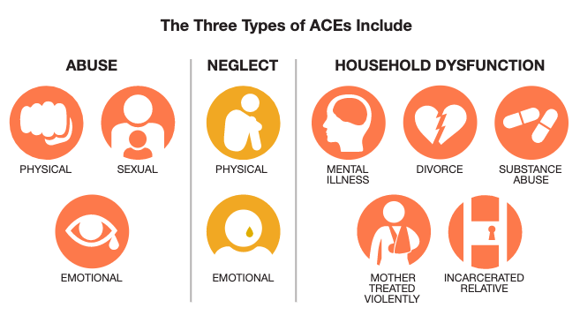
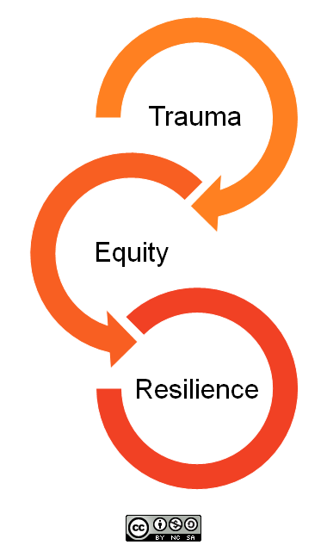
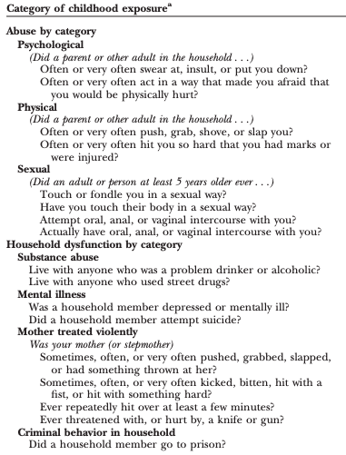
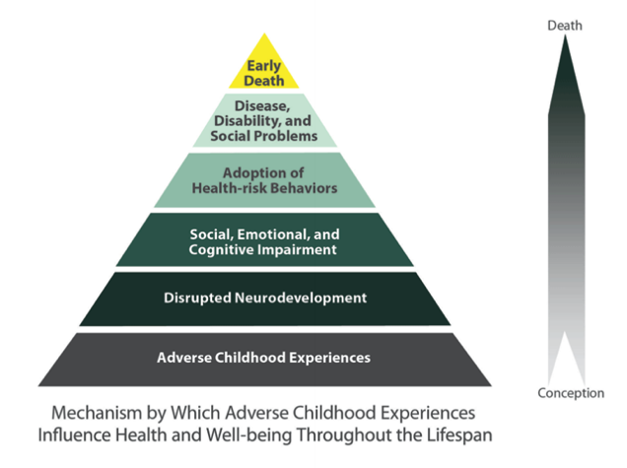
Adverse Childhood Experiences and Psychological Impact in a High-Risk Adolescent Population
Mahtab Danai¹, Michael Wilkes, MD PhD²
¹UC Davis School of Medicine; ²UC Davis Department of Internal Medicine
INTRODUCTION
METHODS
METHODS
PRELIMINARY RESULTS
APPLICATION
PRELIMINARY RESULTS
Multiple studies have shown the link between childhood adversity and various poor health outcomes including suicide risk, substance use disorder, obesity, hypertension, diabetes and others. The effects of childhood trauma are complex and probably multi-factorial and may have physiological links to increased cortisol levels and subsequent blunted hypothalamic pituitary adrenal (HPA) axis reactivity. Although research has identified several risk factors for ACEs, there are few qualitative studies assessing how adolescents perceive their own childhood adversity experiences and how they have coped.
Objectives:
Assess the prevalence of ACEs in the Wind Youth Services high-risk teen clinic population
Assess patient awareness of ACEs, whether they feel ACEs have impacted their health, and what factors they felt were protecting (provided resilience)
Through this qualitative study, we hope to gain further insight into the psychological impact of ACEs in this high-risk teen population.
Study Population: Wind Youth Services (WYS) Teen Clinic
WYS: Youth homeless services organization located in Sacramento County serving high-risk youth aged 12-24 in Sacramento County.
Teen clinic in partnership with One Community Health.
Questionnaire:
10-point ACE questionnaire from the 1998 Kaiser ACE Study is given to all patients seen at WYS Teen Clinic at intake.
Participants asked about their responses to the ACE questionnaire during this study in a 15-20 minute interview.
All responses were audiotaped, transcribed, and kept anonymous.
Inclusion Criteria: Youth patients aged 18-24 seen at the WYS Teen Clinic and able to read and complete the ACE questionnaire given at intake.
Exclusion Criteria: Patients who require emergent medical care, do not have capacity to complete questionnaire and/or interview, are non-English speaking, and/or are unable or unwilling to read questionnaire.
Consent: Written consent was exempt as the study was minimal risk. Subjects were verbally consented prior to being interviewed and informed that questions could be difficult and emotional to answer. Subjects were informed that they could stop the interview at any time and also offered counseling services through WYS.
Interview excerpts and themes:
Disassociation
“I’ve been told I was raped, but I don’t remember any of it… My childhood since then is fuzzy. I try not to remember certain things.”
Anxiety
“I developed a severe anxiety like panic disorder, to the point where I open a ball and scratch myself... And so for a while I just had major major anxiety and even had it at school all day long, to the point where I couldn't focus on work because I was too anxious.”
“I can't talk to certain people that like... [when I] don't know you, something's telling me that I should stay away from you.”
Sublimation
“School is like a vacation. At school, I didn’t have to think about what was happening at home.”
“I’m studying to be a social worker. I want to work with young kids… like my life lesson is to just do better, just provide for people that can't speak for themselves because
Resilience
“We fall, we get back up, we fall, we get back up there sometimes we fall we come back two times stronger than it was before.”
“But what helps is just learning to disassociate with the situation really and knowing that, and associate the situation with the conscious, knowing that it's not your fault.”
Multiple studies have shown that exposure to ACEs is not uncommon and in this high risk population the average number of ACES is 7. Research also suggests that the presence of one ACE increases significantly the likelihood of exposure to another. There is also a strong dose-response relationship between ACE scores and physical and mental health outcomes.
A promising approach to addressing ACEs is to enhance childhood resilience and protective factors, which seem to mitigate or moderate the negative consequences of childhood maltreatment. Teens with a history of ACE exposure in particular may benefit from speaking about their experiences in a safe setting and participating in interventions that address, normalize and impart trauma-focused coping skills.
This study is limited in that we did not directly address unmeasured ACEs in our interviews like racism, bullying, neighborhood safety, and witnessing violence. Research has shown the strong link between higher ACE scores and those experiencing health disparities. A global approach to address ACEs should not only focus on building individual resilience but also building support and strength within communities disproportionately affected by health disparities including underrepresented minorities and LGBTQ+ folk.
REFERENCES
Felitti VJ, Anda RF, Nordenberg D, et al. Relationship of childhood abuse and household dysfunction to many of the leading causes of death in adults. The Adverse Childhood Experiences (ACE) Study. American journal of preventive medicine. May 1998;14(4):245-258.
Moore TG, McDonald M, Carlon L, O'Rourke K. Early childhood development and the social determinants of health inequities. Health promotion international. Sep 2015;30 Suppl 2:ii102-115.
Cronholm PF, Forke CM, Wade R, et al. Adverse Childhood Experiences: Expanding the Concept of Adversity. American journal of preventive medicine. Sep 2015;49(3):354-361.
Wade R, Jr., Shea JA, Rubin D, Wood J. Adverse childhood experiences of low-income urban youth. Pediatrics. Jul 2014;134(1):e13-20.

