Slide 1



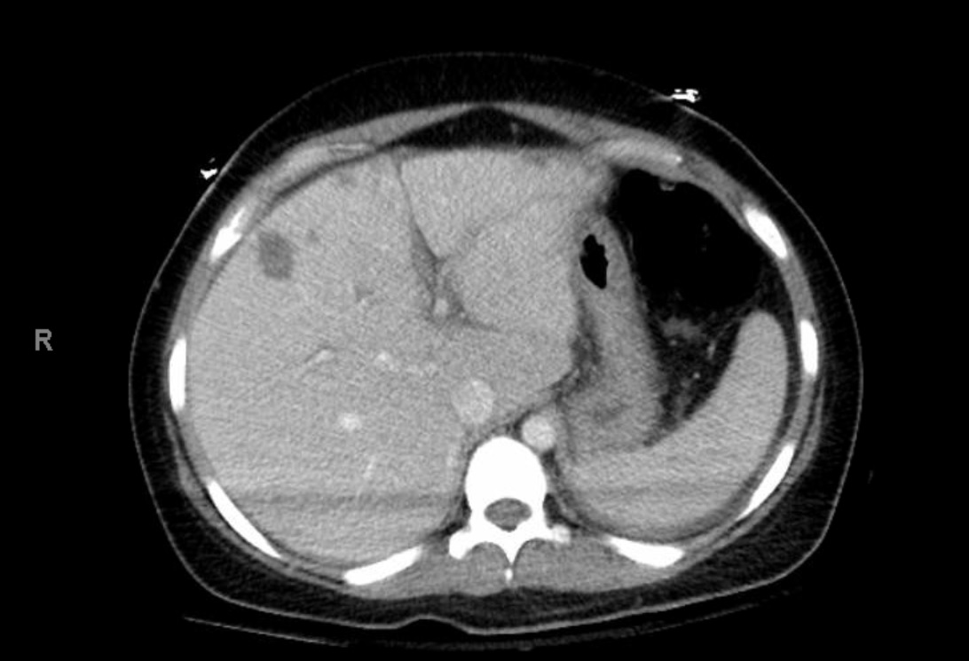
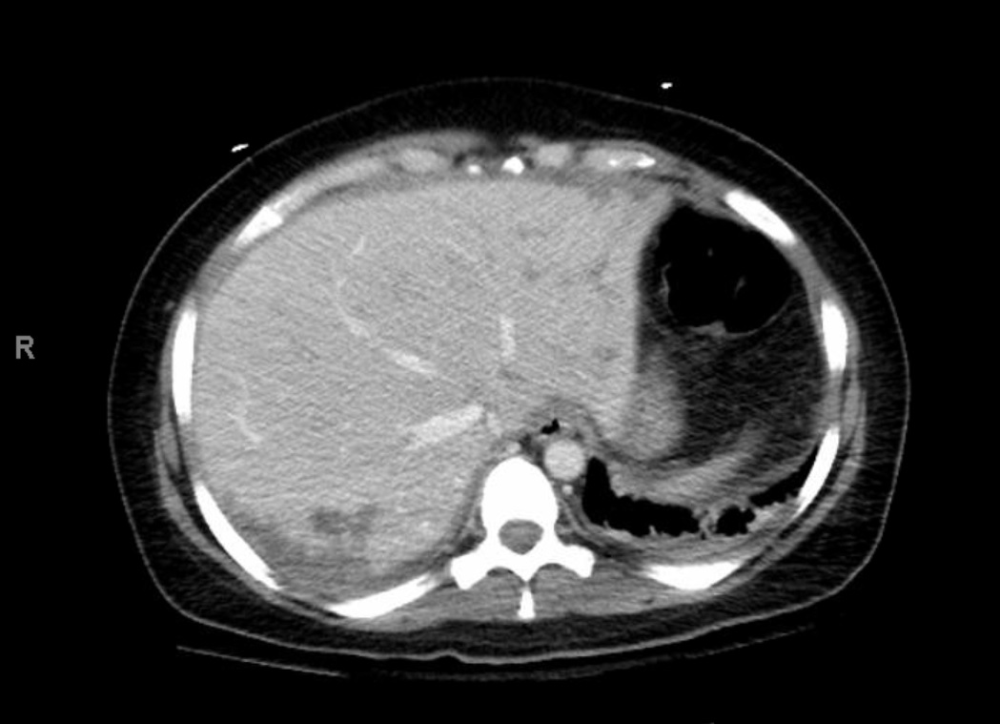
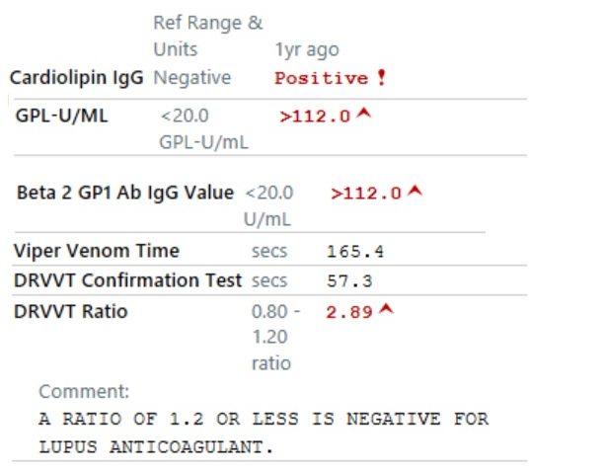
        A Case of CAPS – a comprehensive review of treatment modalities
        Meg Byrne, MS4; Melody Tran, M.D.; Farah Shaheen, M.D.; Richard White, M.D.
        University of California, Davis Medical Center; Sacramento, CA
Introduction
Clinical Data
Treatment Modalities
Catastrophic Anti-Phospholipid Syndrome (CAPS) is a rare autoimmune disorder characterized by widespread small vessel thromboembolic events in multiple organs. There are four diagnostic criteria:
presence of antiphospholipid antibodies
histopathological evidence of small vessel occlusion
involvement of 3 or more organ systems
development of manifestations in <1 week
A triple therapy approach of anticoagulation, corticosteroids, and therapeutic plasma exchange (TPE) or IVIG has been shown to decrease mortality. However, there are no prospective trials exist to guide chronic management, and the optimal timing and frequency of these treatments is unknown. We present the case of a patient with definitive and recurrent CAPS, and our experience with the chronic management of this rare condition.
Figure 1: CT Abdomen revealing progression of “multiple, ill-defined, hypodense lesions throughout the liver”, caused by multifocal thrombosed vessels.
Treatment modality Dates we used | Mechanism of action | Experience in our case
Anticoagulation throughout disease course | Intervene at different steps of coagulation cascade to prevent the process over-stimulated by anti-phospholipid antibodies | Warfarin contraindicated due to difficulty in monitoring (unreliable INR). No clear difference in disease modifying effects with prolonged use of rivaroxaban, lovenox, dabigatran
Corticosteroids high dose infusions in most flares; less use since Fall 2019 | Decrease inflammatory production of auto-antibodies | High dose infusions unable to decrease flare symptoms unless paired with Plasma Exchange
Therapeutic Plasma Exchange all flares except most recent Dec 019 - present | Remove harmful antibodies | Initially successful at decreasing symptoms during active flares; weaning efficacy over time
Mycophenolate Mofetil April 2018-May 2018 | Decreases division and antibody production of rapidly dividing immune cells | Took an abbreviated maintenance course during a period of disease remission; unclear efficacy
Cyclophosphamide Nov 2018 – July 2019 | Apoptosis of rapidly dividing immune cells | Unsuccessful at decreasing frequency of flares despite receiving a full course (9 monthly infusions)
Rituximab Aug 2019– Oct 2019 | Deplete B cells producing auto-antibodies | Possibly harmful – flared twice within days of receiving infusion
IVIG Dec 2019 - present | Bind and neutralize harmful auto-antibodies | Tentatively successful to date; appears to have slowed frequency of flares
  Figure 2: Initial results of her antiphospholipid antibody panel.
  Dilute Russell’s viper venom time (DRVVT) ratio: indicates the presence of lupus anticoagulant.
  Her anti-cardiolipin and anti-beta2glycoprotein antibodies have generally been too high to quantify every time they are measured.
  “GPL” refers to IgG phospholipid antigens and represents a measuring unit of anti-cardiolipin antibodies.
Case Presentation
A 40-year-old woman, with history of first trimester pregnancy loss, presented with subacute, progressive sharp right upper quadrant (RUQ) abdominal pain with associated rash.
Exam: febrile, tachycardic; RUQ tenderness; maculopapular rash of face and chest
W/u: CT abd concerning for liver abscesses. Liver biopsies benign; rash punch biopsy: vasculitis
Empiric sepsis treatment
→ clinical status worsens: chest pain, elevated troponin, consistent with demand ischemia; abdominal pain worsening
Repeat CT: hepatic infarcts, portal vein thrombosis, and bilateral adrenal hemorrhage
All three antiphospholipid antibodies present
→ CAPS diagnosis made
Pulse IV steroids and heparin initiated; some improvement, but then develops DIC
Urgent TPE initiated with significant clinical and laboratory improvement. She was discharged after 8 total sessions
She has since experienced recurrent flares. Her flares have presented similarly each time – maculopapular rash of the face and chest, RUQ pain, fever, and tachycardia.
References
Cervera, Ricard, Ignasi Rodriguez-Pinto, and Gerard Espinosa. "The diagnosis and clinical management of the catastrophic antiphospholipid syndrome: a comprehensive review." Journal of autoimmunity 92 (2018): 1-11.
Padmanabhan A, Connelly-smith L, Aqui N, et al. Guidelines on the Use of Therapeutic Apheresis in Clinical Practice - Evidence-Based Approach from the Writing Committee of the American Society for Apheresis: The Eighth Special Issue. J Clin Apher. 2019;34(3):171-354.
Kumar, Deepak, and Robert AS Roubey. "Use of rituximab in the antiphospholipid syndrome." Current rheumatology reports 12.1 (2010): 40-44.
Katz, Uriel, Yehuda Shoenfeld, and Gisele Zandman-Goddard. "Update on intravenous immunoglobulins (IVIg) mechanisms of action and off-label use in autoimmune diseases." Current pharmaceutical design 17.29 (2011): 3166-3175.
Touma, Zahi, et al. "Mycophenolate mofetil for induction treatment of lupus nephritis: a systematic review and metaanalysis." The Journal of rheumatology 38.1 (2011): 69-78.
Rodríguez-Pintó, Ignasi, et al. "The effect of triple therapy on the mortality of catastrophic anti-phospholipid syndrome patients." Rheumatology 57.7 (2018): 1264-1270.
Figure 3: The case presentation described occurred in March 2018. As demonstrated, since diagnosis, her flares have been occurring more frequently. Refer to dates seen in treatment table to the right for different escalations in treatment modalities at selected time points. Initially, her disease appeared to respond best to Plasma Exchange; however, over time, its efficacy appeared to wane, as demonstrated by the increased frequency of her presentations.

