Slide 1
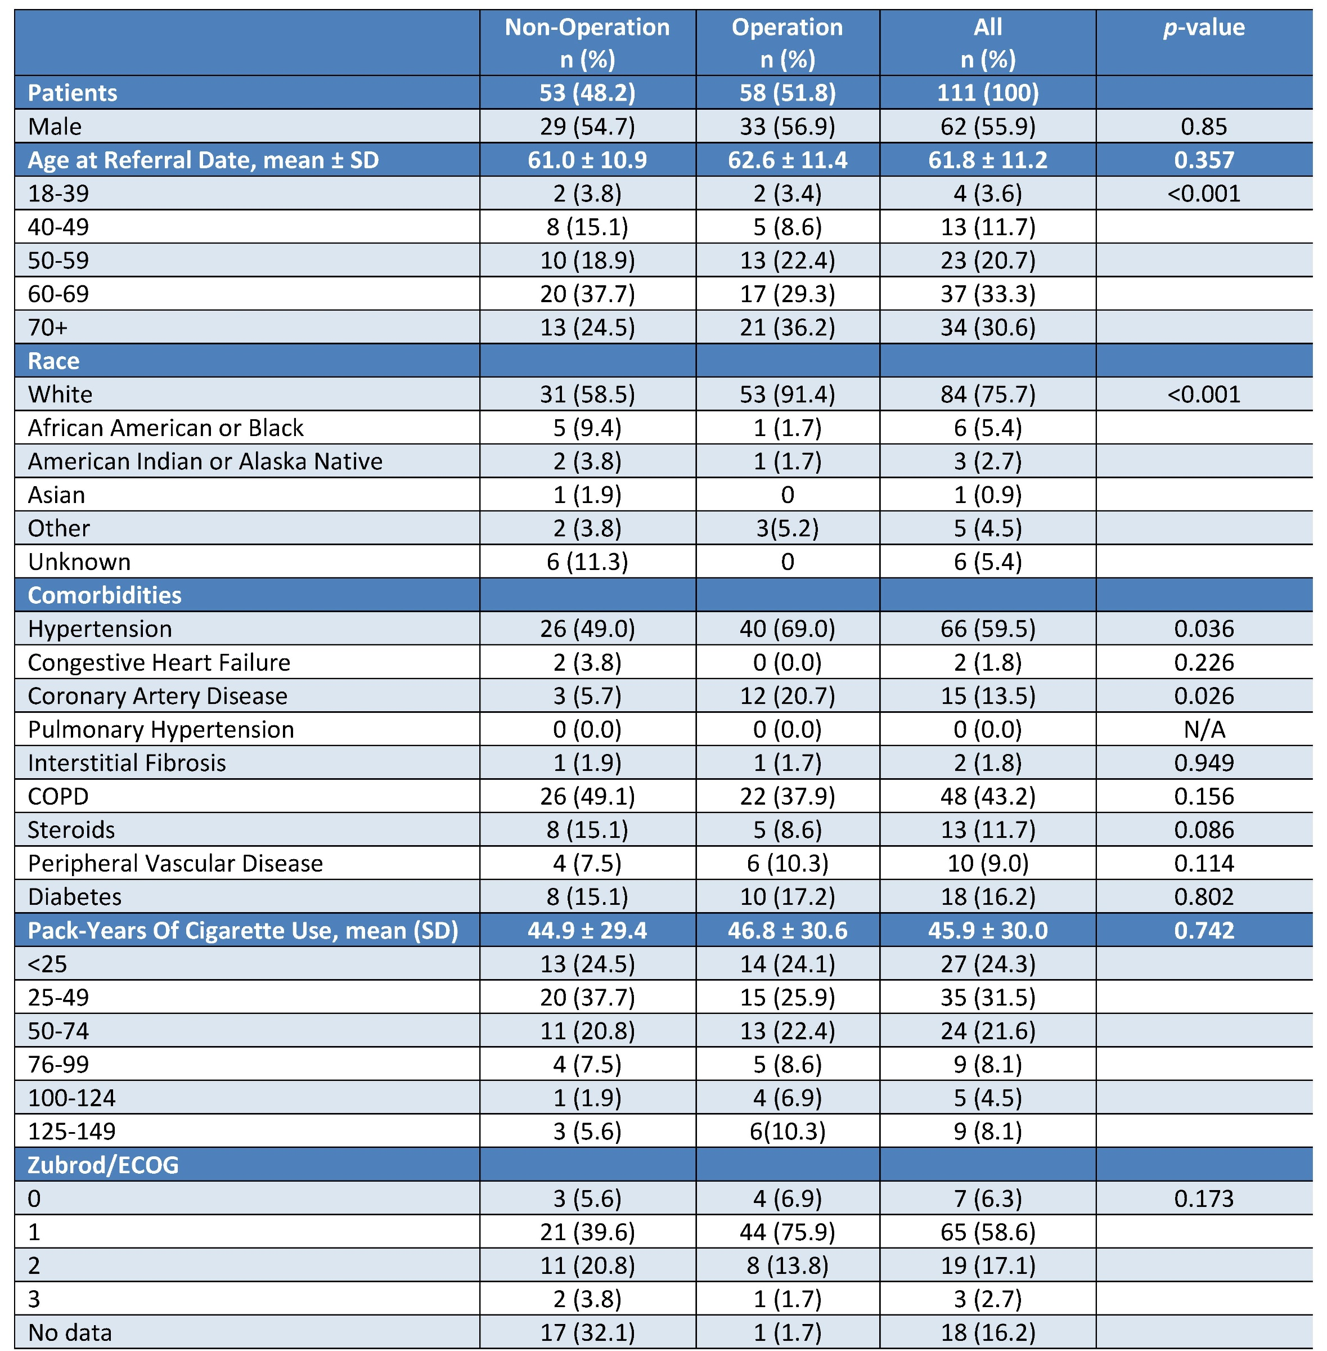
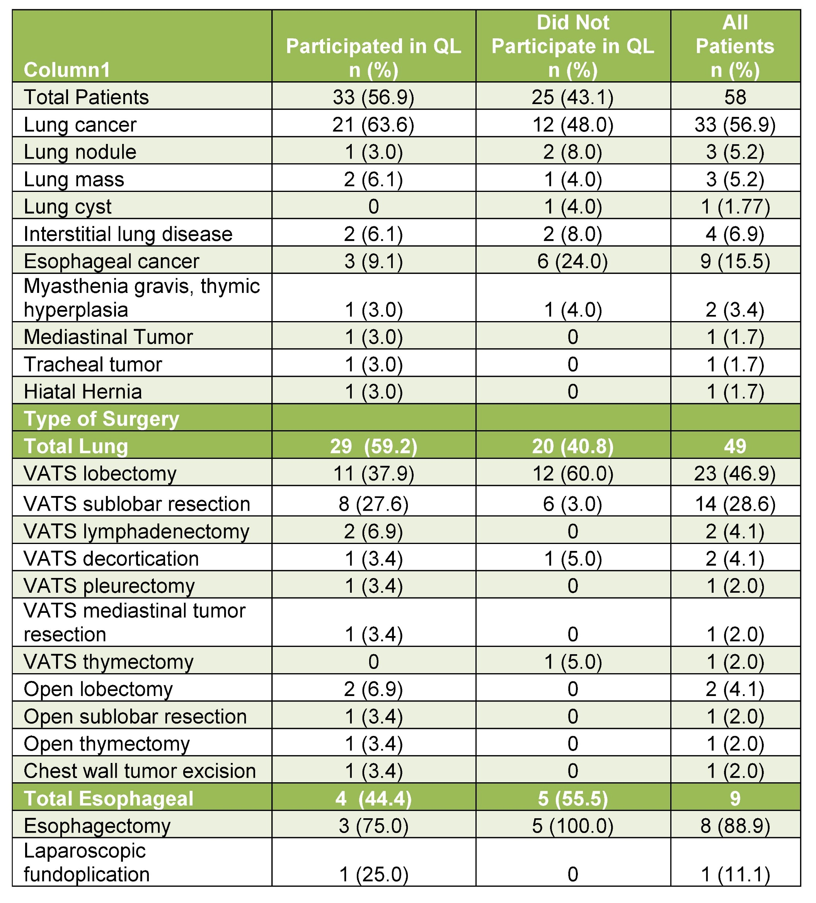
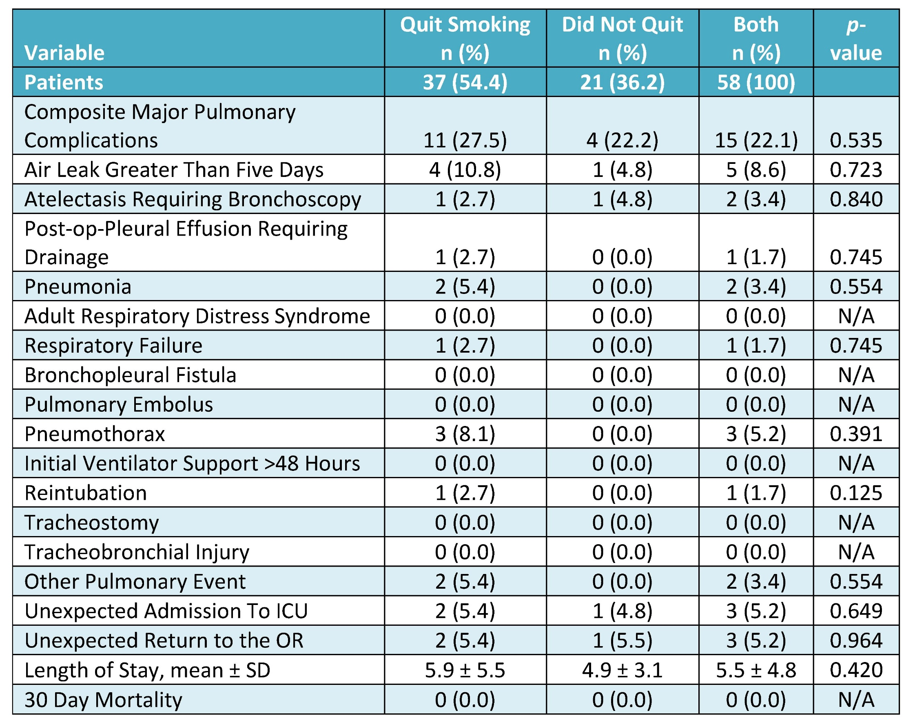
Thoracic Surgery and Population Health: Efficacy of a Voluntary Smoking Cessation Quit Line Intervention in the Thoracic Surgical Clinic
Mollie Mustoe, BA, James M. Clark, MD, Timothy Huynh, BA, Lisa M. Brown, MD, MAS, David T. Cooke, MD
Section of General Thoracic Surgery, Department of Surgery, University of California, Davis Health
Background & Purpose
Smoking Quit Line (QL) programs utilizing free education and telephone counseling services have been well demonstrated to effectively promote smoking cessation in outpatient primary care settings. Given that active smoking increases pulmonary complications after thoracic surgery,¹ we sought to evaluate the efficacy of the voluntary California Smoker’s Helpline (CSH) QL program in the setting of a thoracic surgery preoperative clinic and tested the hypothesis that patients undergoing surgery would have higher durability of smoking cessation after QL intervention compared historical non-surgical figures.
Results
Table 1: Demographics of patients referred to Quit Line,
stratified by operation status Table 2: Diagnosis and Operation Type for Operation Cohort
Table 3: Smoking Cessation Outcomes for Non-Operation Cohort
Table 4: Smoking Cessation Outcomes for Procedure Cohort
Table 5: Postoperative Pulmonary Complications
Discussion
Patients undergoing thoracic surgery were nearly twice as likely to quit smoking, regardless of QL referral.
Smoke-free durability was comparable in non-operative patients regardless of participation in the QL program
Operative patients had comparable preoperative quit-rates regardless of QL referral, but those participating in the QL had higher smoke-free durability at the postoperative visit and at 6 months, with rates higher than with CSHQL results (24% and 13% at 1 month and 6 months, respectively) in a general healthcare setting.²
Conclusions
Patients undergoing a thoracic operation are more motivated to quit smoking.
In-office preoperative smoking cessation counseling is effective, but durability improves with an adjunct such as referral to a QL program.
As such, subspecialty clinicians can dramatically improve smoking cessation rates even in non-operative patients with appropriate outpatient counseling, and intervention.
These results of an optional “Opt-In” QL referral program will serve as a comparison to our recently launched “Opt-Out” QL program in the thoracic surgery clinic.
Design & Methods
We identified active smoking patients referred to the voluntary QL from a thoracic surgery preoperative clinic visit. We merged demographic, clinical, and perioperative data with QL data regarding participation in the program and success and durability of smoking cessation. Primary outcome was successful participation in the QL program. Secondary outcomes included smoking cessation preoperatively, and continued cessation at 1 month or the first postoperative visit and 6 months, postoperative complications, length of stay, and 30 day mortality.
Demographic and clinical variables were compared with contingency tables and t-test analysis. Predictors of participation in the QL program were assessed with logistic regression modeling.
On logistic regression modelling, there were no predictors of a referred patient to choose to enroll in the QL program, however having an operation increased the odds of smoke-free durability at the postoperative visit/1month by 2.6 x (p=0.005).
References
Lugg ST, et al. Smoking and timing of cessation on postoperative pulmonary complications after curative-intent lung cancer surgery. J Cardiothorac Surg 2017;12:52. doi:10.1186/s13019-017-0614-4.
Zhu SH, et al. Evidence of Real-World Effectiveness of a Telephone Quitline for Smokers. The New England Journal of Medicine, vol. 347, no. 14, 2002, pp. 1087–1093. doi:10.1056/NEJMsa020660
Analysis
Contingency table and t-test analysis were used to compare demographic and clinical outcomes. Logistic regression was used to evaluate predictors of participating in the QL program.
Funding & Acknowledgements
Research was supported by the Lillian Mae Rapp Endowment of the UC Davis Medical Student Research Fellowship and the American Association for Thoracic Surgery Summer Intern Scholarship.

