Slide 1
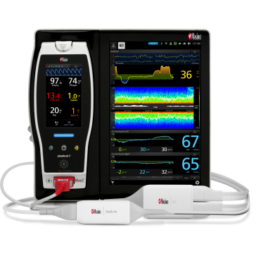
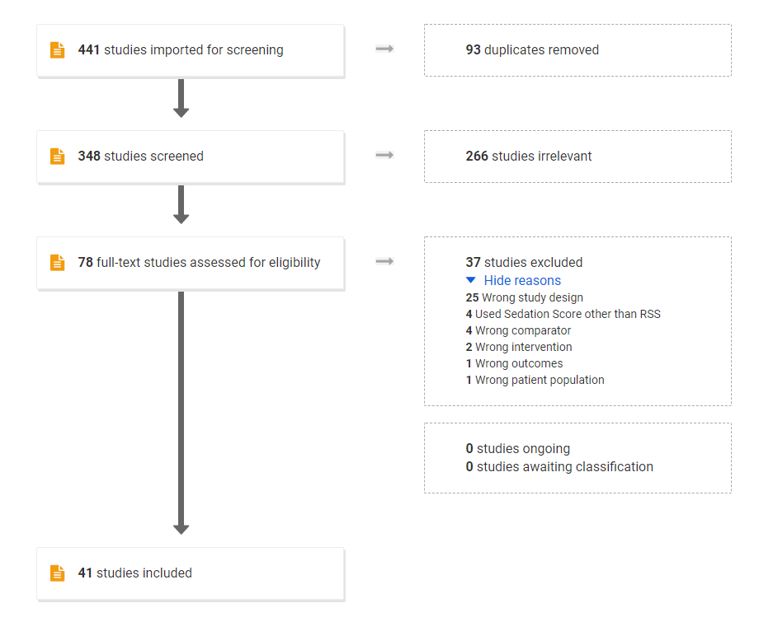
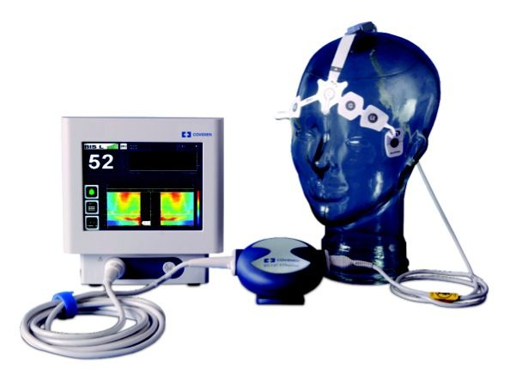
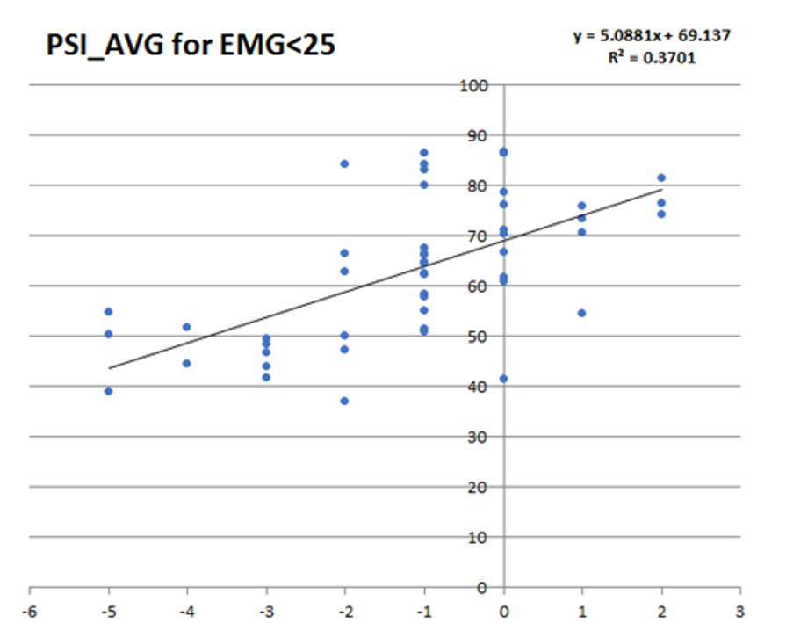
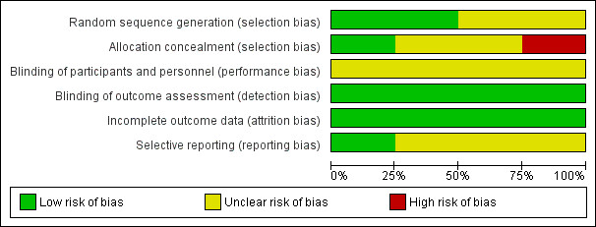
Utilization of processed EEG’s to evaluate depth of sedation in Critically Ill patients: A Systematic Literature Review
Daniel Dinh B.A., Richard Applegate II, M.D., Neal Fleming, M.D. Ph.D.
University of California, Davis, Department of Anesthesiology & Pain Medicine
Introduction
Methods
Summary
Maintaining accurate measurements of sedation in the ICU are essential for patient comfort, safety, and clinical outcomes
Current clinical sedation scales, such as the Richmond Agitation-Sedation Scale (RASS) suffer from subjectivity and poor inter-rater reliability
Processed EEGs (pEEGs) may provide a more objective and reliable alternative to assess depth of sedation in ICU patients
In this study, we conducted a systematic literature review on 3 major pEEGs (Masimo Sedline, Bispectral Index, and Narcotrend) and their correlation with gold standard clinical sedation scales
Here we have demonstrated a method for how a clinical question like ours may be addressed using a systematic literature review
From our preliminary screenings, we have discovered that there are few studies that evaluate Masimo Sedline and Narcotrend in relationship to the gold clinical standard clinical sedation scores in comparison to Medtronic’s BIS
Out of 441 studies initially imported by our search algorithm, 41 studies were included and are currently undergoing data extraction and quality assessment
Figure 2. Medtronic BIS
Figure 1. Masimo Sedline
Further Study
 | Paralytics used | Withdrawals and exclusions
Study ID | Type of ICU | Age (Mean, median, range, etc.)
Title | Inclusion Criteria | Sex (number/%, etc.)
Lead author contact Details | Exclusion Criteria | Race/Ethnicity
Country | Total number of patients | Diagnosis
Aim of Study | Baseline imbalances | Comorbidities
Study Design | Withdrawals and exclusions | Additional study interventions
Start Date | Age (Mean, median, range, etc.) | Method of recruitment
End Date | Sex (number/%, etc.) | Processed EEG used
Study funding resources | Race/Ethnicity | Total Duration of EEG
Possible conflicts of interest | Diagnosis | Clinical Assessment comparison
Total Study duration | Comorbidities | Correlation Coefficient
Severity of illness scoring system | Paralytics used | Withdrawals and exclusions
Possible conflicts of interest | Type of ICU | Age (Mean, median, range, etc.)
Total Study duration | Inclusion Criteria | Sex (number/%, etc.)
Total Study duration | Exclusion Criteria | Race/Ethnicity
Severity of illness scoring system | Total number of patients | Diagnosis
Sedatives Used (name, dosage, #patients) | Baseline imbalances | Comorbidities
Future work will focus on continued data extraction and quality assessment to help us understand their comparison to the gold standard clinical sedation scores and evaluate their clinical outcomes
Figure 4. Review Flow Diagram
Figure 3. RASS vs PSI
Relevant studies underwent data extraction and quality assessment generated by the reviewers
Methods
References
Population: Adults 18+, Critically ill patients (MICU, SICU) requiring sedation in ICU setting; utilization of 3 major pEEGs
To determine relevant citations, we consulted Bruce T. Abbots (UC Davis Health Sciences Librarian, Blaisdell Medical Library) to optimize search patterns and conducted a computerized search in PubMed, Embase, Cochrane Database from 1996-2020 with key terms related to pEEGs and ICU sedation
Studies were imported into Covidence (www.covidence.org), an online systematic literature review tool) and were screened independently by two reviewers for relevance by abstract and full text, and a consensus was made for any conflicts
Khalid S Khan MB MSc Regina Kunz MD MSc, Jos Kleijnen MD PhD,Gerd Antes PhD Five steps to conducting a systematic review. J R Soc Med 2003;96:118–121
Shetty RM, Bellini A, Wijayatilake DS, Hamilton MA, Jain R, Karanth S, Namachivayam A. BIS monitoring versus clinical assessment for sedation in mechanically ventilated adults in the intensive care unit and its impact on clinical outcomes and resource utilization. Cochrane Database Syst Rev. 2018 Feb 21;2(2):CD011240
Figure 5. Data Extraction Template
Figure 6. Quality Assessment Example Shetty et al. 2018

