Slide 1

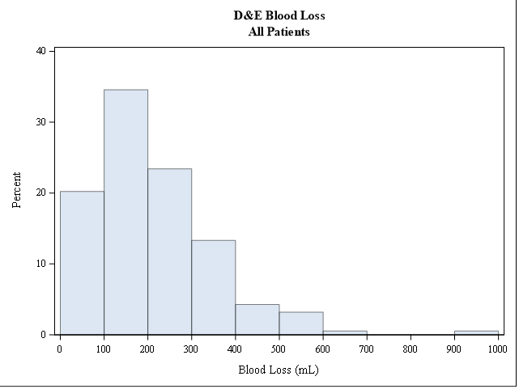
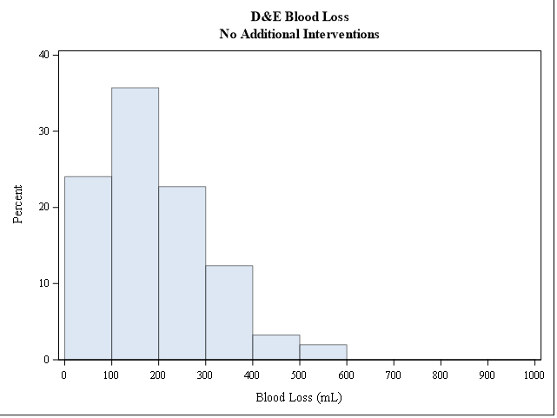
Using Quantitative Blood Loss to Define Hemorrhage in Post-abortion Patients
Cassandra Gilbert (MS2), Melissa Matulich, M.D., M.A.S., Mitchell D. Creinin, M.D.
Department of Obstetrics and Gynecology, University of California Davis Medical Center
Introduction
Objective
Hypothesis
The variability in the amount of blood loss used as a “definition” of hemorrhage in various studies is related to the lack of any study correlating blood loss to clinically relevant outcomes. A clear definition is needed to standardize future research on procedural morbidity and interventions to decrease significant blood loss.
To identify a quantitative blood loss during dilation and evacuation (D&E) procedures that correlates with clinically relevant outcomes to allow a clearer definition of “hemorrhage” as a procedural complication.
Median quantitative blood loss (mQBL) will correlate with the rate of post-procedure interventions needed to prevent/manage bleeding and identify an amount of blood loss to clinically define “hemorrhage.”
Results
Methods
≤ 1 Intervention Groups | N | mQBL [Q1, Q3]
All Patients No Uterotonics 1 Uterotonic | 188 154 34 | 155 [100, 250] 150 [100, 225] 250 [150, 350]
Reviewed 194 D&E procedures from 5/1/2019 – 10/31/2019 from a de-identified database
mQBL correlated to the number of above standard post-procedure interventions needed related to bleeding
Data was analyzed using SAS software version 9.4
Uterine Factors mQBL | Qualifying Interventions
250 mL | 2 uterotonics: methylergonovine in OR and PACU
450 mL | 2 uterotonics: methylergonovine in OR and PACU
1635 mL intraop, 2500+ mL overall | Uterotonic in PACU (methylergonovine), Tranexamic Acid administration, Uterine balloon tamponade, Blood transfusion
Demographics
Demographic | N (%)
Age | 28.6 ± 6.7
Hispanic or Latino Ethnicity Not Hispanic or Latino Unknown/Declined to State | 130 (69.2%) 55 (29.3%) 3 (1.6%)
White Black or African American Race Asian Other Declined to State Unknown/Unavailable | 78 (41.5%) 45 (23.9%) 15 (8.0%) 10 (5.3%) 38 (20.2%) 2 (1.1%)
Obese (≥30 kg/m²) | 73 (38.8%)
Previous Cesarean Delivery | 62 (33.0%)
< 20 wks Gestational Age 20 wks – 21 wks 6 days ≥ 22 wks | 103 (54.8%) 44 (23.4%) 41 (21.8%)
1 2 Gravidity 3 4 5 ≥6 | 31 (16.5%) 26 (13.8%) 32 (17.0%) 31 (16.5%) 26 (13.8%) 42 (22.3%)
0 Parity 1 2 ≥3 | 47 (25.0%) 45 (23.9%) 48 (25.5%) 48 (25.5%)
Cervical Factors mQBL | Qualifying Interventions
300 mL | Return to OR from PACU, cervical laceration requiring repair
450mL | Cervical laceration requiring repair
Conclusions
Based on our limited findings, no single amount of blood loss is easily correlated with clinical “hemorrhage.”
Limitations: We noted relatively few events requiring interventions for bleeding-related complications; a larger sample may demonstrate a clearer correlation of QBL and “hemorrhage.”
This is an ongoing research project. Investigation will continue to include 12 months of D&E procedures (3/1/2019- 4/30/2020) to examine a larger sample of data.

