Slide 1

Comparison of Depth of Sedation Performance between SedLine and BIS during General Anesthesia: Background and Protocol Development
Penelope Kim-Lim BS, Linda Vo AB, James H. Jones MD, Richard L. Applegate II MD, Neal W. Fleming MD PhD, Department of Anesthesiology and Pain Medicine, University of California, Davis, Sacramento, CA

Slide 2
Background
The ideal end-tidal concentration of anesthetic dose for a patient under general anesthesia is dynamic and depends on factors.
At present, no individual brain function monitoring device has been shown to be substantially superior.
Prior studies have attempted to compare the performance of these devices, but a lack of space and common placement locations compromises interpretation.
The aim of this protocol is to examine the concordance between processed EEG indices (BIS and PSI) and anesthesia provider assessments across a range of anesthetic depths using a custom engineered interface box.

Slide 3
Hypothesis
We hypothesized that processed EEG indices from BIS and PSI (SedLine) monitors can be measured simultaneously using individual electrode placement and a custom designed interface box to combine and split signals, thus allowing performance to be compared across a broad range of anesthetic depths.
This data collection system allows us to investigate the concordance between these monitors and real-time clinical assessments of anesthetic depth.

Slide 4
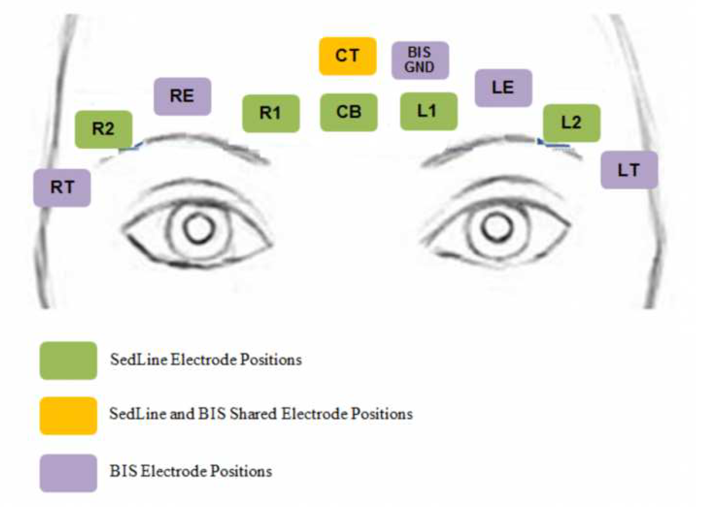
Study Design
Data collection system: prospective, non-randomized, non-blinded trial
Individual and uniquely-designed interface box that allow simultaneous collection of both monitoring indices at once

Slide 5
Inclusion Criteria
Patients aged 18 years or older
American Society of Anesthesiologists’ (ASA) status I-III
English-speaking
Scheduled for surgical or non-surgical procedures requiring general anesthesia

Slide 6
Exclusion Criteria
Any deformities or devices that may prevent application of EEG sensors to the patient’s forehead
Developmental delay
Other conditions for which the patient is otherwise deemed not suitable for the study at the discretion of the investigator

Slide 7
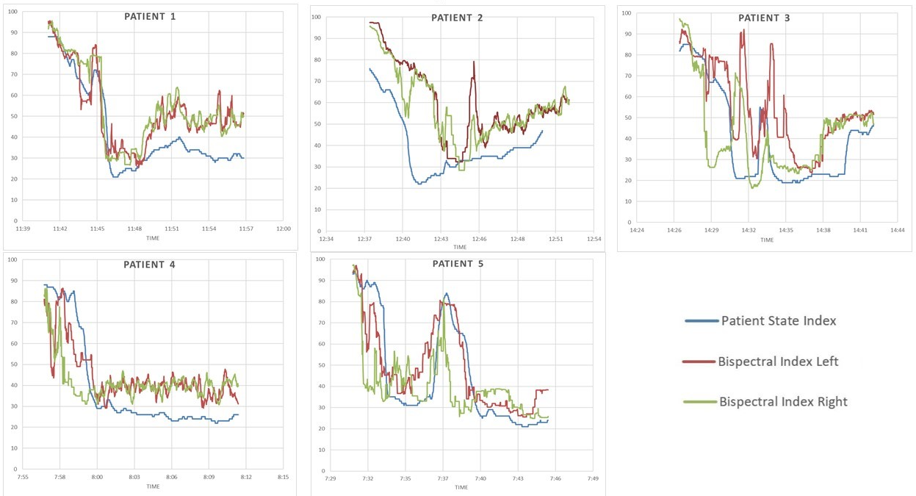
Preliminary Results
Notes:
H

Slide 8
Discussion
We present a novel data collection system that will support a prospective, non-blinded, non-randomized study to concurrently compare the performance of processed EEG indices from BIS and SedLine monitors using a standardized protocol and node placement.
In addition, our inclusion of standardized clinical observations in real-time and collection of raw and processed EEG waveforms will allow us to investigate the agreement of BIS and PSI indices across a wide range of anesthetic depths and establish correlations to clinical assessments.
Real-time, simultaneous comparison of brain function monitoring devices using this electronic interface is the only way by which we can confidently and accurately investigate differences in proprietary algorithms.

Slide 9
Future Directions
Overall, BIS and PSI indices appear to change in parallel during general anesthesia induction for our first 5 patients.
This study is currently in the recruitment phase. Earlier publication of our study design was delayed so that the electrode sensors, custom-built passive interface box, and data collection system could be appropriately evaluated in clinical practice.
Further research with our design will be necessary given the potential benefits of accurately assessing anesthetic depth.
This protocol will further improve the body of literature that exists on concordance of PSI and BIS with a custom engineered and standardized node array for accurate interpretation.

Slide 10
Acknowledgements
Masimo, Inc provided support for the construction and assembly of the data collection hardware and software of this study.

