Slide 1

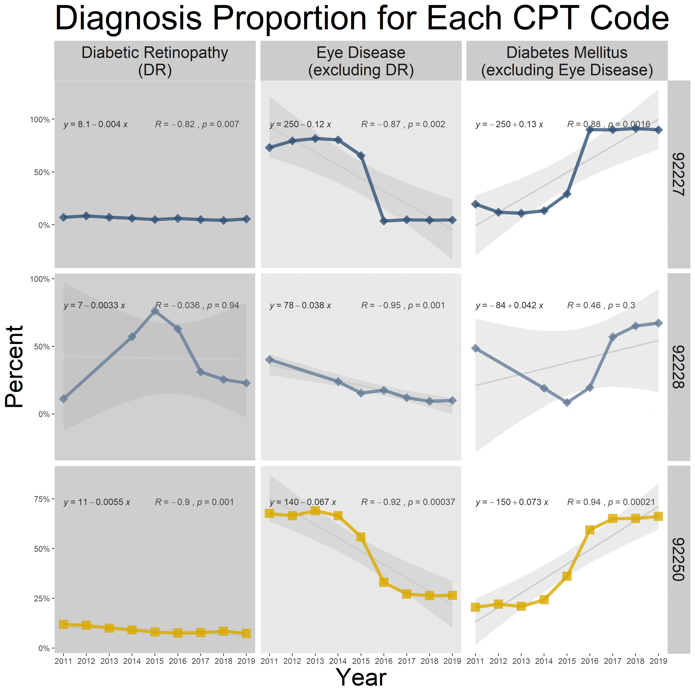
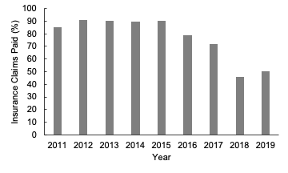
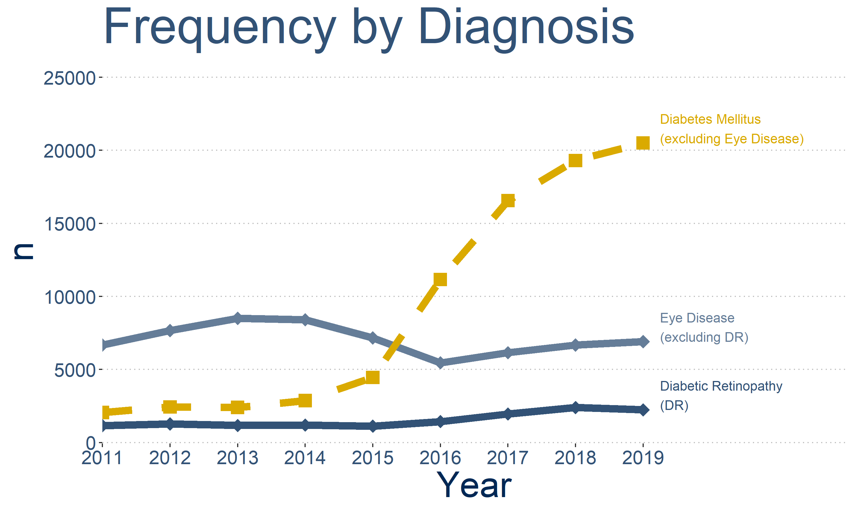
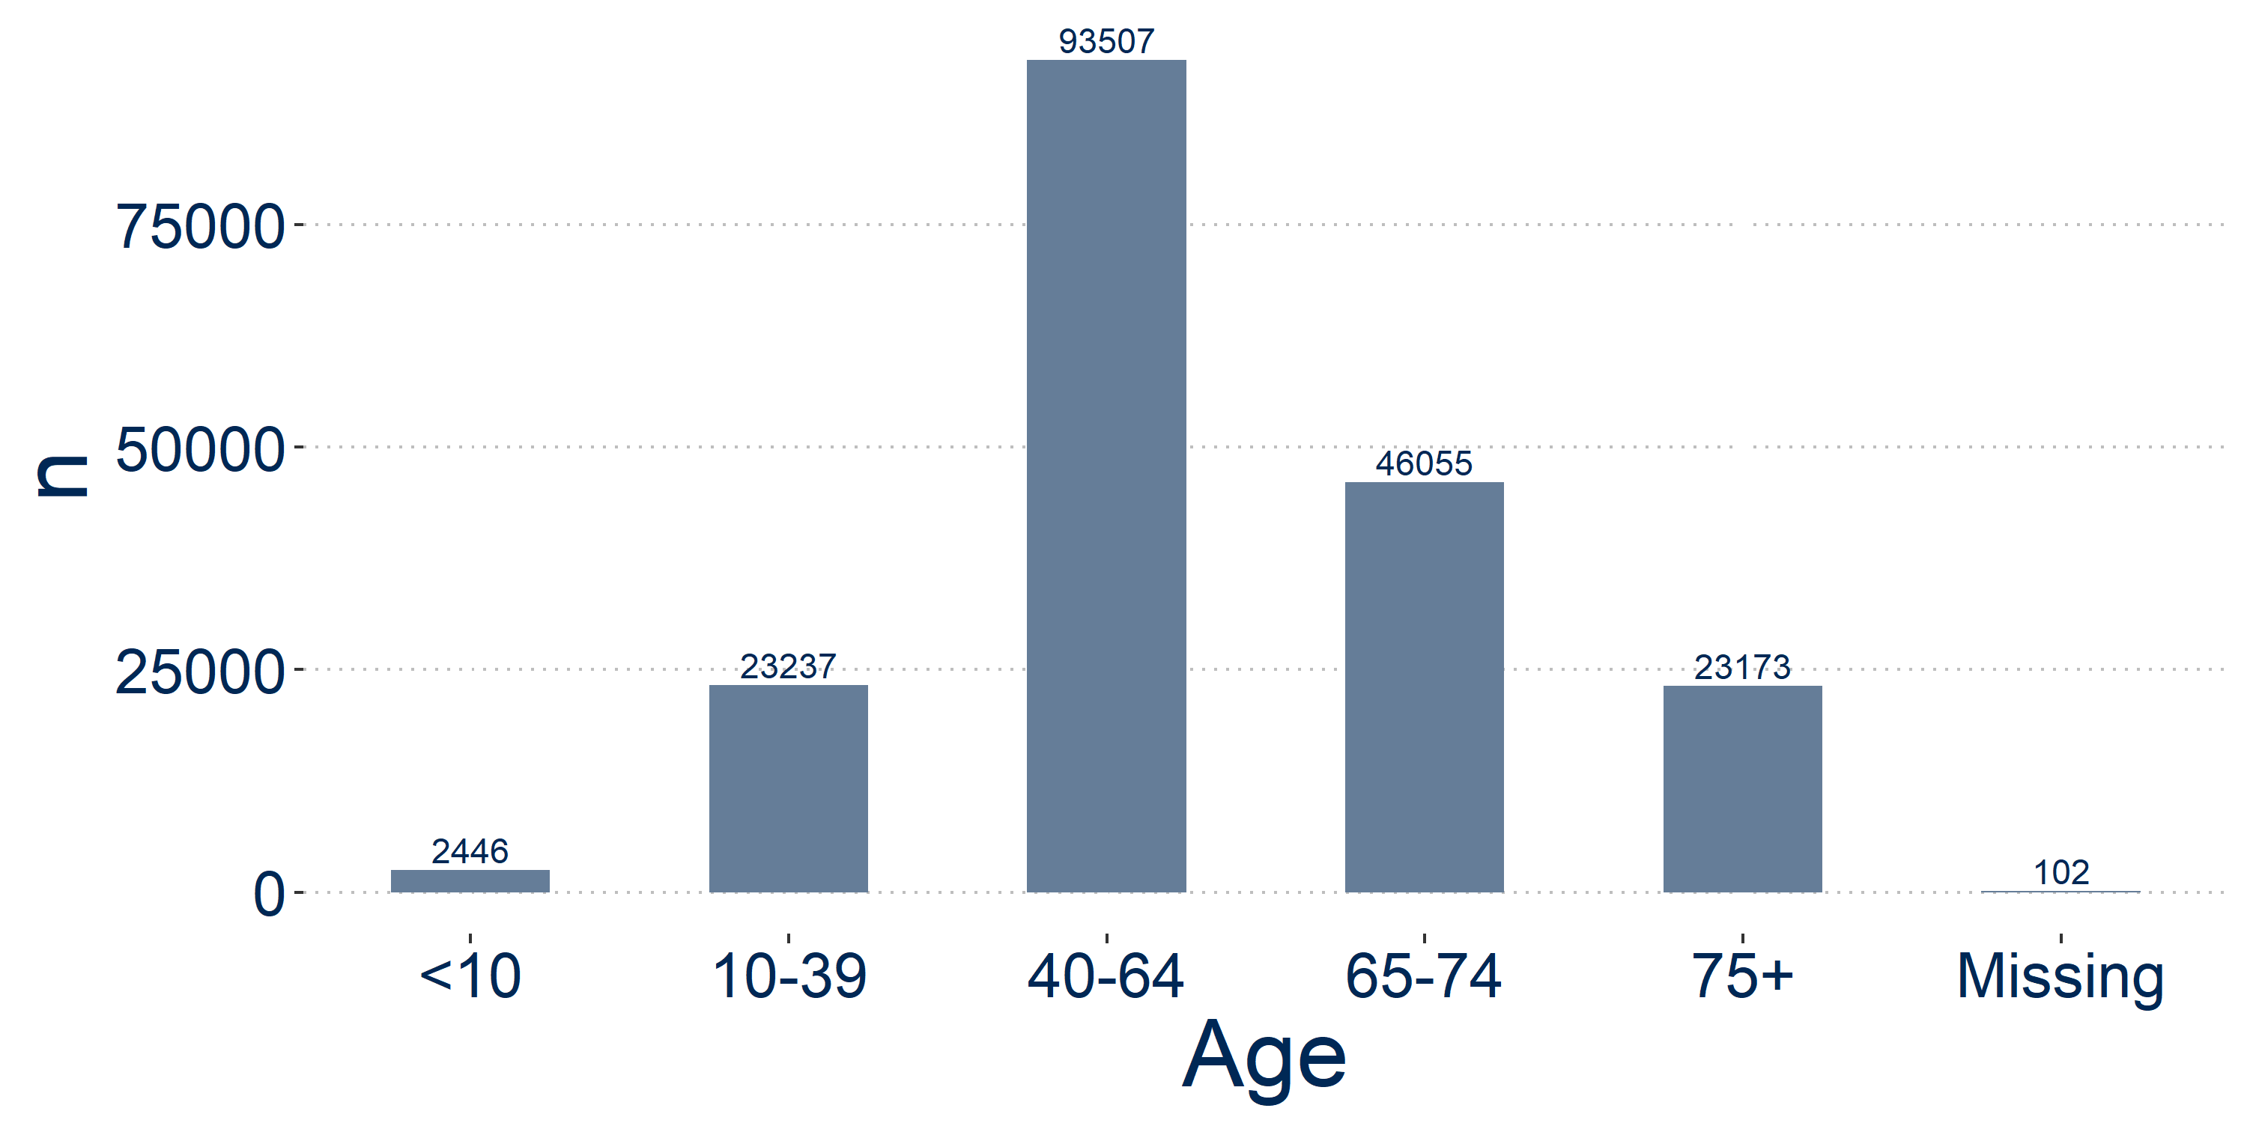
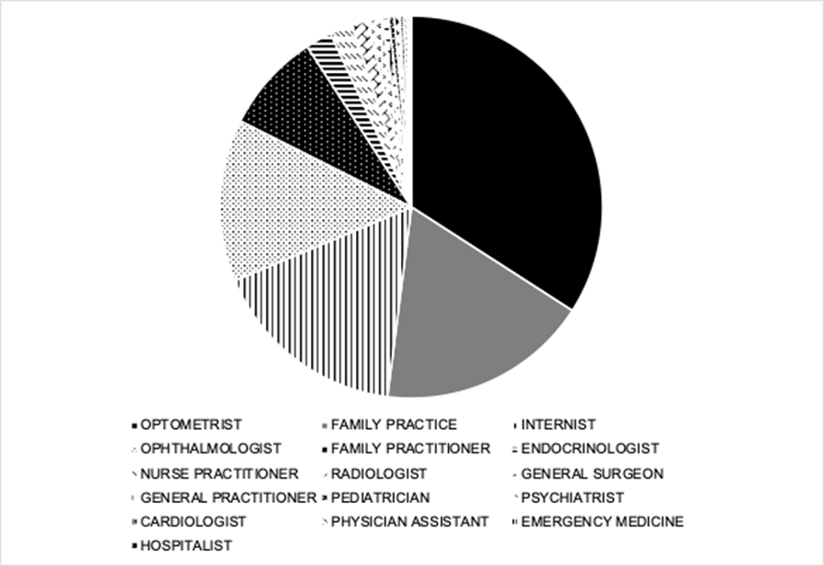
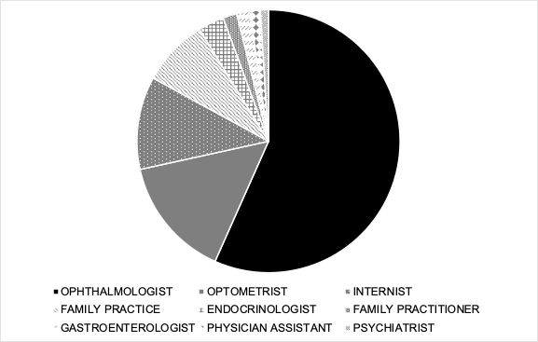
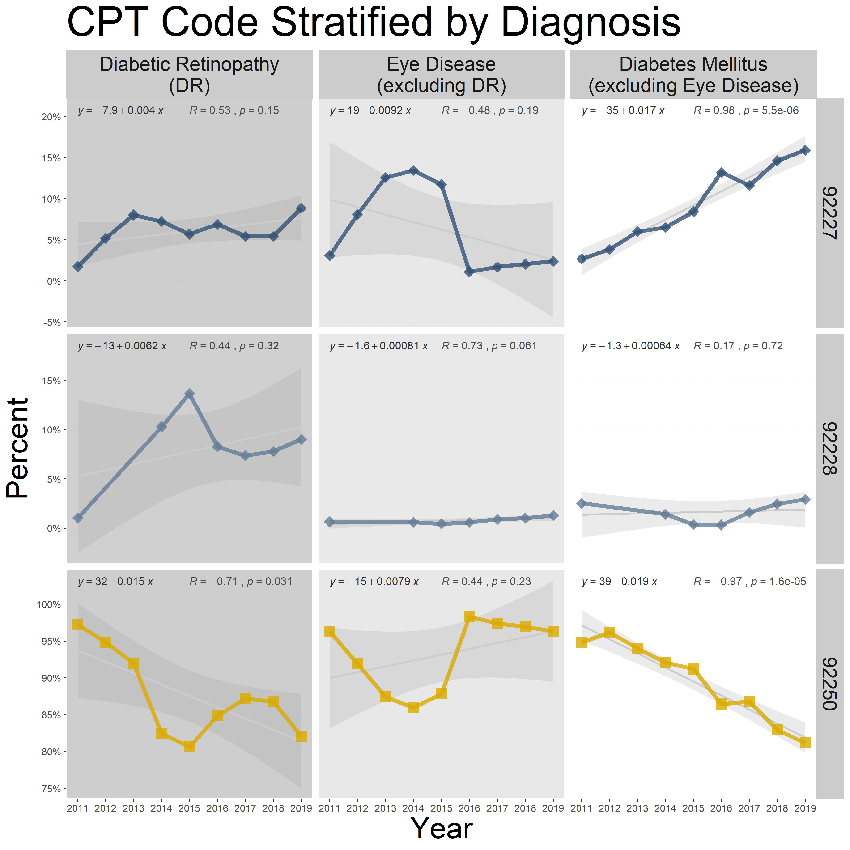
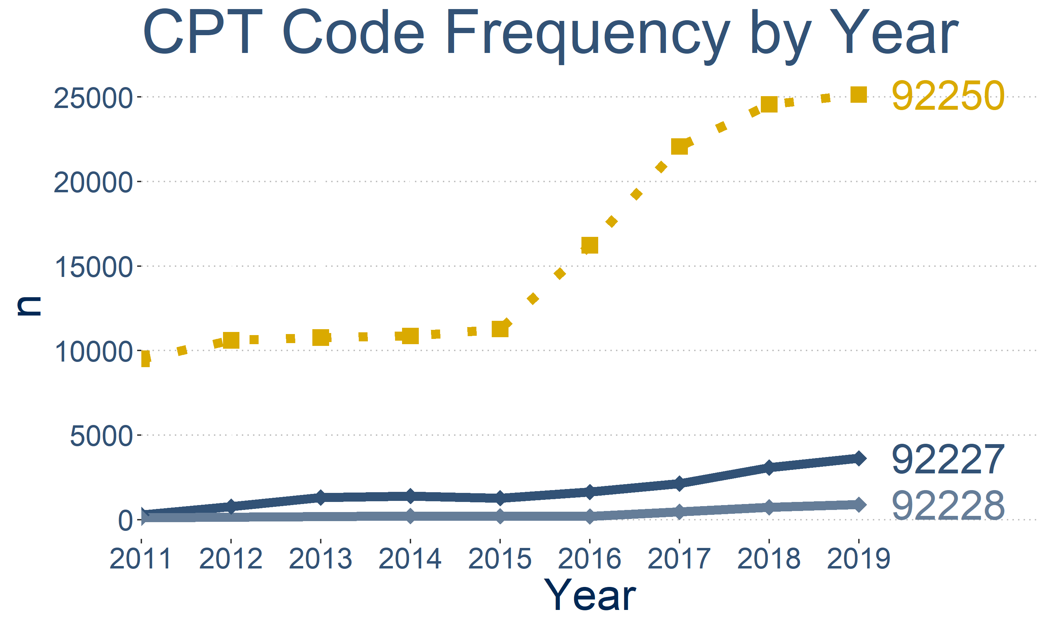

Characterization of Tele-Ophthalmology Use from 2011-2019
Department of Ophthalmology
Monica K. Lieng, PhD & Sophie C. Lee, BS
Neesurg Mehta, MD
Susan Alber, PhD
Parisa Emami-Naeini, MD, MPH
Glenn Yiu, MD, PhD
Introduction
Results
Inequities in distribution of specialty ophthalmology care¹
Increased studies demonstrating efficacy, cost efficiency of teleophthalmology^{2,3}
Rising concerns of compensation, perhaps hindering adoption⁴
AIM: Describe tele-ophthalmology use by year, provider specialty and patient demographics
Age Distribution
Diabetic retinopathy screening increased
CPT by specialty
Conclusions
Utilization increased
Unadjusted utilization rapidly increased after 2015
Lower proportion of claims paid in recent years
Study Design/Methods
Deidentified claims data from 2011-2019 from OptumLabs Data Warehouse®
Population: Patients with documented tele-ophthalmology visits
Future Directions
Claim payment amount stratified by CPT code
Multivariable logistic regression predicting claim payment/denial
 | Asynchronous Fundoscopic Image |  | Fundoscopic Image
CPT codes | 92227 | 92228 | 92250
 | Diabetic Retinopathy |  | General
Use | Screening | Monitoring | General
Avg. Reimburse | $15 | $13 | $22-50
RVU | 0.97 | 0.43 | 1.43
References
% claims paid decreased
Feng PW, Ahluwalia A, Feng H, Adelman RA. National Trends in the United States Eye Care Workforce from 1995 to 2017. Am J Ophthalmol 2020;218:128-35.
Kawaguchi A, Sharafeldin N, Sundaram A, et al. Tele-Ophthalmology for Age-Related Macular Degeneration and Diabetic Retinopathy Screening: A Systematic Review and Meta-Analysis. Telemed J E Health 2018;24(4):301-8.
Rathi S, Tsui E, Mehta N, et al. The Current State of Teleophthalmology in the United States. Ophthalmology 2017;124(12):1729-34.
Ellis MP, Bacorn C, Luu KY, et al. Cost Analysis of Teleophthalmology Screening for Diabetic Retinopathy Using Teleophthalmology Billing Codes. Ophthalmic Surg Lasers Imaging Retina 2020;51(5):S26-S34.
92227
92228
This where copy goes
92227
Variables Collected: Demographics, Physician Specialty
Descriptive statistics: t-tests & chi-square in SAS
Plots using ggplot2 in R environment
92228
92250
Acknowledgements
OptumLabs Visiting Fellow: Dr. Glenn Yiu, MD PhD

