Slide 1

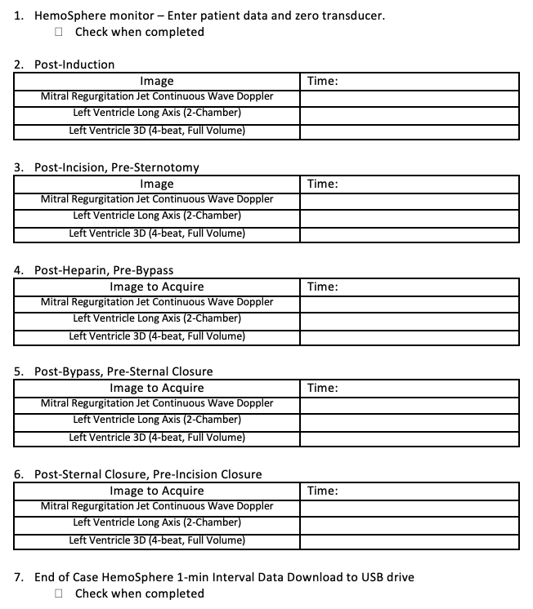
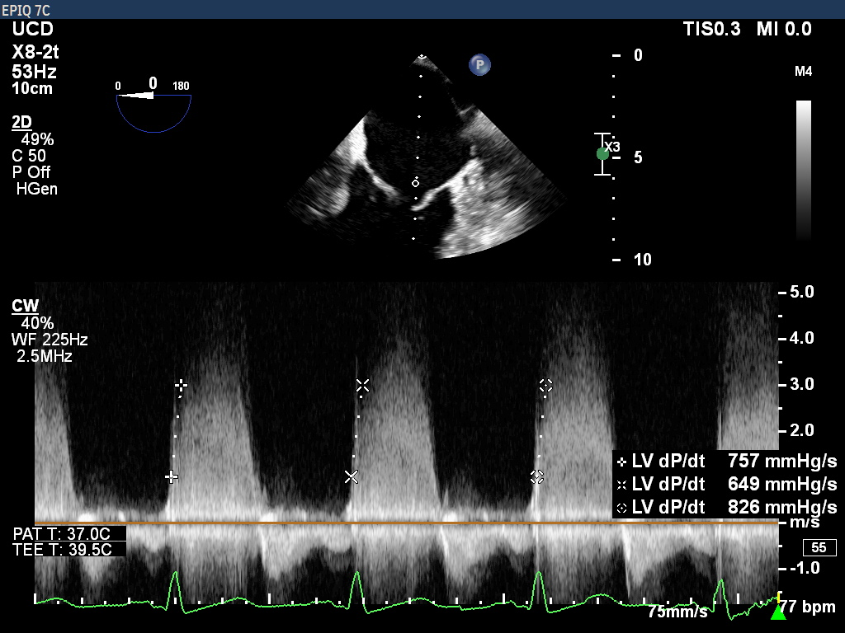
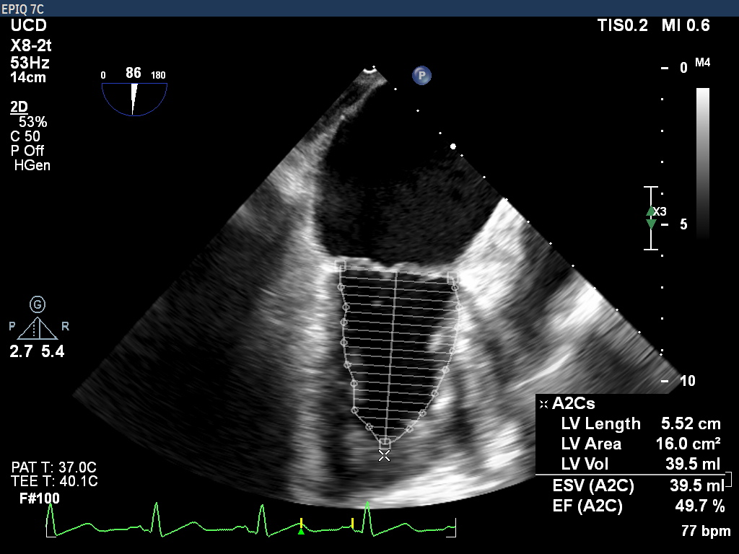
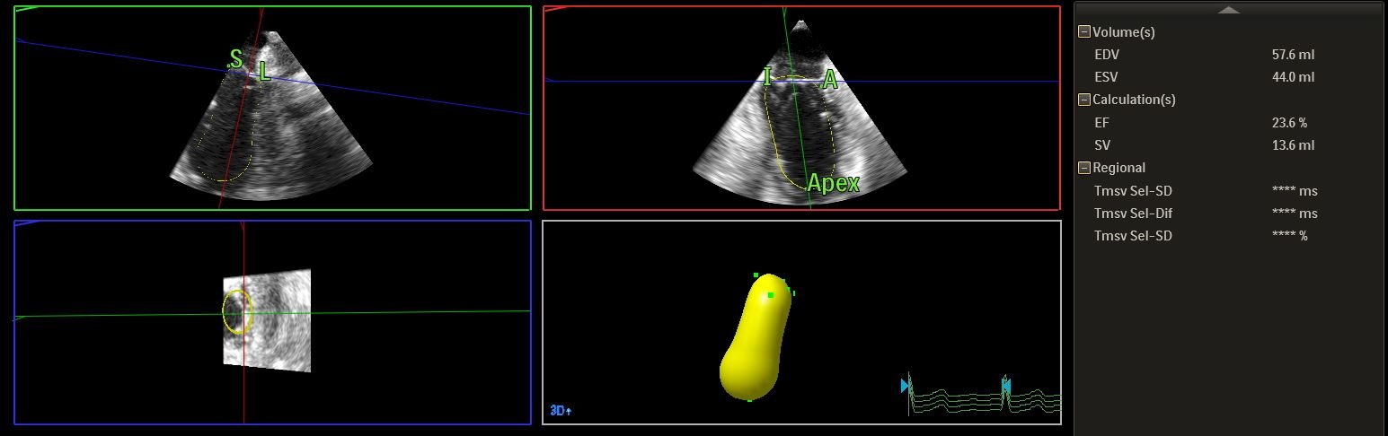
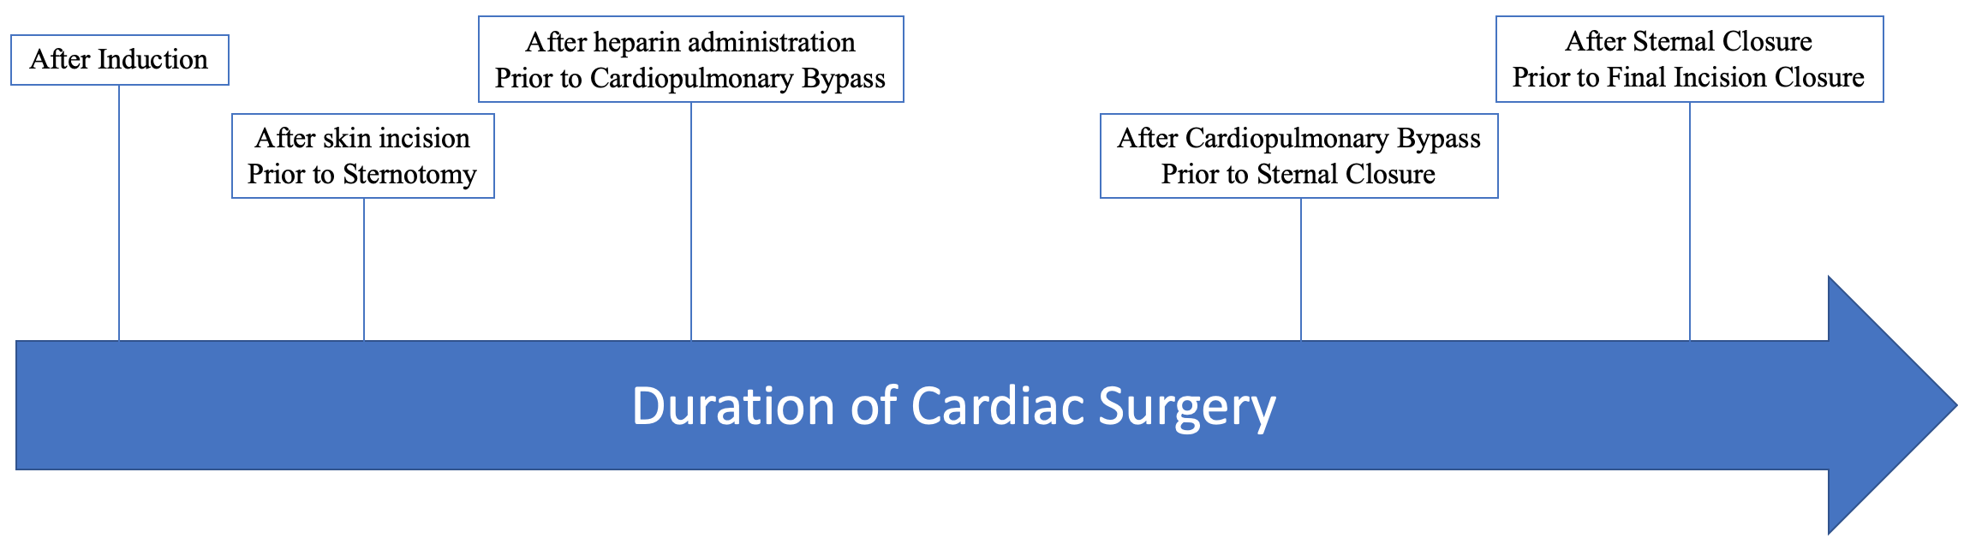
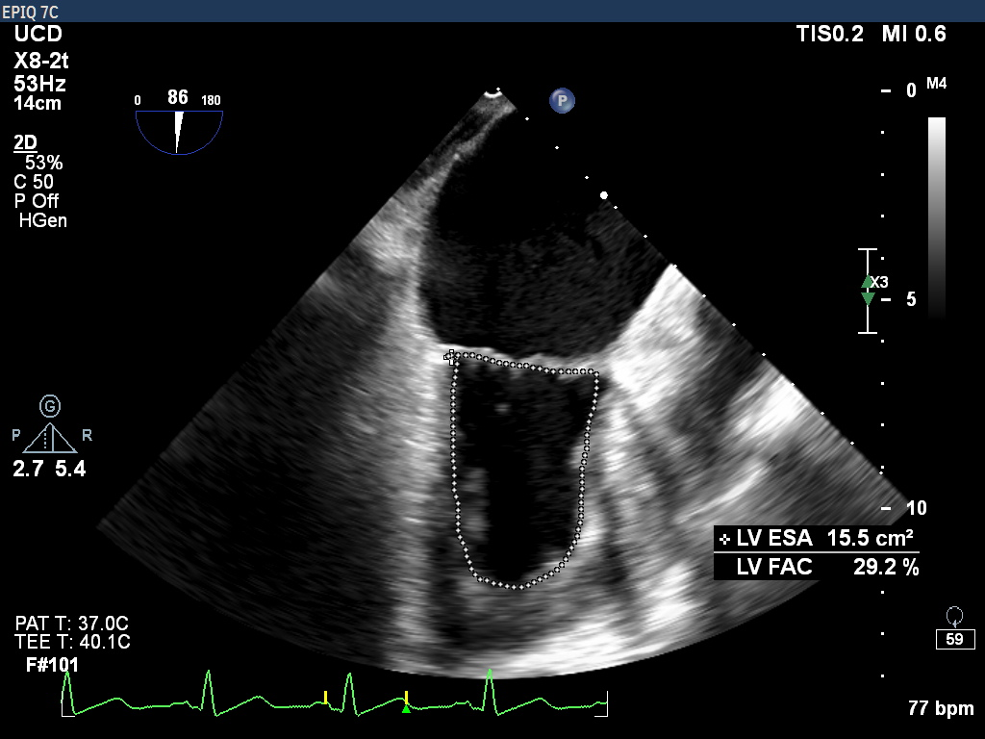
Comparing Intra-Operative Left Ventricular Contractility Measurements: Echocardiogram vs. Novel Software
David Tan, BA, Benjamin Morey, MD, Patricia Applegate, MD, Neal W. Fleming, MD, PhD
University of California, Davis, Department of Anesthesiology and Pain Medicine
BACKGROUND
METHODS
RESULTS
The contractility of the left ventricle (LV) is an important determinant of cardiac function
Measured as dP/dt_{max}, the maximum rate of left ventricular pressure change during isovolumetric contraction
Direct measurement involves invasive catheter placement, but can measure indirectly with echocardiogram [1]
More recently, arterial pressure waveform analysis proposed as a new method of determining dP/dt_{max} [2-5]
In the OR, the Hypotension Prediction Index (HPI) software is a new technology that predicts impending intraoperative hypotensive episodes
The HPI provides a calculated dP/dt_{max}, determined from the radial arterial pressure waveform
Recent study has demonstrated significant correlation between the HPI radial arterial dP/dt_{max} values to those calculated using echo in patients with acute heart failure in the cardiac ICU setting [5]
Due to unforeseen delays, patients have only begun to be recruited for this study
Pilot trial runs have been completed to assure quality and feasibility of study with good results
CONCLUSIONS
Currently too early in data collection process for definitive conclusions
Hopeful that analysis of data collected from this study can be used to evaluate accuracy and precision of a newer method of dP/dt_{max} measurement
Further corroboration of the reliability of this newer method and quantifying the correlations in different clinical settings will hopefully allow for more accurate and efficient measurement of dP/dt_{max} in a larger number of settings in the future
Figure 3. Continuous Wave Doppler on Mitral Regurgitant Jet with dP/dt
Figure 4. Left Ventricular Long Axis (Systole)
Figure 1. Data Collection Sheet
Figure 2. HemoSphere
Figure 5. Left Ventricle 3D Reconstruction
REFERENCES
OBJECTIVES
Bargiggia, G S, et al. “A New Method for Estimating Left Ventricular DP/Dt by Continuous Wave Doppler-Echocardiography. Validation Studies at Cardiac Catheterization.” Circulation, vol. 80, no. 5, 1989, pp. 1287–1292., doi:10.1161/01.cir.80.5.1287.
De Hert, Stefan G et al. “Evaluation of left ventricular function in anesthetized patients using femoral artery dP/dt(max).” Journal of cardiothoracic and vascular anesthesia vol. 20,3 (2006): 325-30. doi:10.1053/j.jvca.2005.11.006
Sharman, J E et al. “Radial pressure waveform dP/dt max is a poor indicator of left ventricular systolic function.” European journal of clinical investigation vol. 37,4 (2007): 276-81. doi:10.1111/j.1365-2362.2007.01784.x
Garcia, Manuel Ignacio Monge, et al. “Performance Comparison of Ventricular and Arterial DP/Dtmax for Assessing Left Ventricular Systolic Function during Different Experimental Loading and Contractile Conditions.” Critical Care, vol. 22, no. 1, 2018, doi:10.1186/s13054-018-2260-1.
Ostadal, Petr, et al. “Continual Measurement of Arterial DP/Dtmax Enables Minimally Invasive Monitoring of Left Ventricular Contractility in Patients with Acute Heart Failure.” Critical Care, vol. 23, no. 1, 2019, doi:10.1186/s13054-019-2654-8.
Fig 3 from https://www.edwards.com/gb/devices/hemodynamic-monitoring/hemosphere
Determine how well correlated dP/dt_{max} as calculated by the HPI software is to dP/dt_{max} as calculated by TEE
Secondarily, evaluate correlations between three methods of measuring cardiac ejection fractions (Fractional Area Change, Simpson’s Method of Disks, and 3D reconstruction) and their respective correlations to dP/dt_{max}
Figure 6. Timeline of Echocardiography Image Acquisition
Figure 7. Fractional Area Change EF Calculation (Systole)

