Slide 1
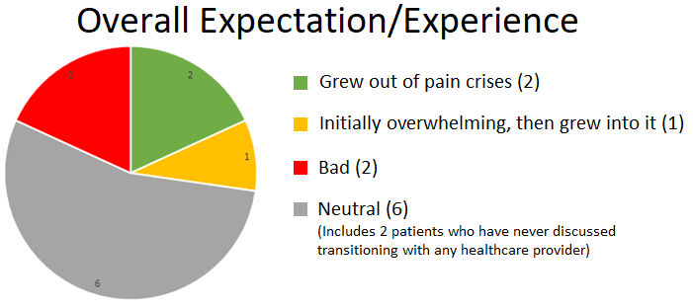
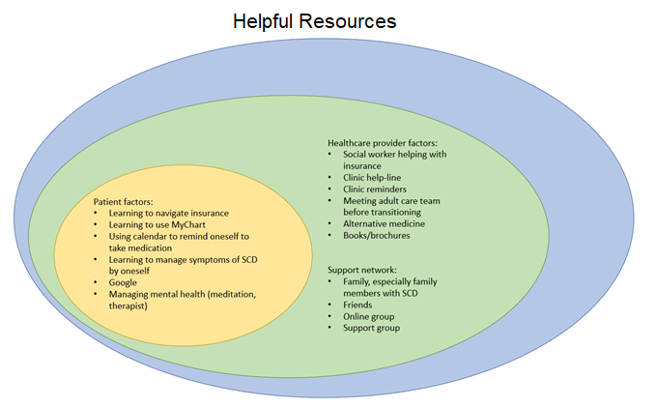
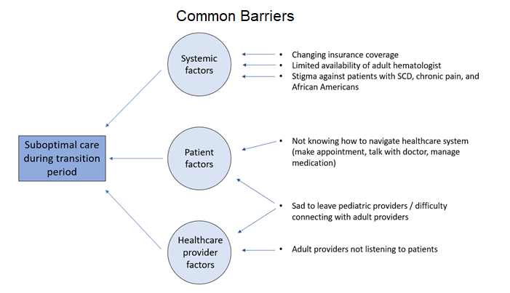
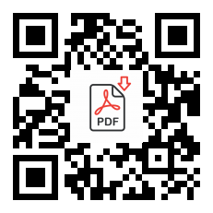
Transitioning from pediatric to adult care: Perspectives of patients with sickle cell disease
Results
Leslie Wu, MS4
University of California, Davis School of Medicine
Introduction
First systematic study of SCD patients’ experiences around transitioning from pediatric to adult care at UCD
Main Finding: Though only a couple of SCD patients expressed bad experiences around transitioning, the overall neutral response does not necessarily mean that there is no problem with the current work flow around transitioning, as there are many factors that may contribute this neutral response, including low response rate and selection bias of phone survey, unfamiliarity with interviewer, and patients’ lack of maturity and/or vocabulary to interpret and vocalize their experiences.
Discussion
Low response rate → selection bias
Concrete complaints
  Value of person-to-person connection
Future directions:
  Objective measurements of transitioning
  Share findings with interdisciplinary committee working to support SCD patients during transitioning
Methods
Needs questionnaire administered over the phone
Called 31 SCD patients age 16 to 25 years old, and 11 agreed to participate

