Slide 1


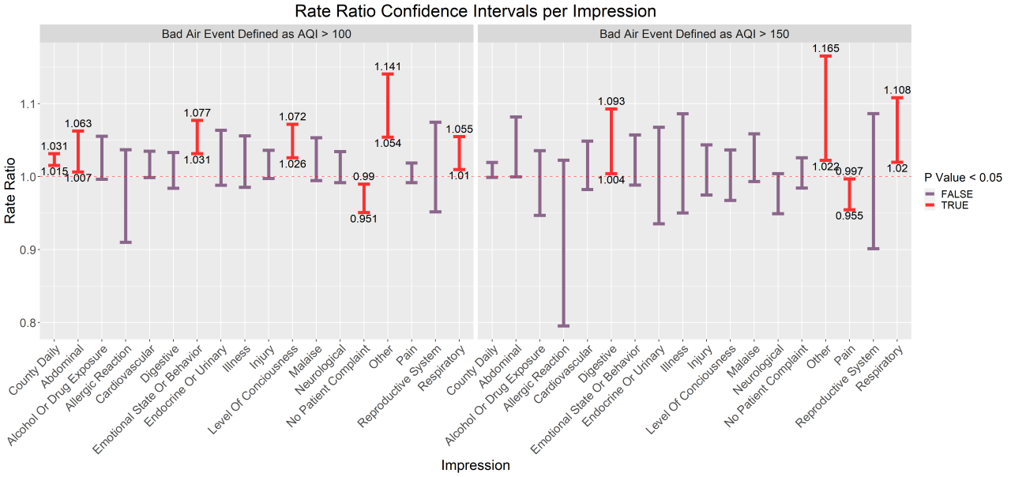
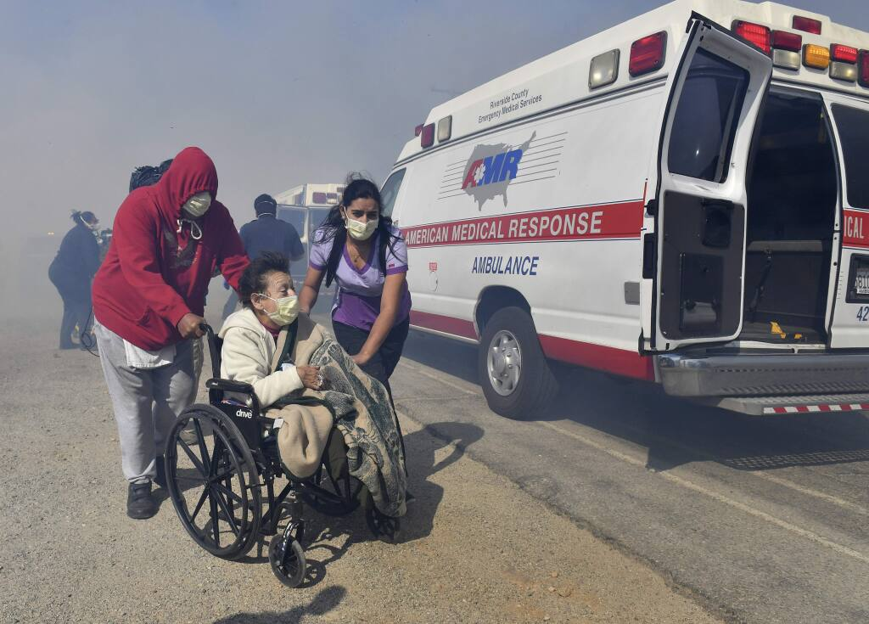
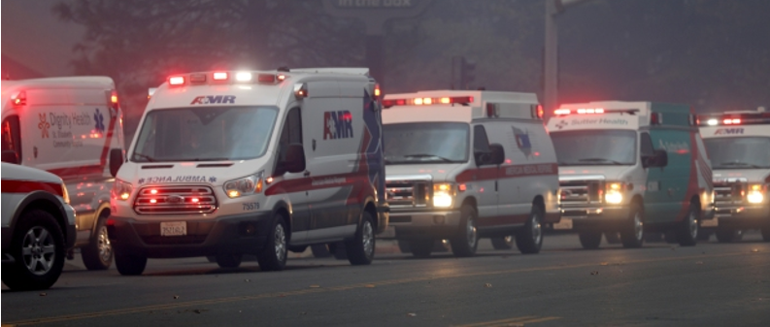
The Impact of Sustained Poor Air Quality Events on Ambulance Calls
A Time-Stratified Case-Crossover Study
Alec McLeod BA, John Rose MD, Colin Murphy BS, Garrett Hagwood BA
University of California, Davis School of Medicine
INTRODUCTION
METHODS
CASE AND CONTROL PICKING EXAMPLE
As wildfires and air pollution become more common across the United States, it is increasingly important to understand the burden they place on public health. Previous studies have noted relationships between air quality and use of emergency medical services (EMS), but until now these papers have focused on day-to-day air quality. Our goal is to investigate the effect of sustained periods of poor air quality on EMS call type and volume.
Using a time-stratified case-crossover design, we observed the effect of exposure to periods of poor air quality on number and primary impression of the first responder of EMS calls in California from 2014-2019. Ambulance call data was provided by American Medical Response for 22 counties throughout the state.
Poor air quality periods greater than three days were identified at the United States Environmental Protection Agency’s Air Quality Index (AQI) levels of unhealthy for sensitive groups (AQI 100) and unhealthy (AQI 150). Periods less than three days apart were combined.
Each poor air quality period was matched with two one-week controls, the first being the closest preceding week that did not intersect a different case. The second control was the closest week at least three days after the case and not intersecting with a different case.
Due to seasonal variation in EMS usage, from the initial cases (AQI 100 N=286, AQI 150 N=75), cases were used only if it was possible to identify controls within 28 days of the case (AQI 100 N=223, AQI 150 N=69).
A conditional poisson regression was used to calculate rate ratios for EMS call volume.
OBJECTIVES
We set out to determine whether sustained periods of poor air quality influenced the number of ambulance calls in that period, and the effect on the number of calls within different categories of primary impression recorded by the responding paramedic or EMT.
Red: Days with high AQI
Orange: Days included in the case without a high AQI. Previous studies have shown delayed effects up to three days after exposure to poor air quality¹, therefore these bridging days were included.
Green: Controls included one week prior and one week later, excluding the three days after the event.
Volume of Ambulance Calls During Sustained Poor Air Quality
Poor air quality defined as AQI > 100
Poor air quality defined as AQI > 150
A caravan of ambulances prepares to evacuate from Paradise, Calif., as a wildfire rages through the town, Thursday, November 8, 2018. (Karl Mondon/Bay Area News Group)
CONCLUSIONS
This data shows more calls during sustained poor air quality, and that several categories are disproportionately affected.
This study is limited by the subjectivity of impressions provided by the paramedic or EMT responding to the 911 call, and more research is needed to understand the effects of periods of poor air quality on the EMS system for more efficient deployment of resources.
Elderly residents of the Riverside Heights Healthcare Center in Jurupa Valley, Calif., are evacuated from their care facility as flames and smoke from the Hill Fire approach. (Will Lester/The Orange County Register via AP)
CITATIONS
RESULTS
Sangkharat K, Fisher P, Thomas GN, Thornes J, Pope FD. The impact of air pollutants on ambulance dispatches: A systematic review and meta-analysis of acute effects. Environ Pollut. 2019 Nov;254(Pt A):112769. doi: 10.1016/j.envpol.2019.06.065. Epub 2019 Jun 20. PMID: 31419665.
Comparing the case periods to the controls, significance was found at 100 AQI for total number of calls and the primary impressions categories: emotional state or behavior, level of consciousness , no patient complaint , other, respiratory, and abdominal.
At an AQI of 150, significance was found for the primary impressions categories: other, pain, respiratory, and digestive.
ACKNOWLEDGEMENTS
Special thank you to Dennis Carter, American Medical Response CES Manager for providing the data that made this study possible

