Slide 1
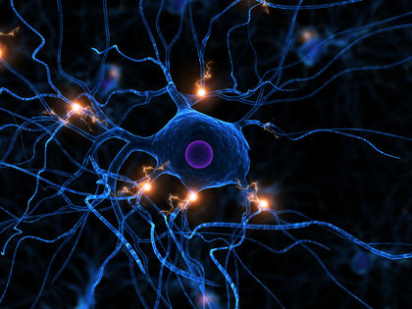
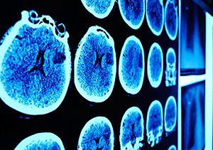
Caregiver Bootcamp Session 1: Alzheimer’s disease and related dementias
Sarah Farias, Ph.D.
Professor, Department of Neurology, UC Davis
Director, California Alzheimer’s Disease Center UC Davis

Slide 2
Outline
What is dementia and Alzheimer’s disease
Signs and symptoms
Other forms of dementia
Diagnosis
Treatment
Prevention

Slide 3
Sponsors of this program
UC Davis California Alzheimer’s Disease Center Program
UC Davis Alzheimer’s Disease Research Center
Program established in 1984 - 10 Centers
Funded by the CA Department of Public Health
Services:
Diagnosis
Treatment
Support services
Education
Program est in 1989
Funded by the National Institutes of Health (NIH)
Research in prevention, detection and treatment of AD
Healthy Aging Clinic

Slide 4
What is the difference between dementia and Alzheimer’s disease?
Notes:
Clinical syndrome
Decline from previous level of ability in multiple areas of thinking
Memory
Language
Visuospatial abilities
Executive (reasoning, problem solving)
Cause loss of independence in activities of daily living (no longer able to manage finances, medications, etc.)
Course characterized by gradual onset and progressive decline
Mention other forms like Parkinson’s disease
Mixed dementia – multiple pathologies most common in 80y/o+

Slide 5
Causes of Dementia
Alzheimer’s disease
Vascular disease
Lewy body disease
Mixed dementia (*most common in those over 80 y/o)
Frontotemporal degeneration
Parkinson’s disease and related disorders
Alcoholism
Repeated traumatic brain injury
Pseudodementia/reversible conditions (e.g., severe depression)

Slide 6
Prevalence of Alzheimer’s disease
Currently 6+ million people are living with AD
By 2050 this figure is projected to rise to 15 million
1 in 3 seniors dies with AD or another dementia
4th leading cause of death in CA
11 million people provide unpaid care to those affected by AD
Source: Alzheimer’s Association Facts and Figures, 2022; CDC
Notes:
All the people that live in LA and Chicago city limits put together
15 million – nearly twice the number of people that live in NYC

Slide 7
Age: the single greatest risk for Alzheimer’s disease

Slide 8
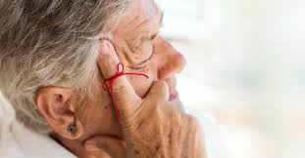
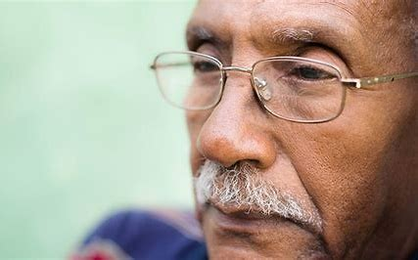
Symptoms of early AD
Cardinal first feature: memory impairment
Repetitive questions
Forgetting recent conversations and events
Difficulty keeping up with current events
Consistently misplacing items
Forgetting appointments

Slide 9
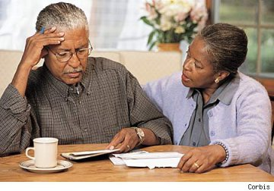
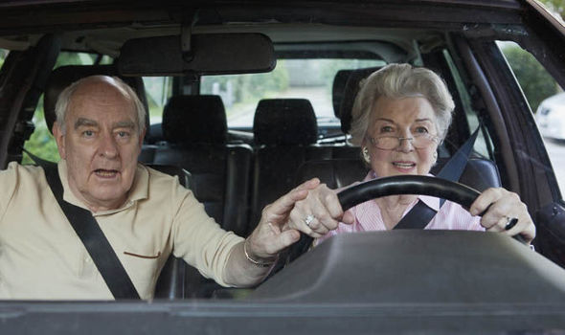
Other cognitive symptoms
Language
Frequent/consistent difficulty with word retrieval
Difficulty expressing ideas
Using the wrong word
Visual Perception
Trouble navigating while driving
Difficulty recognizing locations
Getting lost in familiar environments (neighborhood)
Judgment, problem solving, multi-tasking
Becoming easily distracted
Difficulty figuring out how to complete home projects
Making poor financial or other decisions
Vulnerability to financial and other scams

Slide 10
Behavioral and Personality Changes
Depression
Apathy and inactivity
Social withdrawal
Getting upset, worried or angry more easily
Agitation or aggression
Hiding things or believing others are hiding things (paranoia)
Perseveration – getting stuck on certain ideas
Wandering away from home
Pacing

Slide 11
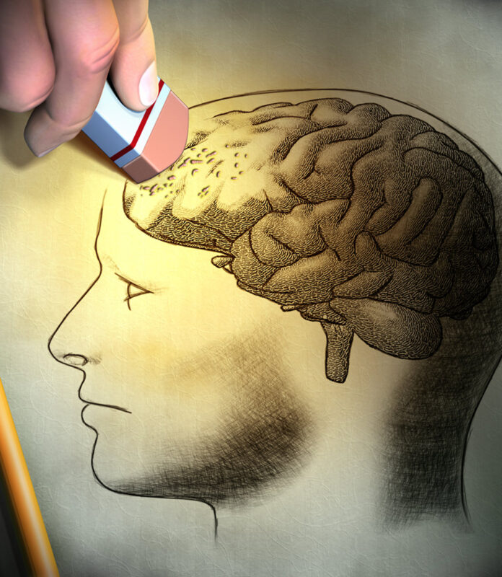
Anosognosia
Anosognosia is a medical condition
People are unaware that they have a cognitive impairment
Common in AD (~80%)
Variable across symptoms or time (they may acknowledge memory loss but refuse help with paying bills or managing medications)
May minimize their symptoms or provide explanations for concerns
Different from psychological denial
Direct result of both memory impairment and executive functioning deficits (biological basis)

Slide 12
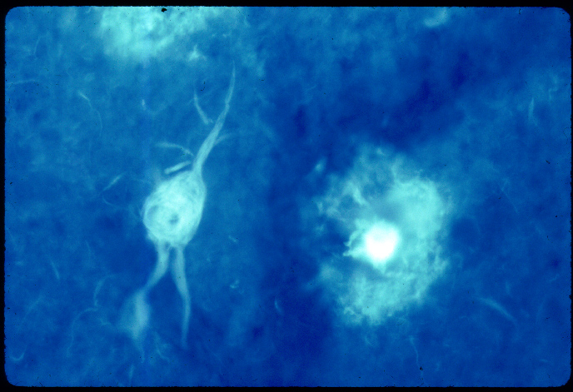
Brain changes associated with Alzheimer’s disease
Neurofibrillary tangles
Neuritic Plaques

Slide 13
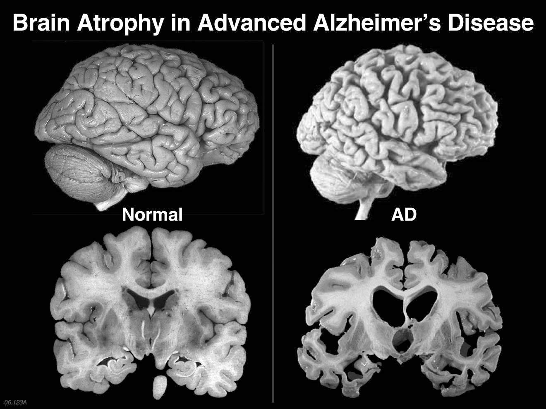
Global atrophy of the brain
Insert picture

Slide 14
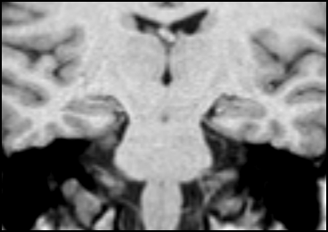
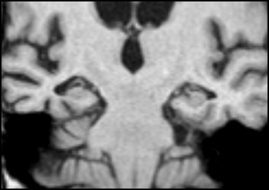
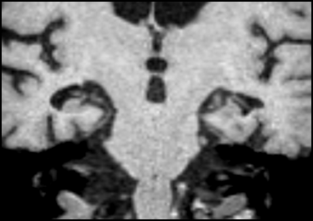
Atrophy of brain structures vital for memory
normal
size
Moderate
atrophy
Severe
atrophy
Notes:
This small structure is critical to memory. Damaged early and severely by AD.
One of the research questions that we are pursuing at at the Alzheimer’s Center is what measurements of this small area can tell us about predicting AD. Can we predict who will get AD, how fast the disease will progress, etc.
What we are seeing is the effects of AD, not the plaques and tangles
Because AD typically starts in this brain region, memory loss is the typical first symptom. But large areas of the brain are damaged and the effects extend well beyond memory

Slide 15
Other forms of dementia

Slide 16
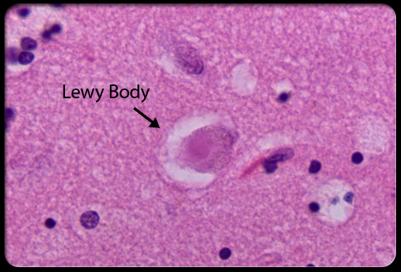
Lewy Body Dementia
Lewy Bodies within the brainstem and cortex
Most often co-occurs with AD
Memory problems similar to AD (may be slightly less)
Other core features/symptoms
Parkinsonism
Visual hallucinations
Prominent visual-spatial deficits (depth perception)
Fluctuations in alertness
REM Behavioral Sleep disorder

Slide 17
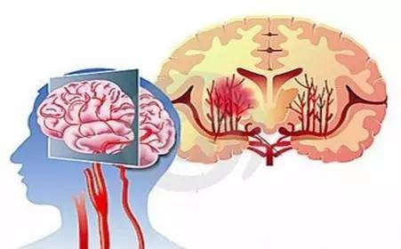
Microvascular Disease
Often no acute symptoms
More variable course (depends on management of risk factors)
Prominent cognitive symptoms: slowed thinking, poor attention, executive dysfunction (multitasking, organization, planning)
Memory usually not as severely affected
Often co-occurs with AD (particularly in those over 80)

Slide 18
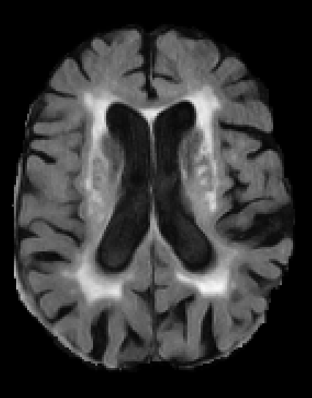
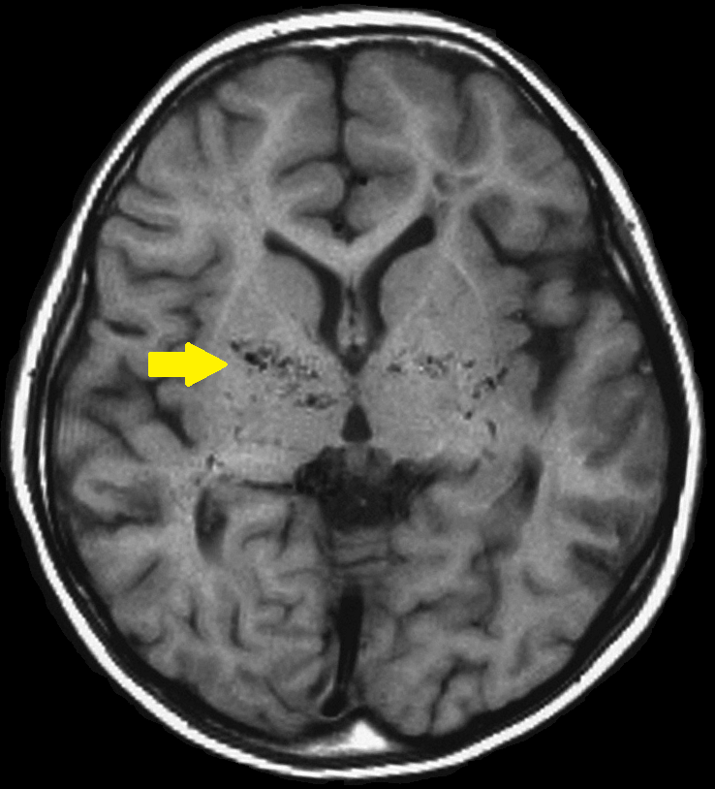
Microvascular Disease on MRI

Slide 19
Frontotemporal dementia
Younger age of set
50% with a family history of similar dementia
Prominent personality changes: ‘loss of filter’, reduced empathy, extreme apathy, obsessive compulsive behaviors
Prominent language problems:
Severe word finding difficulties
Unable to talk in full sentences
Difficulty understanding words
Difficulty reading and writing

Slide 20
Brain changes in Frontotemporal dementia

Slide 21
Other causes of cognitive impairment that can look like dementia
Depression
Often associated with low mood, pervasive sadness or lack of interest and apathy; anxiety
Delirium
Altered level of alertness, confusion, often associated with hospitalization, acute illness, infection

Slide 22
Mild Cognitive Impairment (MCI)
Transitioning from Normal Cognition to Dementia
Normal Cognition
Mild Cognitive Impairment
Dementia
Notes:
People don’t just wake up having dementia

Slide 23
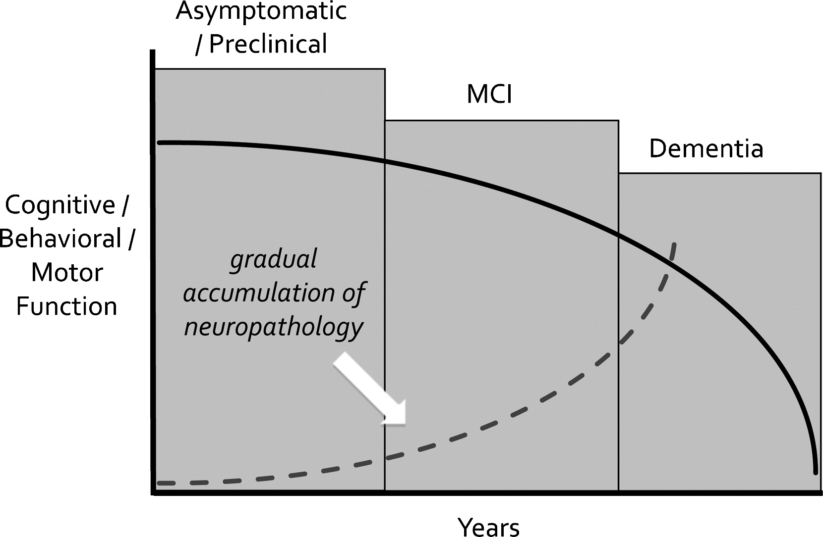
What is mild cognitive impairment?
Definition: mild cognitive changes BUT they are still able to compensate and function independently in their daily life
Often, but not always, a precursor to AD or other form of dementia

Slide 24
What changes in thinking are just a normal part of aging?
Slowing down (takes a little longer to think through things)
Word retrieval is slower (but does not interfere with communication)
Memory
Forgetting why you went into a room
Increased difficulty recalling people’s names
Depends on frequency (rare vs. frequent and worsening)
Some abilities improve with age!
Vocabulary
Wisdom

Slide 25
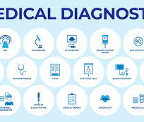
How is MCI and dementia diagnosed?
Start the conversation with your doctor
History of symptoms (helpful to hear from patient and family)
Physical/neurologic exam
Blood work
Brain imaging (MRI)
Cognitive testing

Slide 26
Why is diagnosis important?
Rule out treatable causes
Optimize risk factors
Symptomatic treatment
Opportunity to participate in clinical trials
Emotional support for patients and families
Anxiety actually decreases with a diagnosis
Planning for the future
Safety issues (driving, living alone, financial scams)
Start treatment

Slide 27
What about treatment?

Slide 28
Currently available medical treatment
Current FDA-approved medications help slow decline
Aricept
Namenda
Aducanumab
Treating other risk factors is important:
Hypertension
Diabetes
Obesity
Smoking
Alcohol abuse

Slide 29
Can we prevent, delay or slow symptoms through lifestyle changes?
Up to 40% of dementia is attributable to modifiable factors
Physical inactivity
Poor diet
Low cognitive stimulation
Lack of social engagement
Depression

Slide 30
Physical Exercise
Randomized controlled trials of aerobic exercise → improvements in memory/thinking
May even benefit the measurable health of the brain (decrease atrophy rates)
Typical protocol: 40-50 minutes of brisk walking 4-5x/wk or other moderate intensity activity
Who benefits: at risk individuals, MCI and dementia
Those with genetic risk for AD may exhibit greatest benefit
Notes:
There are lots of changes you can make to protect your brain, but if you are just going to do one – your best bet may be exercise more
When my patients ask me what they can do to protect their brain health and maintain their memory, I generally tell them if your going to pick just one thing- exercise. Of all the risk factors, there is perhaps the most research suggesting that exercise can help maintain brain and cognitive health. The evidence comes from both
The good news is that the typical exercise protocol is very simple
Another great thing is the benefit can be seen in people with and without cognitive impairment

Slide 31
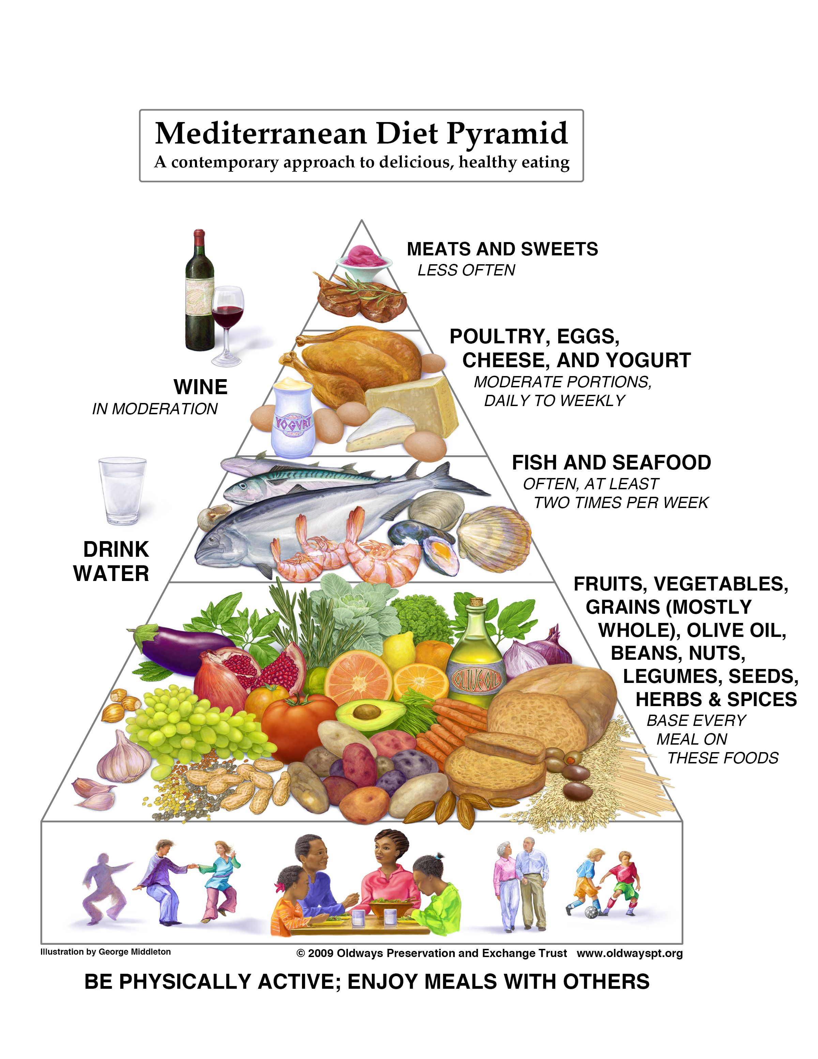
Nutrition
Originally identified as a result of epidemiological studies → lower rates of cardiovascular disease in Mediterranean countries in the 1960’s
Observational studies showed reduced risk of AD
Randomized clinical trials show adherence associated with slower cognitive decline
Notes:
What is the Mediterranean diet? Staple of the diet is on the bottom of the pyramid

Slide 32
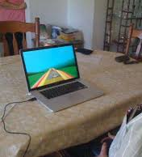
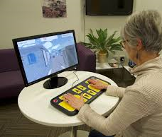
Cognitive Engagement: Use it or Lose it!
Taking classes
Volunteering
Practicing music
Artistic endeavors
Reading/listening to audiobooks
Playing games of skill
Interacting with others
Notes:
So let’s talk about a few randomized trials that had people engaged in mentally stimulating activities to study the impact on cognition

Slide 33
The intersection of brain health and mental health
Depression, chronic stress, and anxiety → modifiable risks for cognitive impairment and dementia
Why? chronic stress hormones, associations with other risks (e.g., low physical exercise, poor eating habits, alcohol abuse)
Loneliness has major negative consequences on many health outcomes and mortality
Its impact is equivalent to many diseases (smoking, obesity, hypertension)
Many studies have associated loneliness with risk for cognitive decline and dementia
Greater emotional well being, positive affect, and sense of purpose associated with decreased risk for dementia

Slide 34
Evidence based approaches to improve emotional well being
Deeping social bonds with others (greatest predictor of happiness and well being)
Practicing meditation and other forms of mindfulness
Practicing gratitude
Volunteering/helping others
Finding your purpose in life; participating in activities that are meaningful to you

Slide 35
Questions
Questions

