Slide 1
How Does Body Maintain Normal Blood Sugar? a Insulin Resistance and Its Consequences
Sidika E. Karakas, M.D
Professor and Chief
Division of Endocrinology, Diabetes and Metabolism

Slide 3
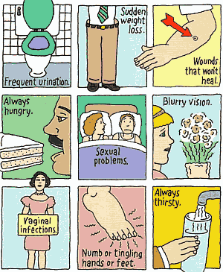
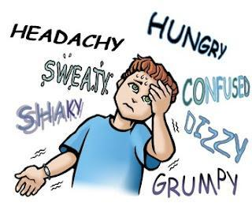
Symptoms of High Sugar
(Diabetes)
Symptoms of Low Sugar
(Hypoglycemia)

Slide 4
Blood Sugar Homeostasis

Slide 5
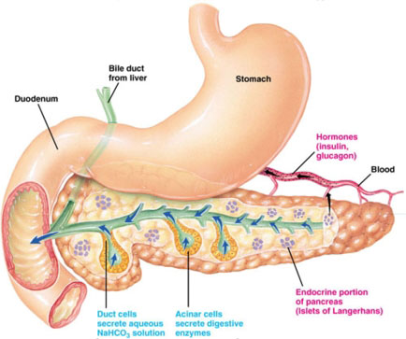
Pancreas

Slide 6
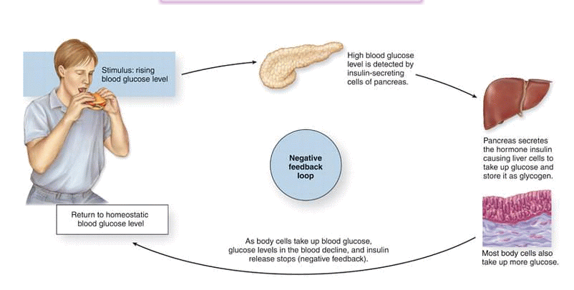
Amount of Insulin We Need Depends on What We Eat
Meals containing sugars and simple carbohydrates
require more insulin

Slide 7
Amount of Insulin We Need also Depends on Our Body

Slide 8
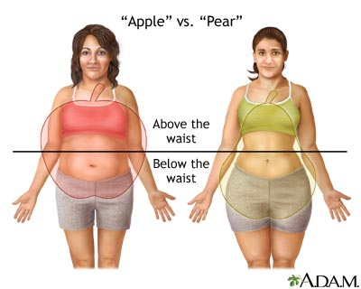
Larger the Waistline Higher the Need for Insulin (Insulin Resistance)

Slide 9
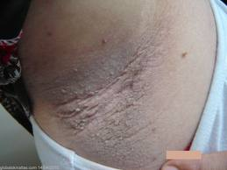
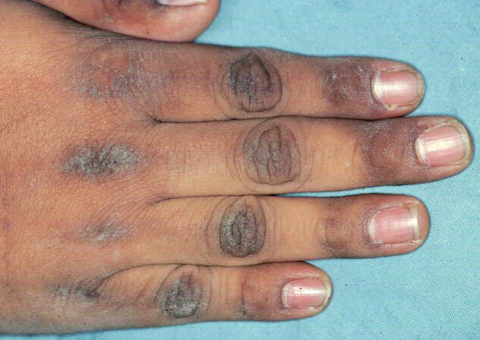
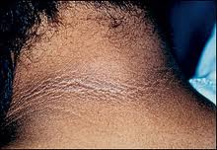
Skin Signs of Insulin Resistance

Slide 10
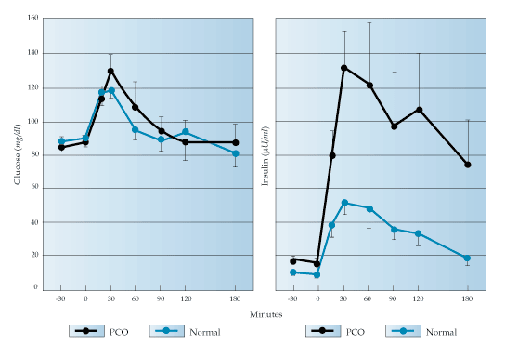
Insulin Response to Sugar Intake
Insulin resistant
Normal

Slide 11
INSULIN RESISTANCE
NEED for EXCESS INSULIN
PANCREAS FATIGUE
TYPE 2 DIABETES

Slide 12
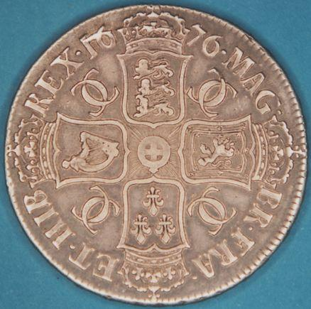
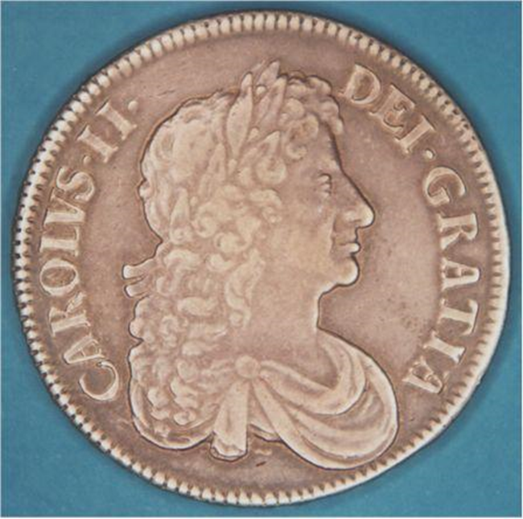
Common Cause of Insulin Resistance in Females: PCOS
Insulin Resistance
Cysts in the Ovaries

Slide 13
Polycystic Ovary Syndrome (PCOS)
Most common endocrine condition in women
Affects 1 out of 16 women
8% of AA; 5% of White
Causes irregular periods
Excess facial or body hair

Slide 14
Menstrual cycles are a vital sign Andrea Dunaif, MD.

Slide 15
What is normal?
More than 35 days in between two periods is considered “too long”
One year after having their first period, 65% of adolescents have more than 10 periods / year
Three years after, more than 90% have >10 menses /year

Slide 16
Difficulty in getting pregnant
Excess Hair
Weight gain
Acanthosis
Infrequent periods
Age
20
10
30

Slide 17
What can we do about it
We can do a lot
Weight control
Insulin sensitizers (metformin)
Medicines for acne, facial hair and body hair

Slide 18
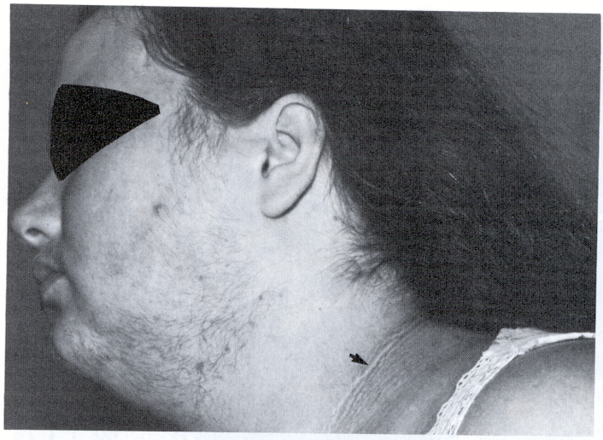
Clinical Findings of PCOS

Slide 19
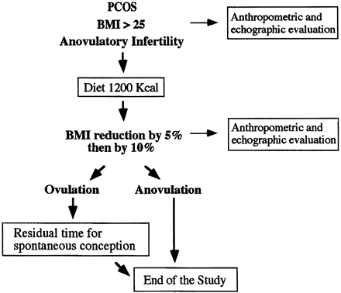
Effects of Weight Loss on Fertility
33 PCOS patients
25 lost 5% weight
11 of these lost >10%
15 women ovulated
10 became pregnant
P.G. Crosignani et al. Human Repro 18:1928, 2003.

Slide 20
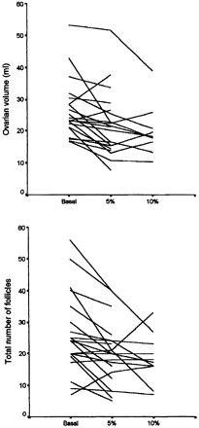
Cysts in the ovaries decreased with weight loss
Ovarian volume decreased by
18% with 5% weight loss
25% with 10% weight loss
Follicle number decreased
from 23.5±11.5 to 19.9 ±9.9 with 5%,
to 18.3 ±7.5 with 10% weight loss

Slide 21
Healthy Ways to Decrease Insulin Resistance
Decrease simple sugar intake
DO NOT DRINK SWEETENED DRINKS
Don’t overeat
Walk, do sports
150 min/wk to maintain weight
250 min/wk to lose weight
Talk to your parents and doctor
If you don’t have monthly periods
If you are getting excess hair

Slide 22
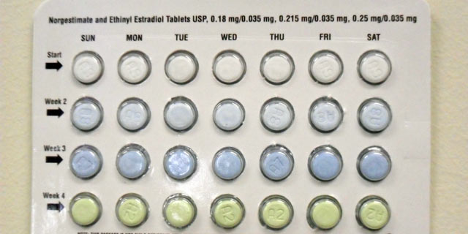
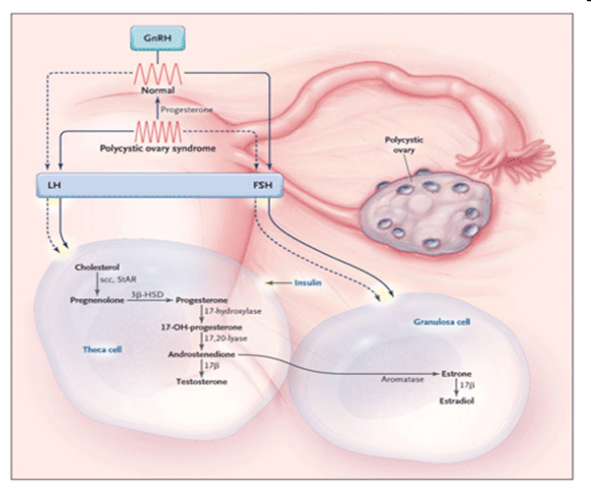
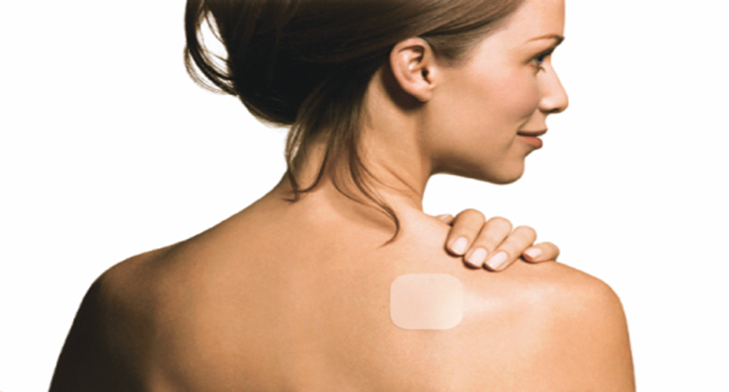
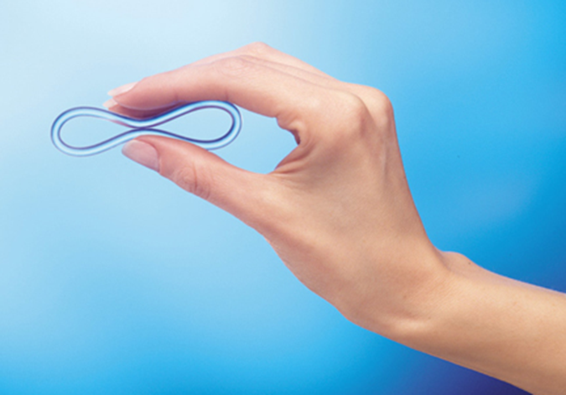
Treatment of Facial Hair
Suppress ovarian androgen production –contraceptives

Slide 23
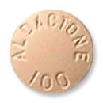
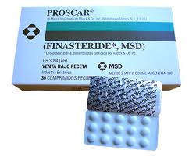
Treatment of Facial Hair
Block androgen receptor (sprinolactone)
Block conversion of testosterone to DHT (finasteride)

Slide 24
Management Planning
Oral Contraceptives
Lipids
Insulin resistance
Diabetes
Pregnancy
Pregnancy
Facial Hair

Slide 25
Difficulty in getting pregnant
Excess Hair
Weight gain
Acanthosis
Infrequent periods
Age
20
10
30

Slide 26
sekarakas@ucdavis.edu

Slide 27
https://health.ucdavis.edu/internal-medicine/research/endocrinology/

